Slide 1
From Sinking to Swimming: How to Awaken Your Library Friends Group Out of a Beach Slumber
Tywanda L. Cuffy, Director of External Relations, Communications and Development Initiatives Nicole M. Hernandez, External Relations Coordinator
Notes:
Introductions: Tywanda and then Nicole. Share your name, preferred pronouns, title, length of time in the role, description of duties and responsibilities and something fun/interesting about you.

Slide 2
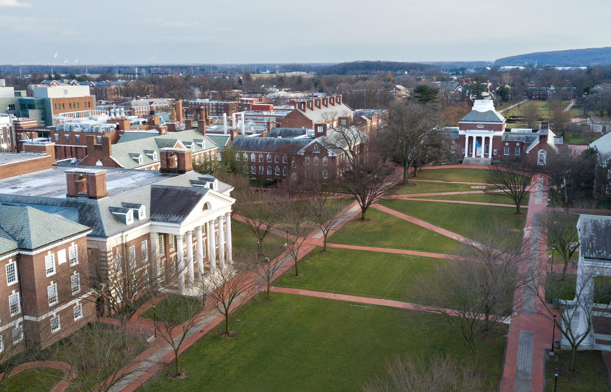
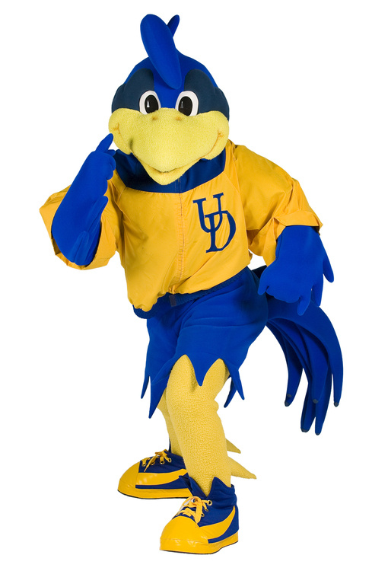
University of Delaware
Roots trace back to 1743
Land-grant, Sea-grant and Space-grant Public Institution
R1, 80 research centers
21 NCAA D1 Teams
10 colleges/schools; 150+ majors and minors; 250+ graduate/post-baccalaureate programs
23,613 total enrollment; 4,746 employees; 200,000+ Alumni around the world
First U.S. institution to study abroad in 1923
And there’s Joe
Notes:
Tywanda
One of the oldest universities in the U.S.
First class was the most distinguished in terms of later achievements. - Thomas McKean, George Read and James Smith all signed Declaration of Independence and/or U.S. Constitution.
Motto is “Knowedge is the light of the mind.:”

Slide 3
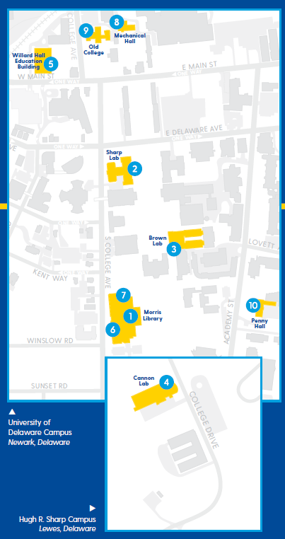
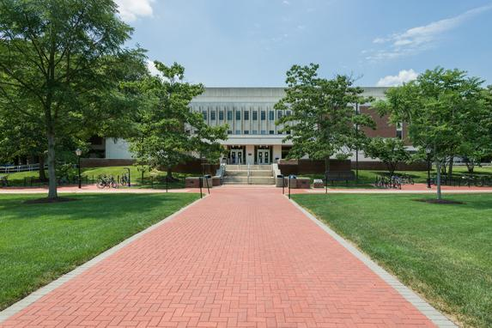
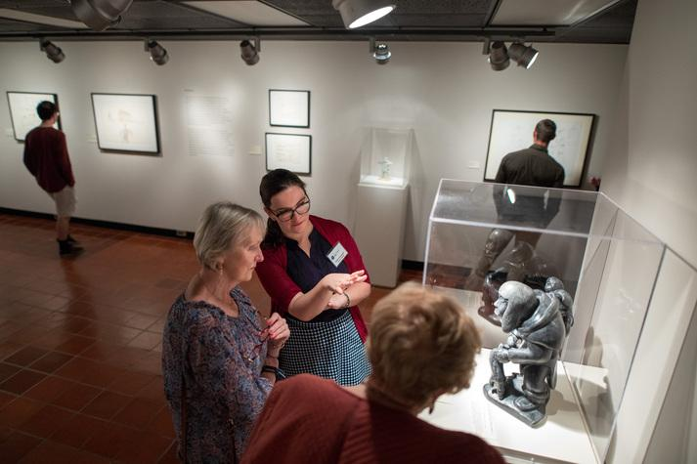
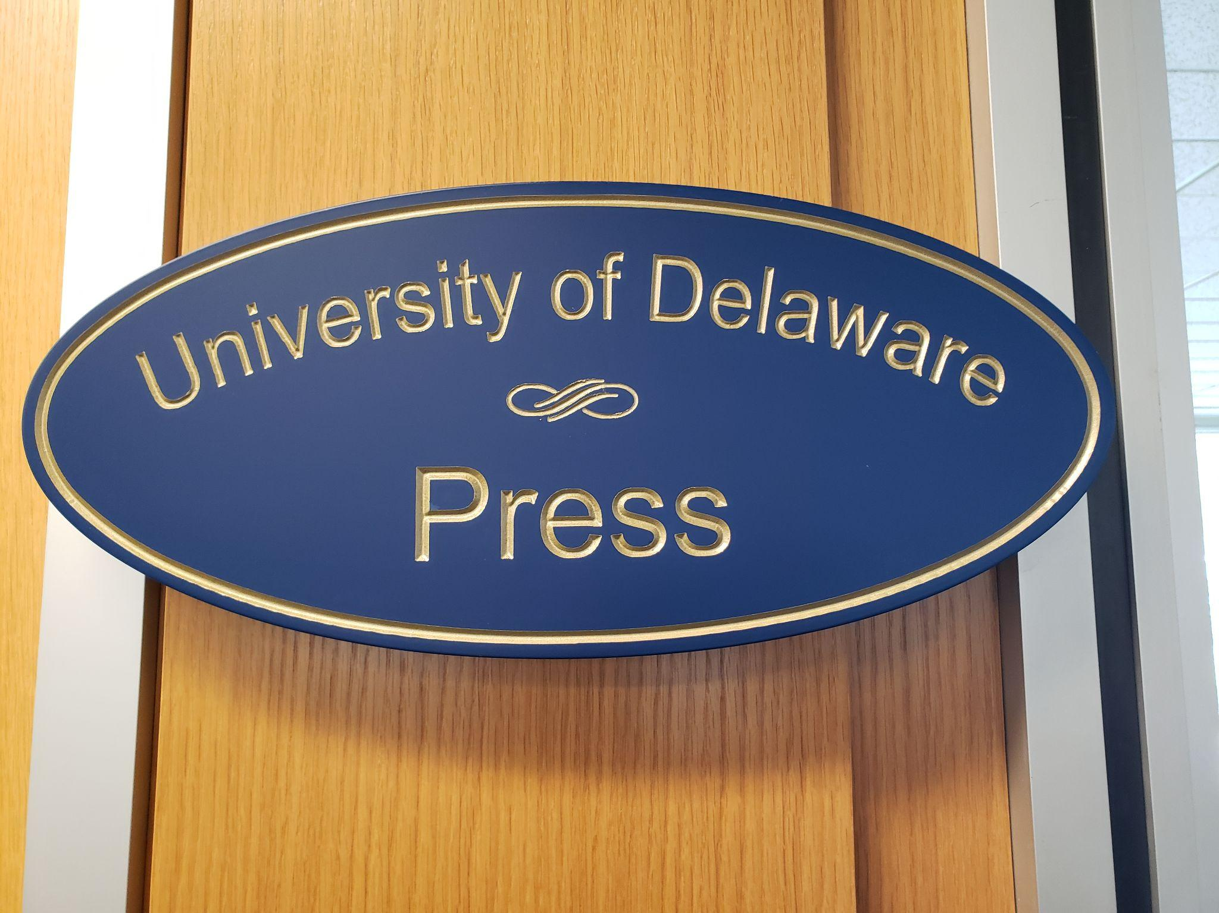
UD Library, Museums and Press
One flagship library
Four branch libraries - chemistry, physics, marine science and education resource center.
Four Special Collections and Museums Gallery Spaces
One University Press
124 Full-Time Staff; 121 Student Staff
Notes:
Nicole
Main library is Morris Library. Named after Judge Morris.
Collections strengths are: Art and Fine Art, especially Indigenous art, minerals and gems, African-American art, sculpture, photography; American, British and Irish Literature (especially from 18th to 20th century). Home to Mark Samuels Lasner Collection of British literature and art from 1850-1900, with emphasis on Pre-Raphaelites. Also, large Delawareana collection of Delaware history, literature, culture, politics, etc. Also, a lot of history of American, British and European history from 16th century to present, especially Lincoln Collection,

Slide 4
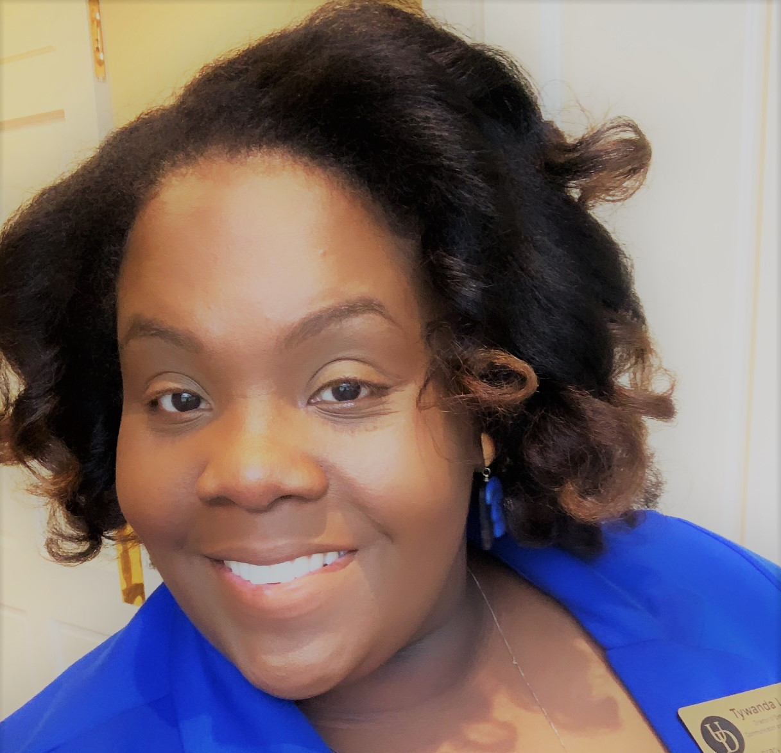
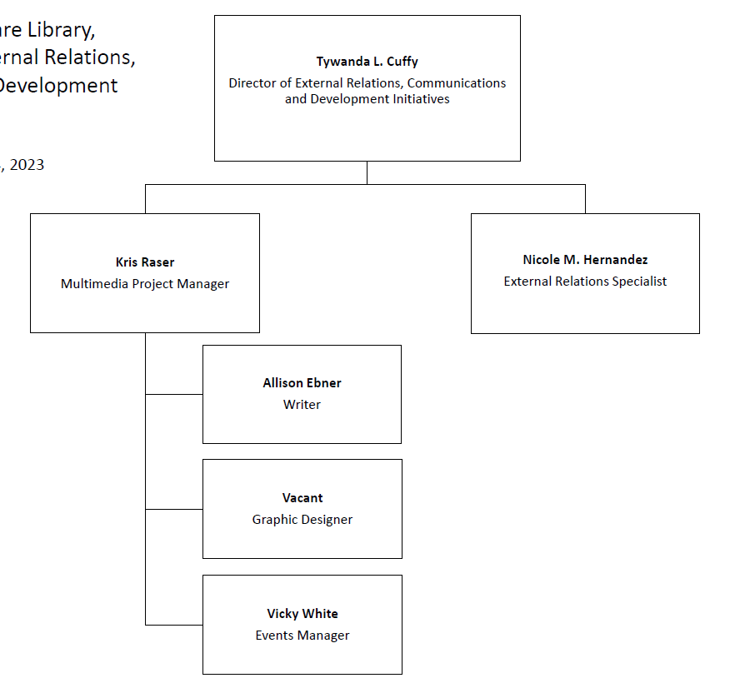
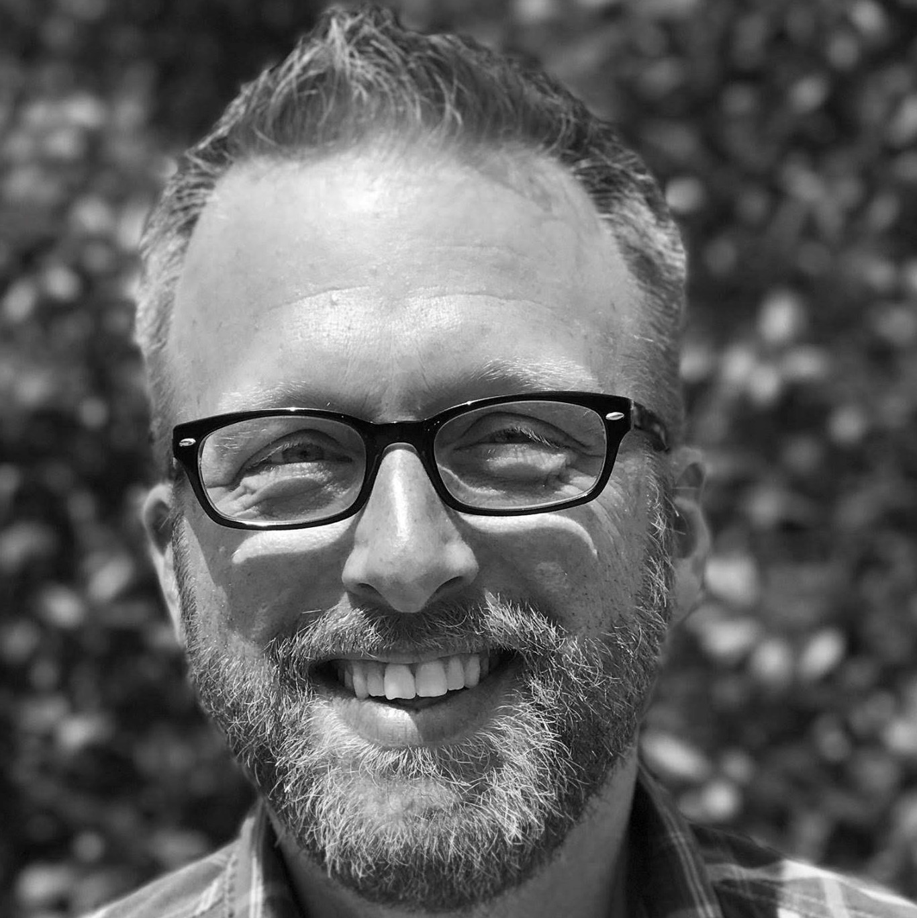
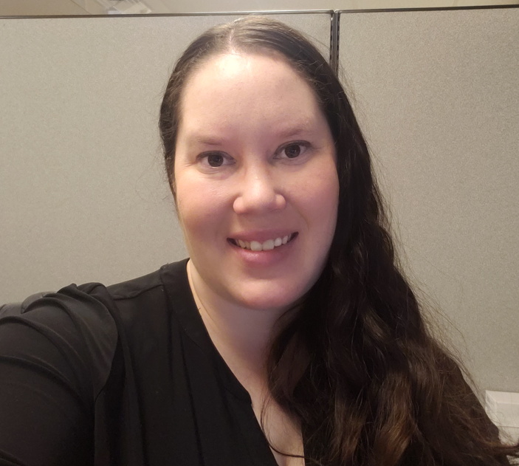
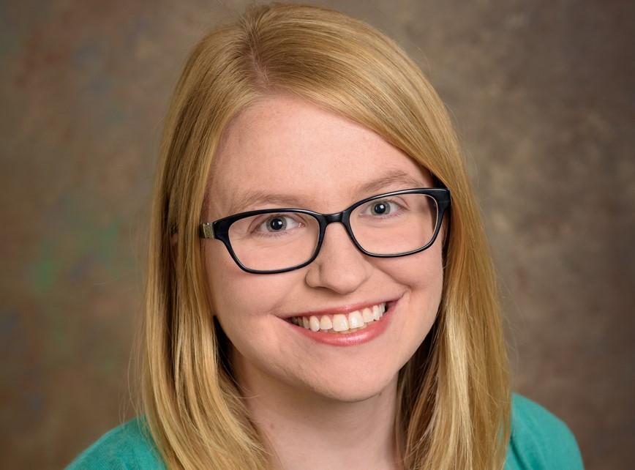
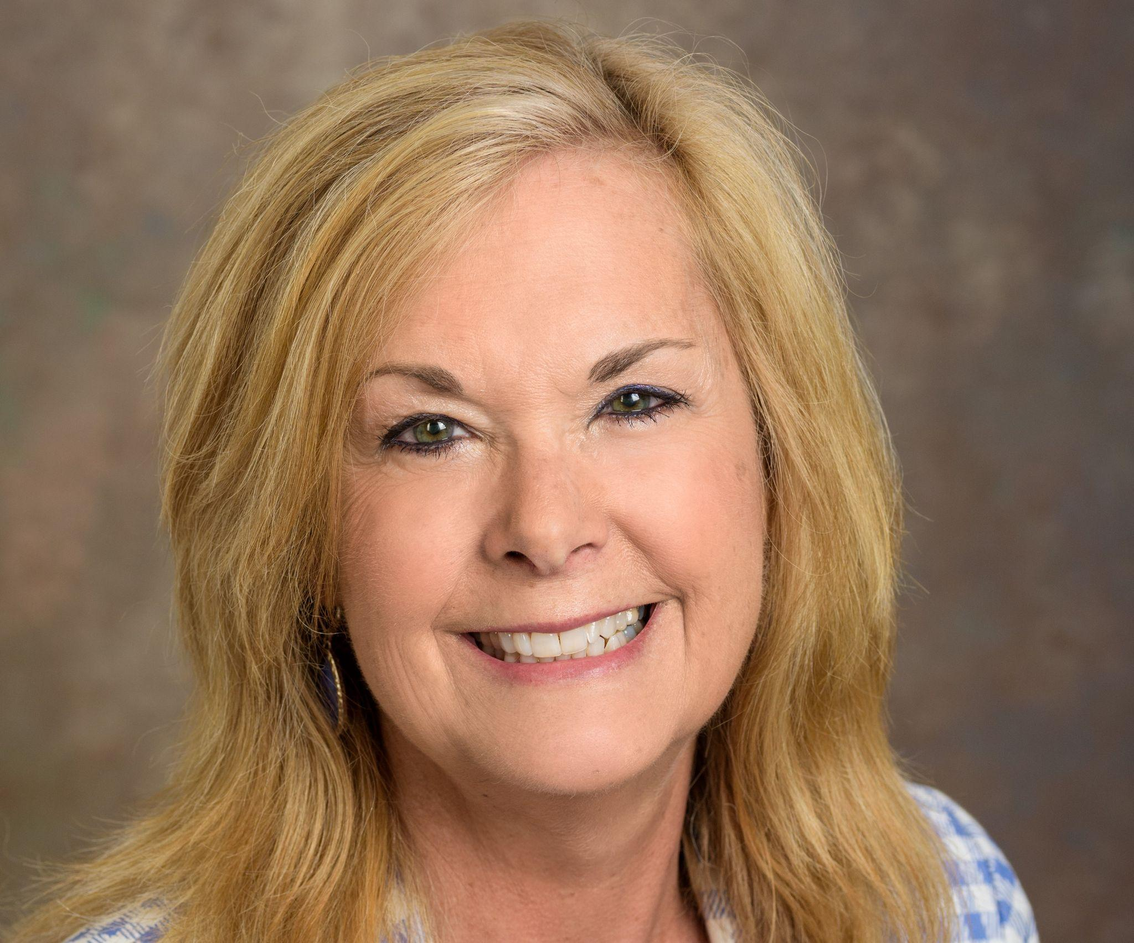
External Relations, Communications and Development Initiatives Team
Notes:
Tywanda
How team has changed.

Slide 5
Collaboration with
the Office of Development and Alumni Relations
Donor
Relations
Team
Gift Processing
Team
Senior Director of Development
Communications Team
Annual
Giving
Team
Notes:
Nicole
Work with the Senior Director of Development on identification and qualification of major gift prospects/donors; workin with Annual Giving Team for I Heart UD Giving Day, Giving Tuesday, Annual Dean Solicitations; Gift Processing Team to process all gifts, especially Gifts in Kind; Comm. Team to ensure we have fresh, clean data and are working within UD’s full comm. calendar for send dates, etc.; and Donor Relations Team for strategy on donor events and stewardship of key donors.
Important to give foundation of how development works at our University so you can see how it works.

Slide 6
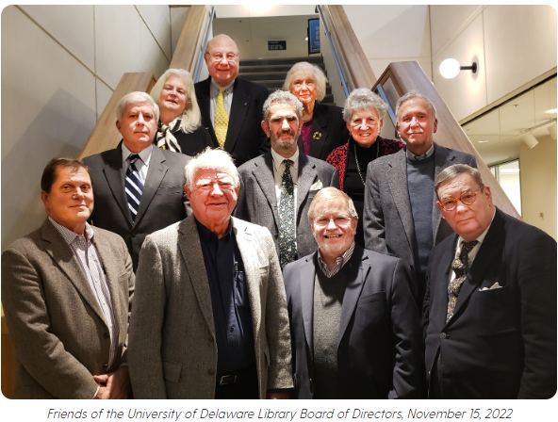
Friends of the University of Delaware Library
Supporting the UD Library, Museums and Press for past 65 years
Given over $2.5 Million+
Annual gift to Special Collections of $100,000
New Digitization Gift of $277,000 over 5 years
Current members = 168 (and counting!)
The group has an executive committee, board of directors, sub-committees and general members
Notes:
Nicole
2.5 Millions plus and counting. Records up to 1990s, but more likely closer to 4 million as we find records.

Slide 7
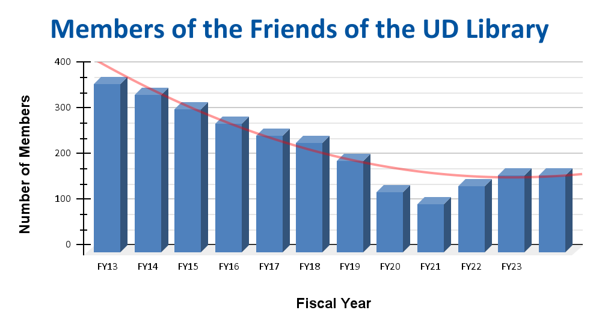
State of the Friends in 2018
Previous, long-time Vice Provost and Director both retired in 2015 and 2016.
New Vice Provost joined UD in 2016.
Held a Executive Committee Retreat in 2017.
Resulted in Consultation Report in October 2017.
New Director in March of 2018.
Group wildly co-dependent on director and efforts of the Library, not truly or meaningfully engaged in
the work of the UD Library, Museums and Press.
Notes:
Tywanda
Trevor will become President of ARL in 2024. Current, President-Elect.
REcommendations for Consulting Firm - Goal 1: Examine UDLA’s missions and partnership with the UD; Goal II: Modify Structure to Meet Current Demands; Goal III: Develop Strategies to Increase BOard Engagement and UDLA Membership; Goal IV: Develop Resources for UDLA; Goal V: Cultivate Board projects and prograns

Slide 8
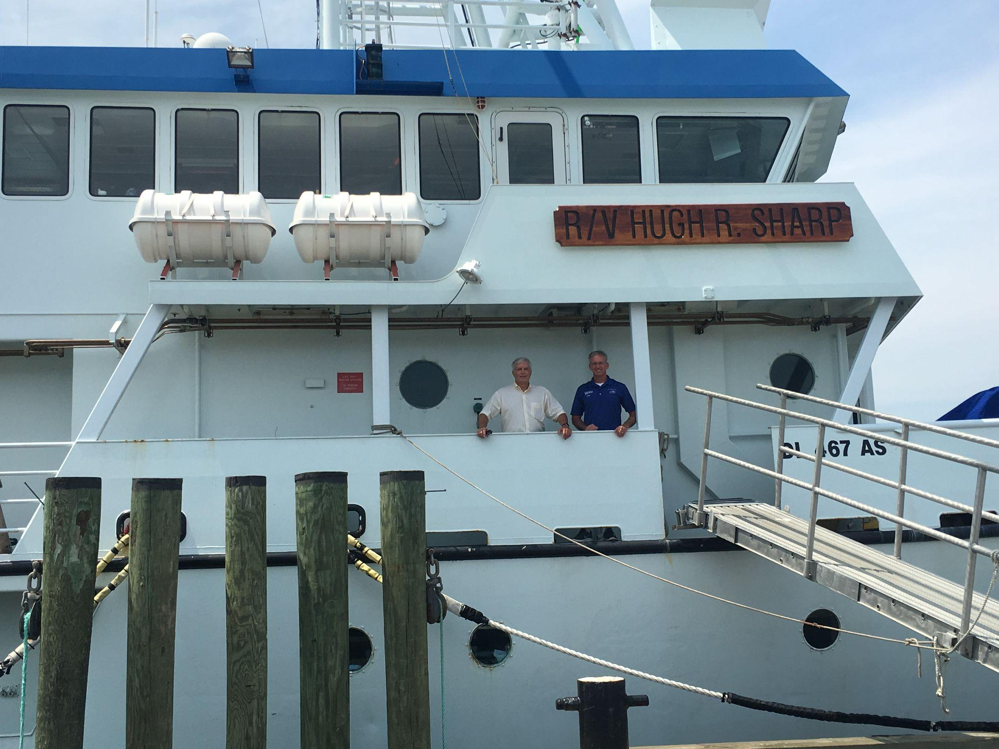
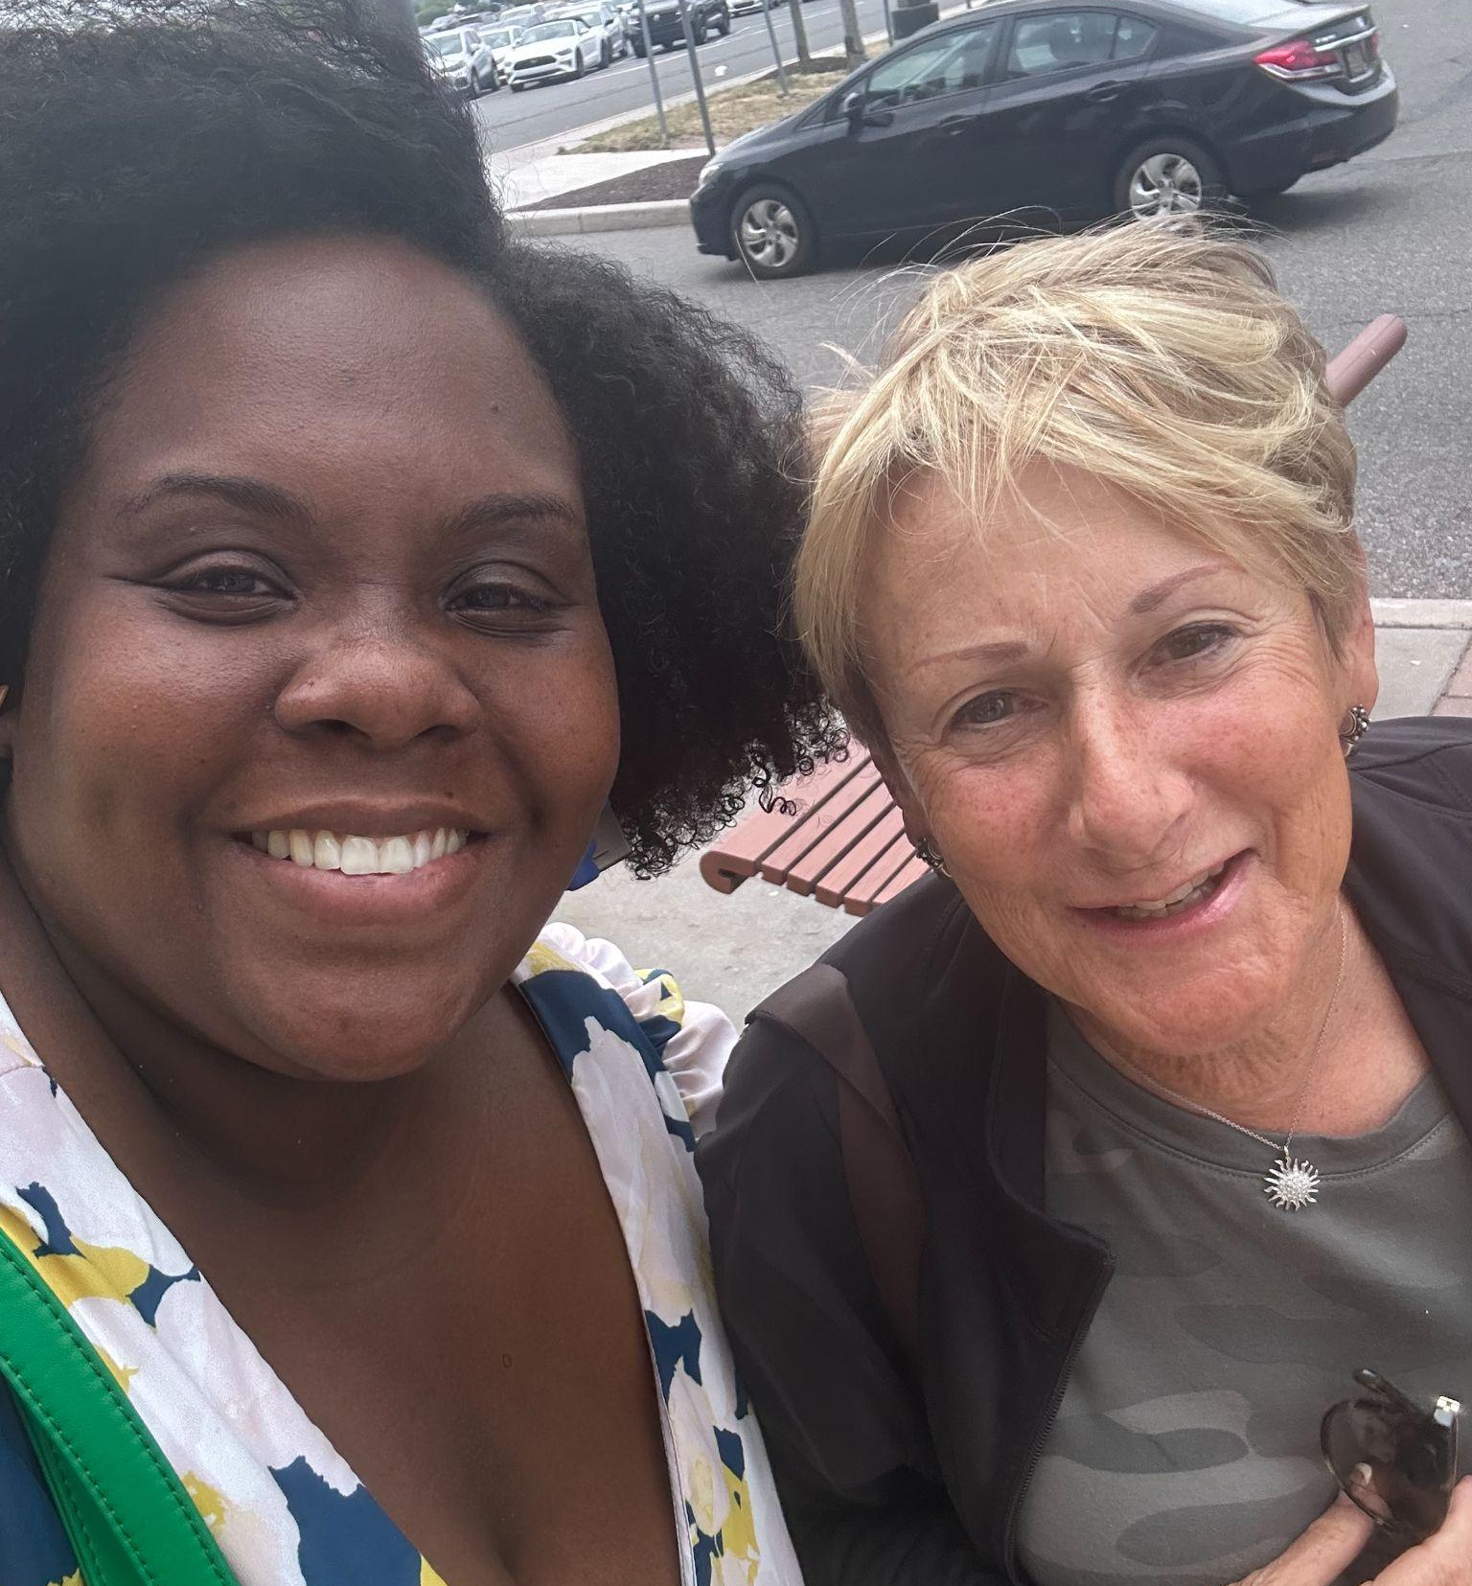
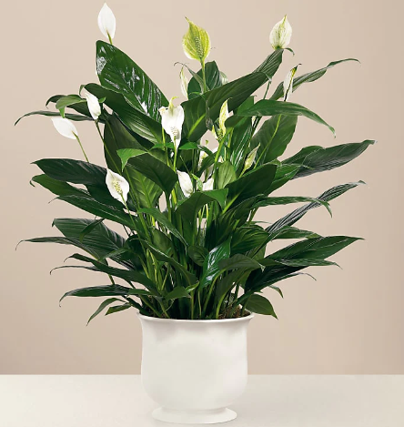
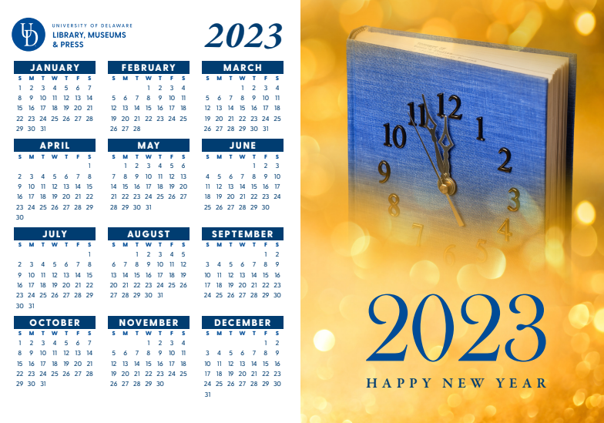
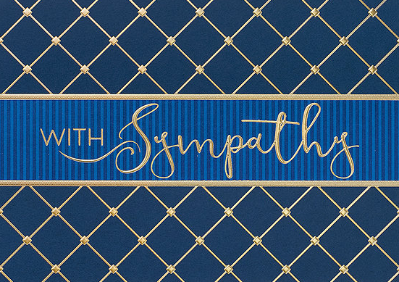
Step 1: Getting to Know the Friends
Began meeting for Lunch and/or Coffee with each individual Board of Directors member.
Started stewarding them in a greater capacity.
Notes:
Tywanda and Nicole

Slide 9
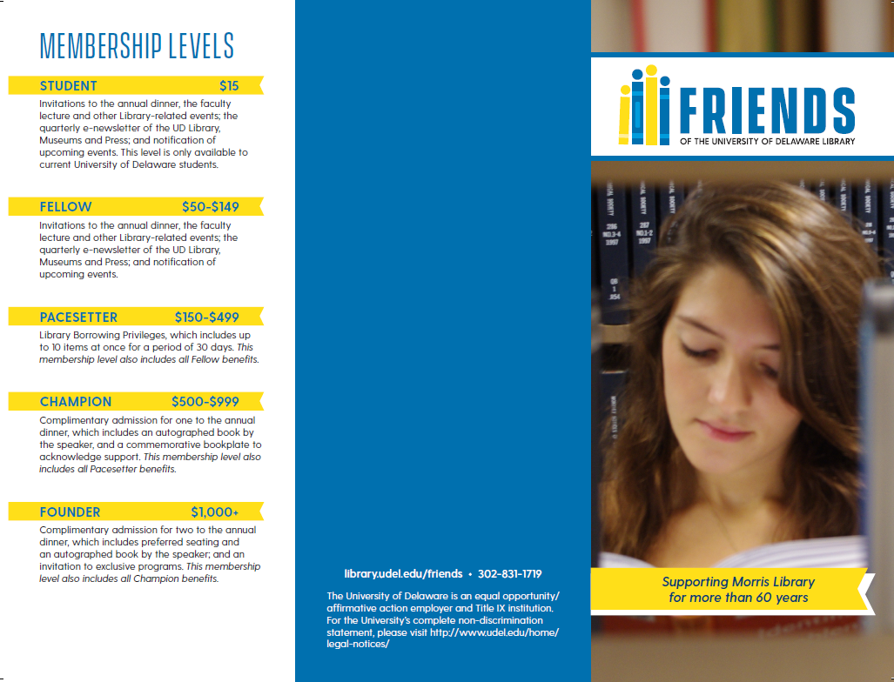
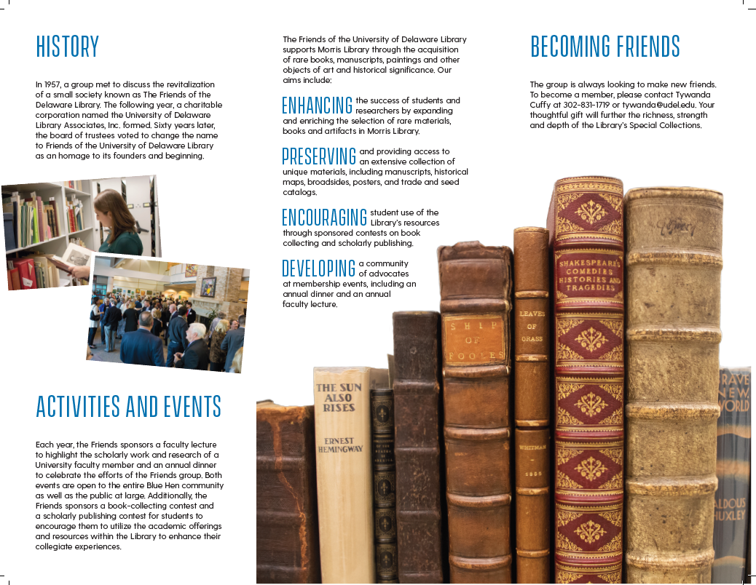
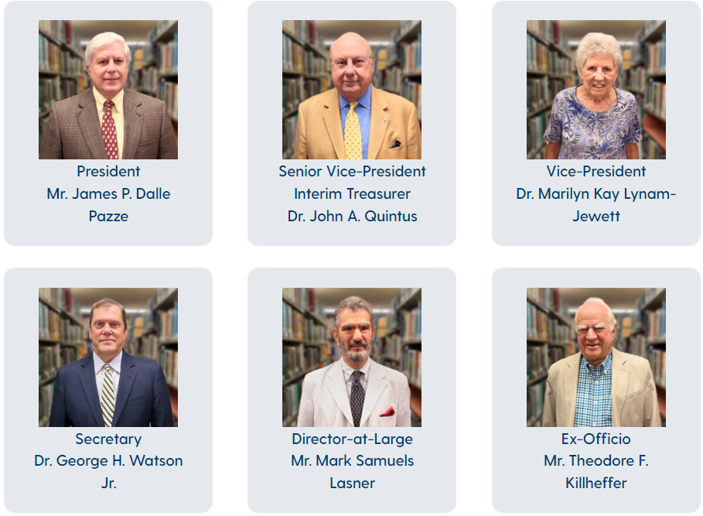
Step 2: Freshening Up Their Identity
Name Change
Logo Created
Membership Brochure Updated
New Letterhead
Email Address
Updated Website Presence
Notes:
Tywanda and Nicole
Website became multiple pages- includes new initiatives, history, and events.

Slide 10
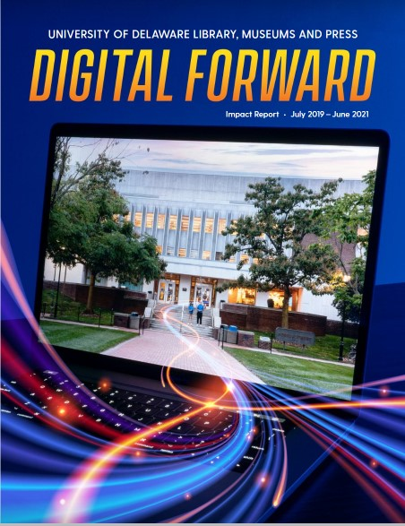
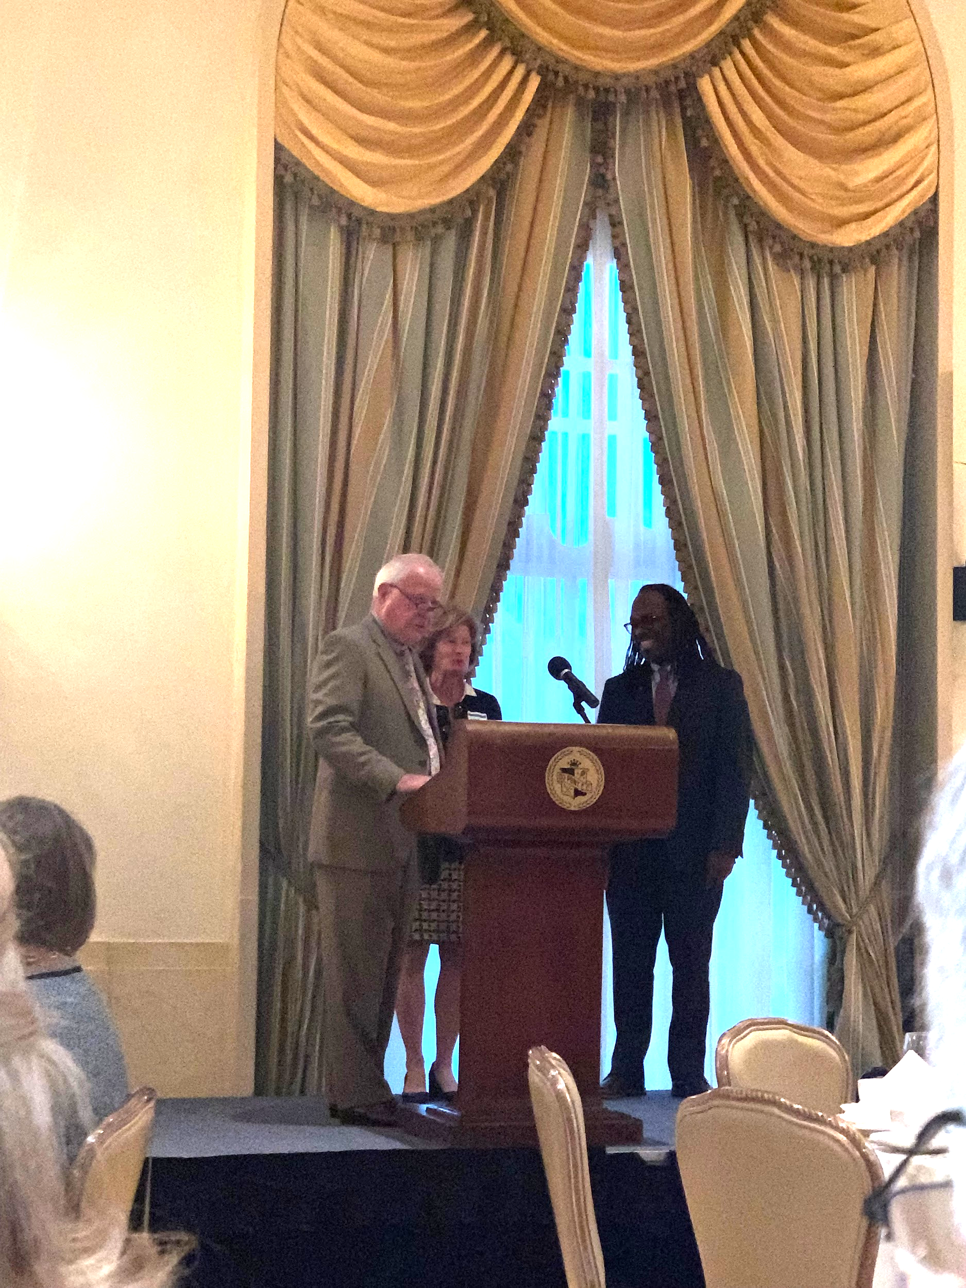
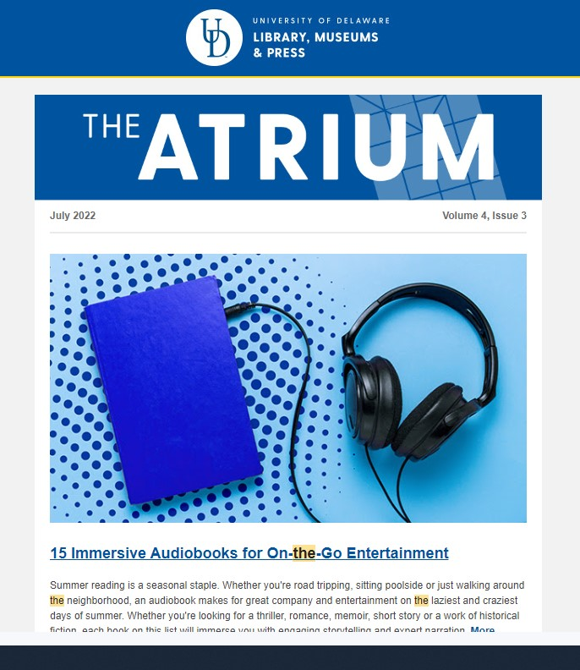
Step 3: Informing them of our Efforts
Added Friends members of past 10 years to monthly events roundup, bi-annual Friends solicitations.
Shared new Impact Report with Friends members.
Strategic Messaging/Reports from Vice Provost at quarterly meetings.
Bring new Library senior leadership to Friends meetings and events.
Notes:
Tywanda
Making sure Trevor was in front of them.

Slide 11
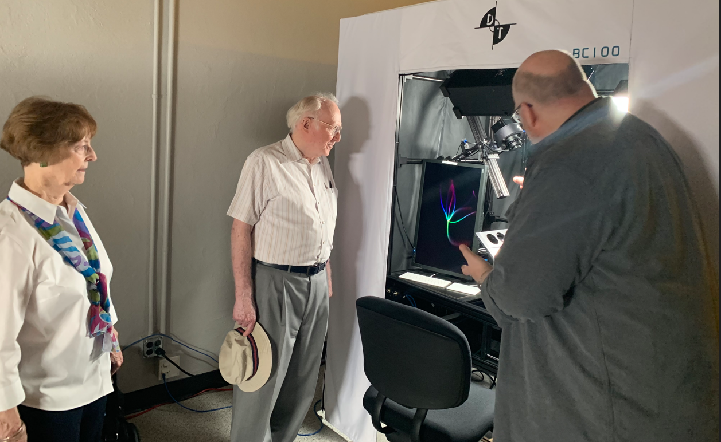
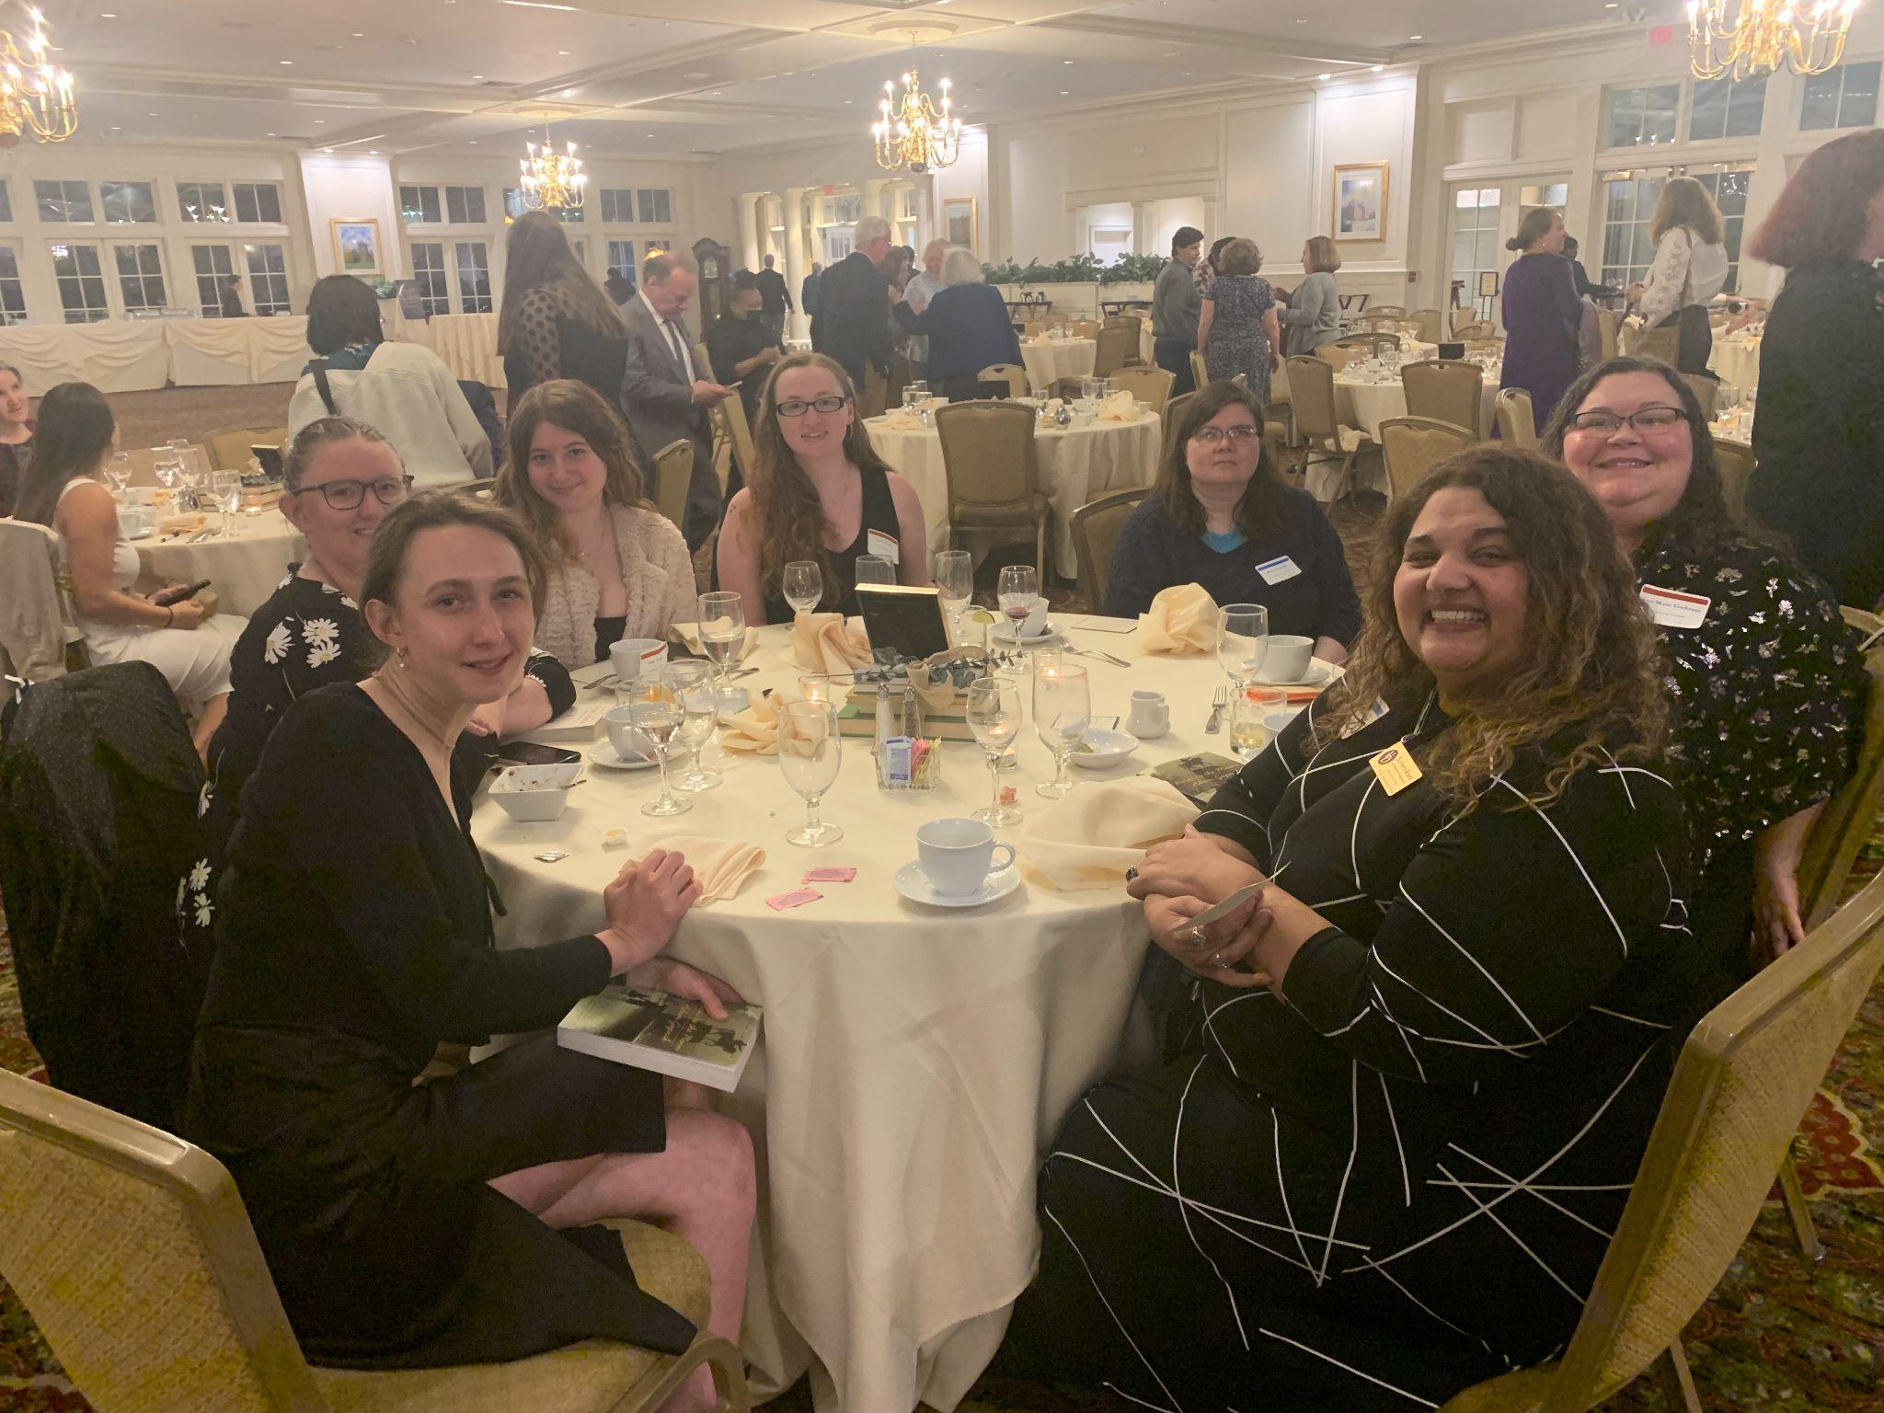
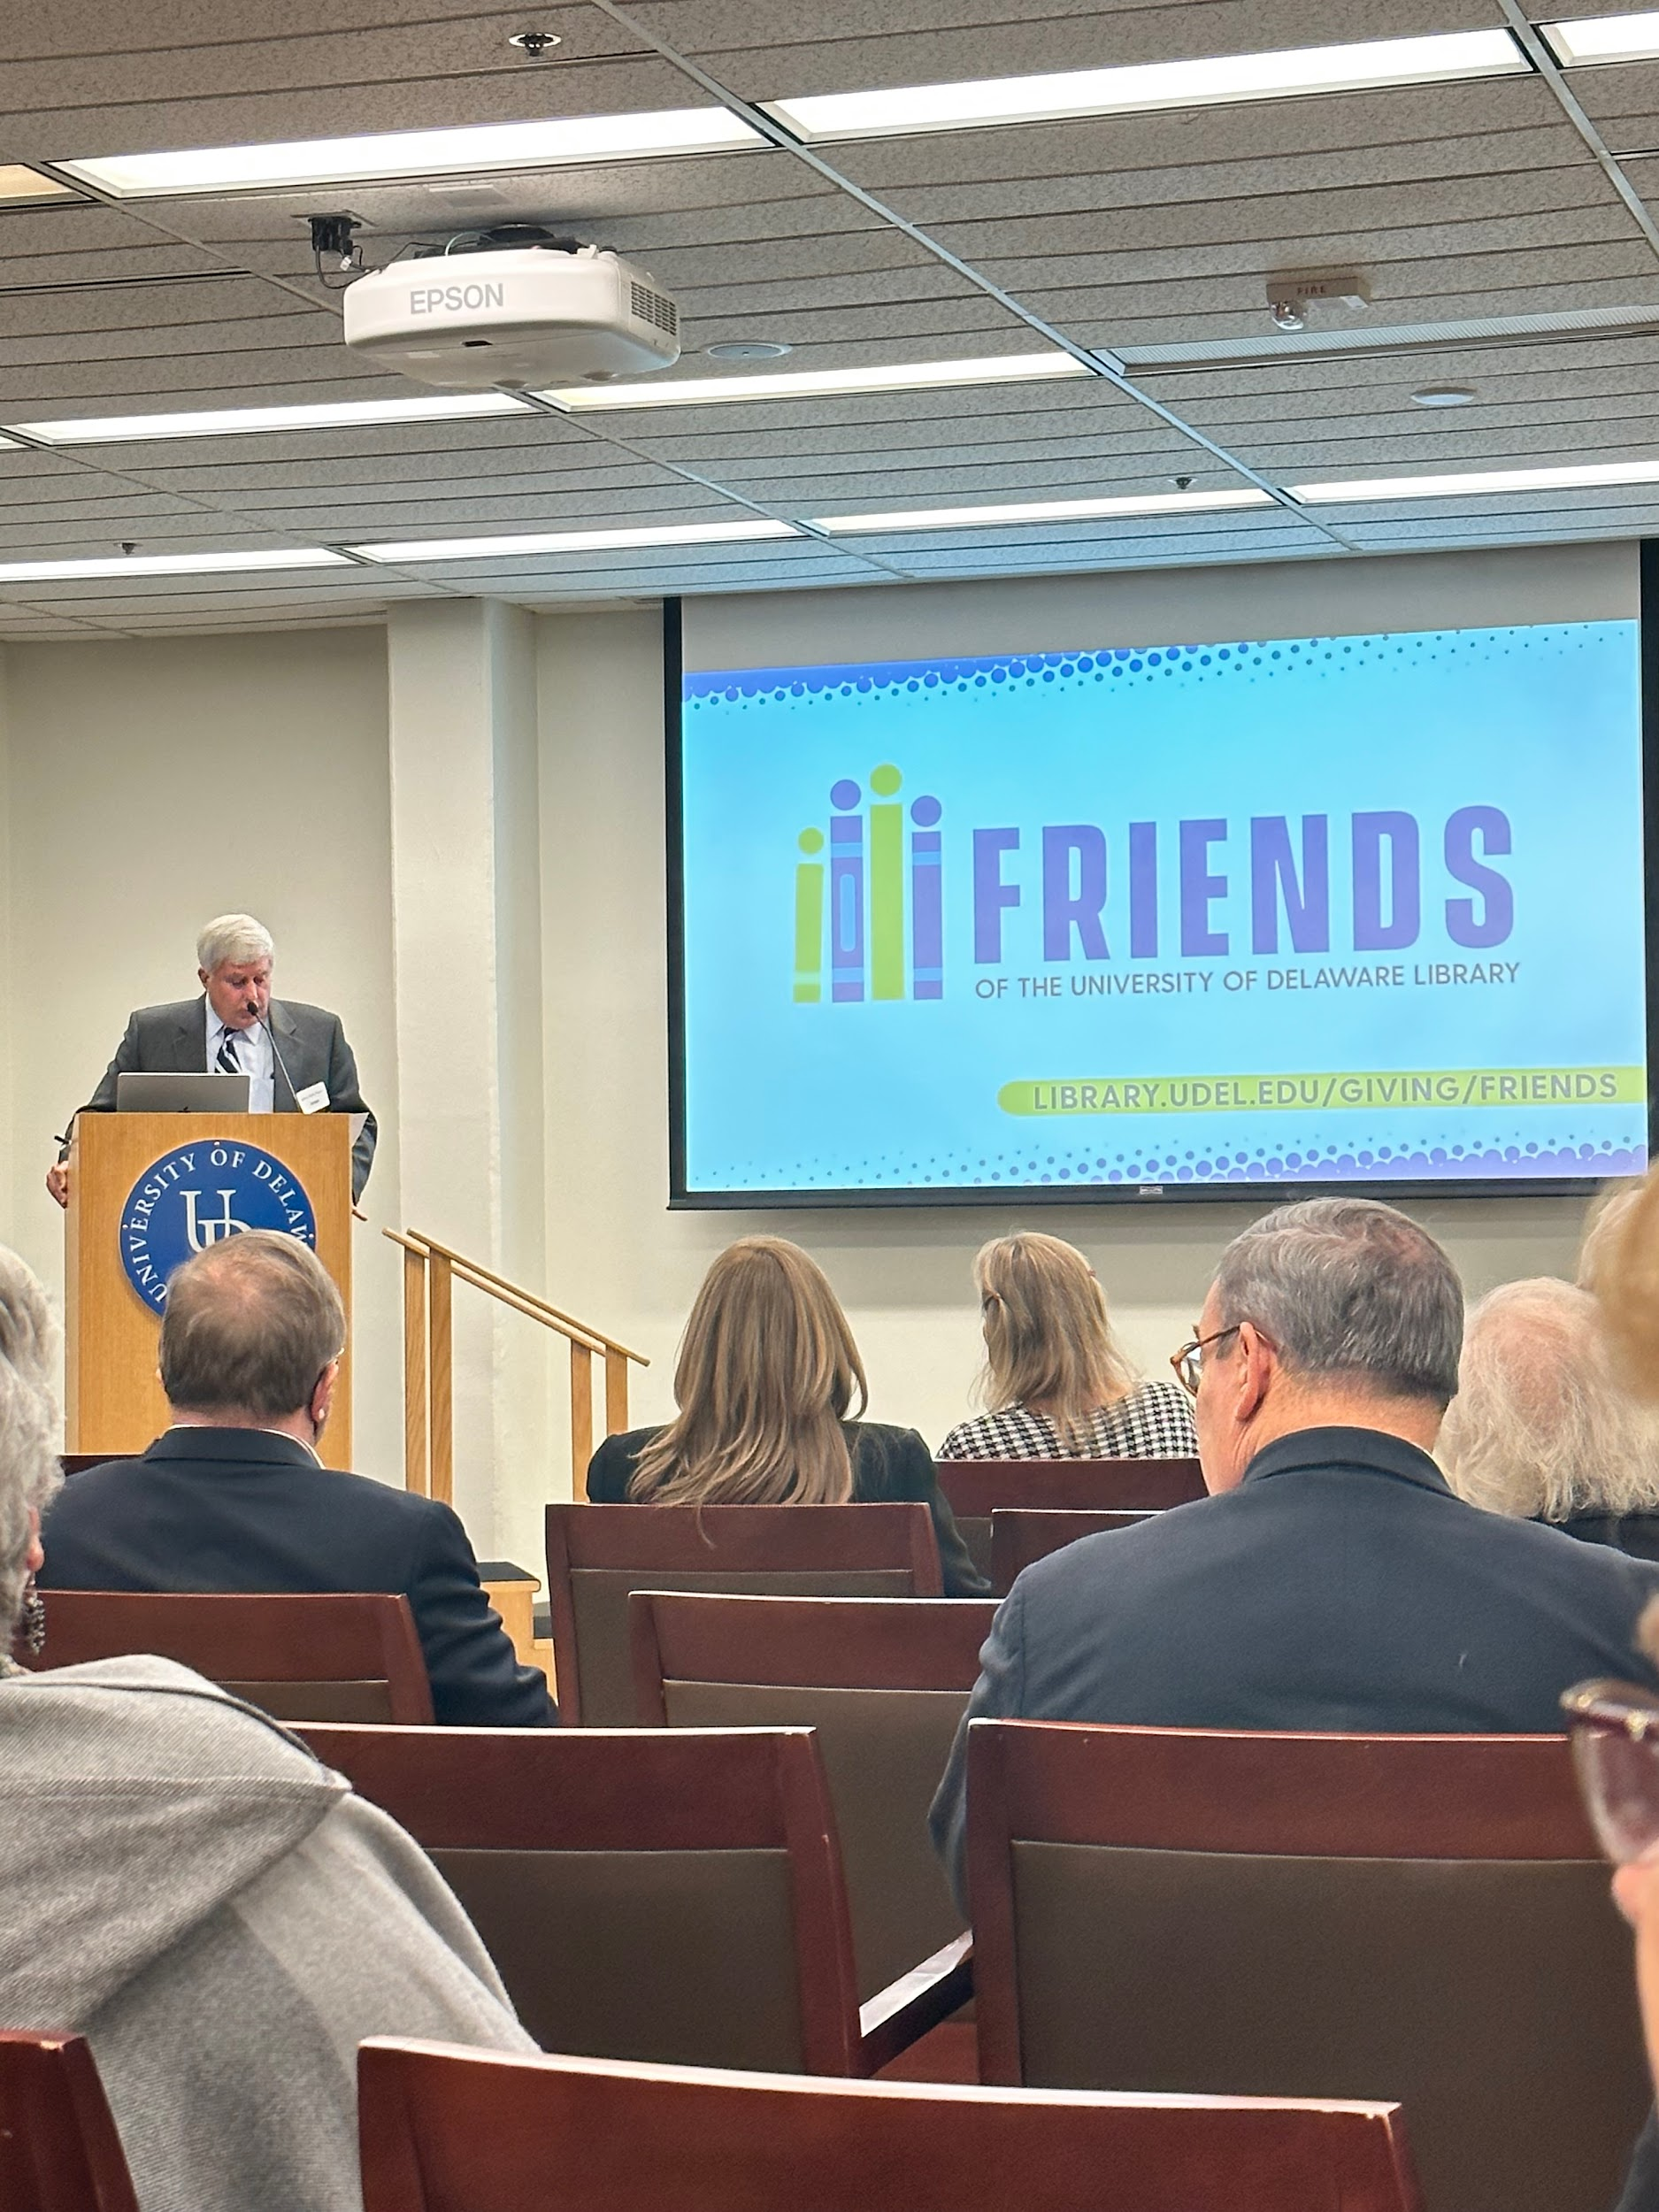
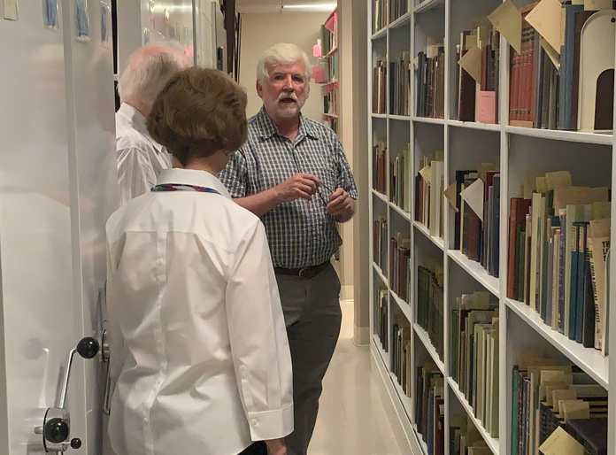
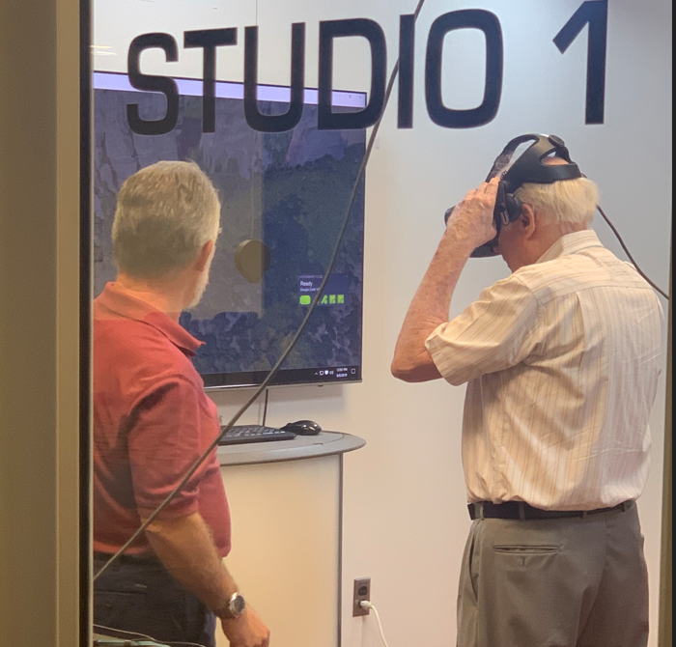
Step 4: Strengthening their Engagement
Notes:
Tywand and Nicole
We began to build trust between the Friends and I. Started asking more questions. Learning more about things we do.
We put together a lot of behind the scenes tours.
Tour of museums. Full library tour. Behind the scenes of Special Collections. Behind the scenes in digitization.

Slide 12
Starting To Wake Up
Notes:
Nicole

Slide 13
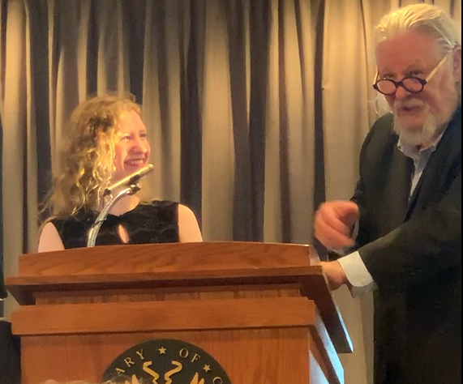
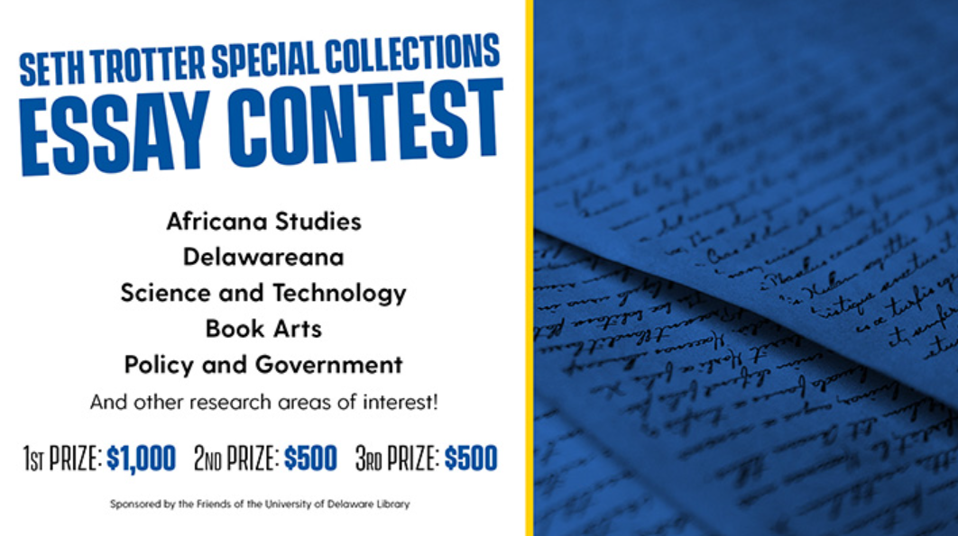
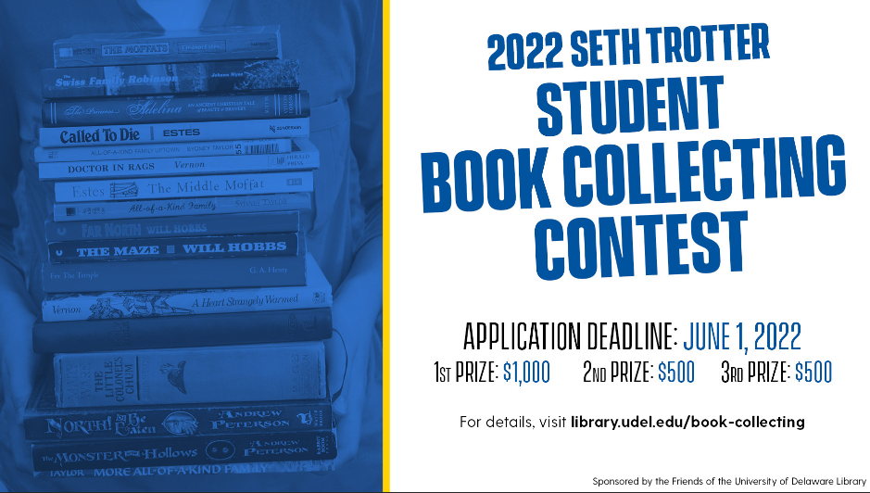
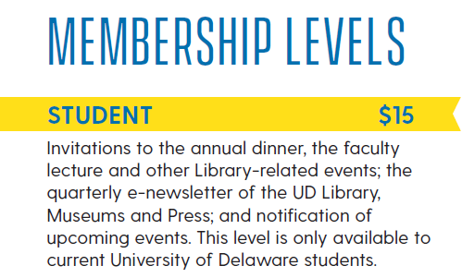
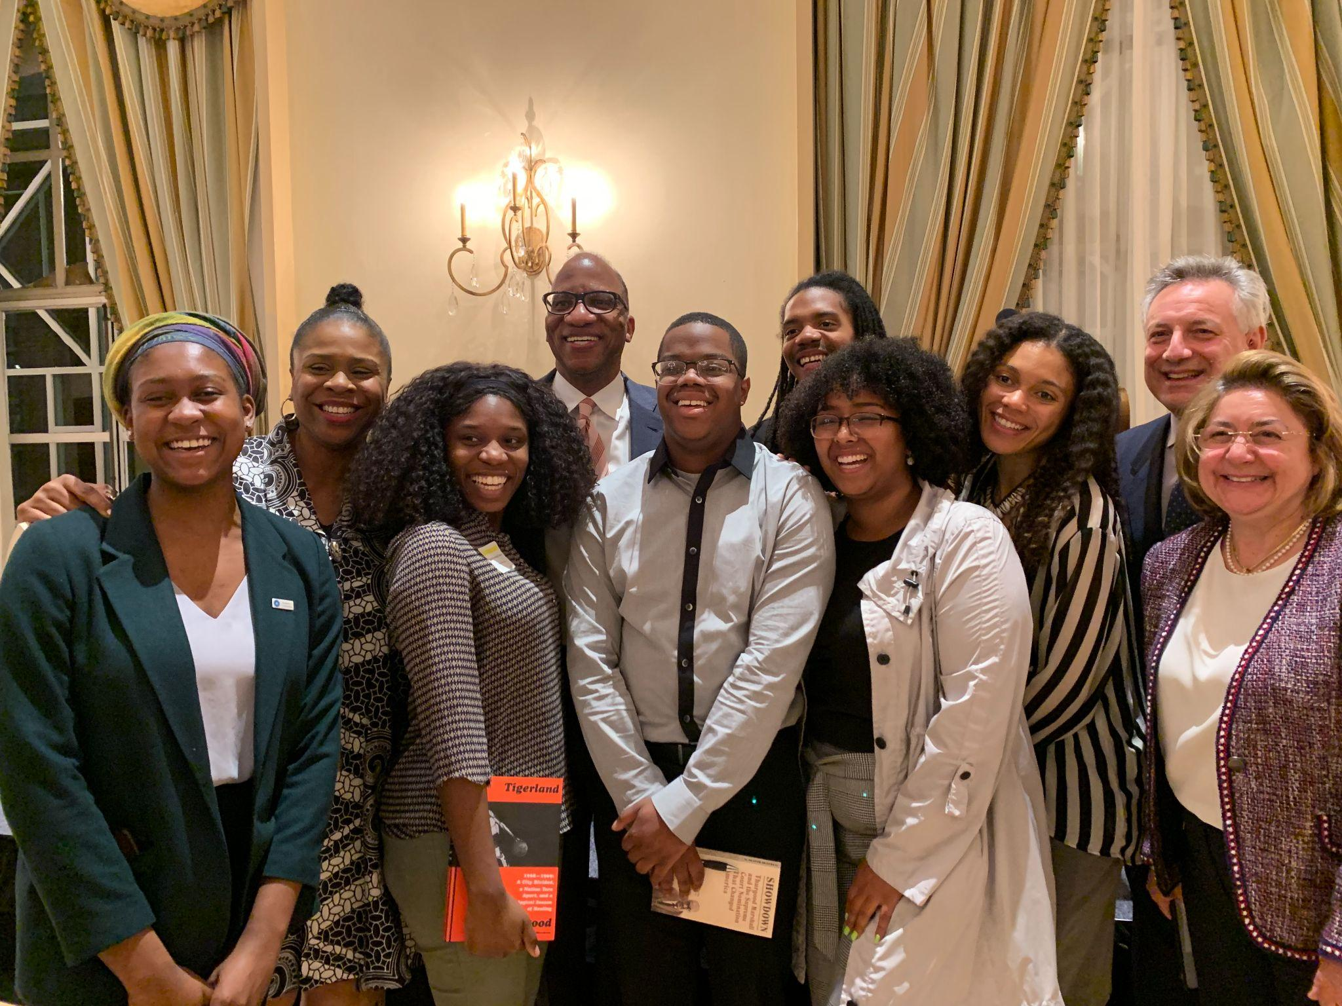
Increasing Student Engagement
Seth Trotter Book Collecting Contest in 2019
Seth Trotter Special Collections Essay Contest in 2020
Developed Discounted Student Membership Rate
Invited Contest Entrants/Winners to Annual Dinner
Notes:
Nicole
Mark wanted to start book collecting contests. Mark is a bibliophile. Both contests win money.
John originally funded Special Collections. John is a professor- wants to help get folks ready to publish on these special collections materials.
One winner went on to nationals. Invited to Library of Congress for special ceremony and dinner.
Invited a group of students from the Center of Black Culture and paid for them to attend the annual dinner for a speaker on Civil Rights.

Slide 14
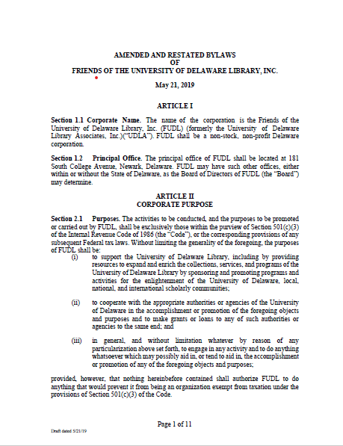
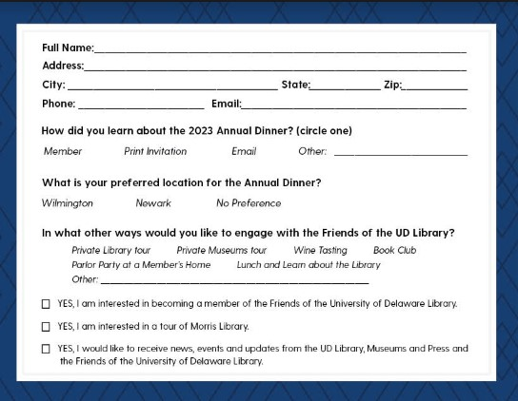
Step 5: Motivating Structural Changes
Updated By-Laws
Changed Frequency of Meetings
Established Program Committee
Established Nominating Committee
New Board of Directors
New Honorary Members
UD Faculty Involvement
Established Membership Committee
Annual Dinner Follow-Up
UD Alumni Lawyers
Board Member on Committees
Thank You Calls
Notes:
Tywanda

Slide 15
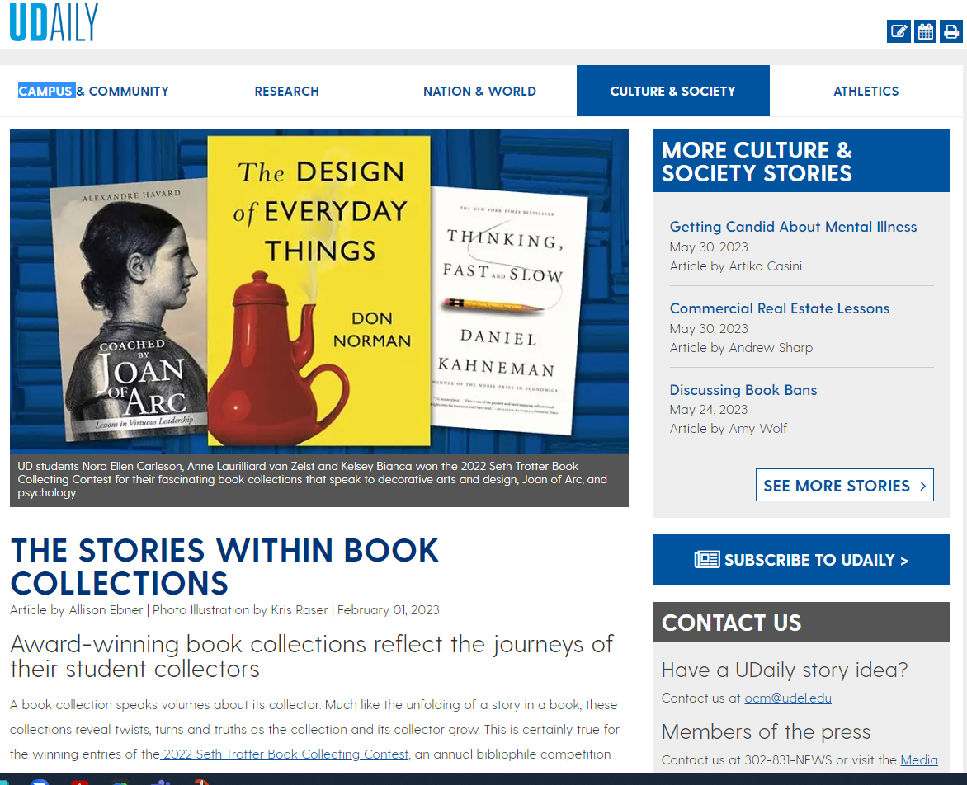
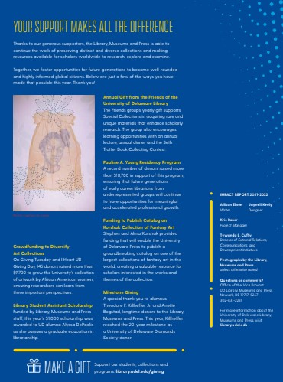
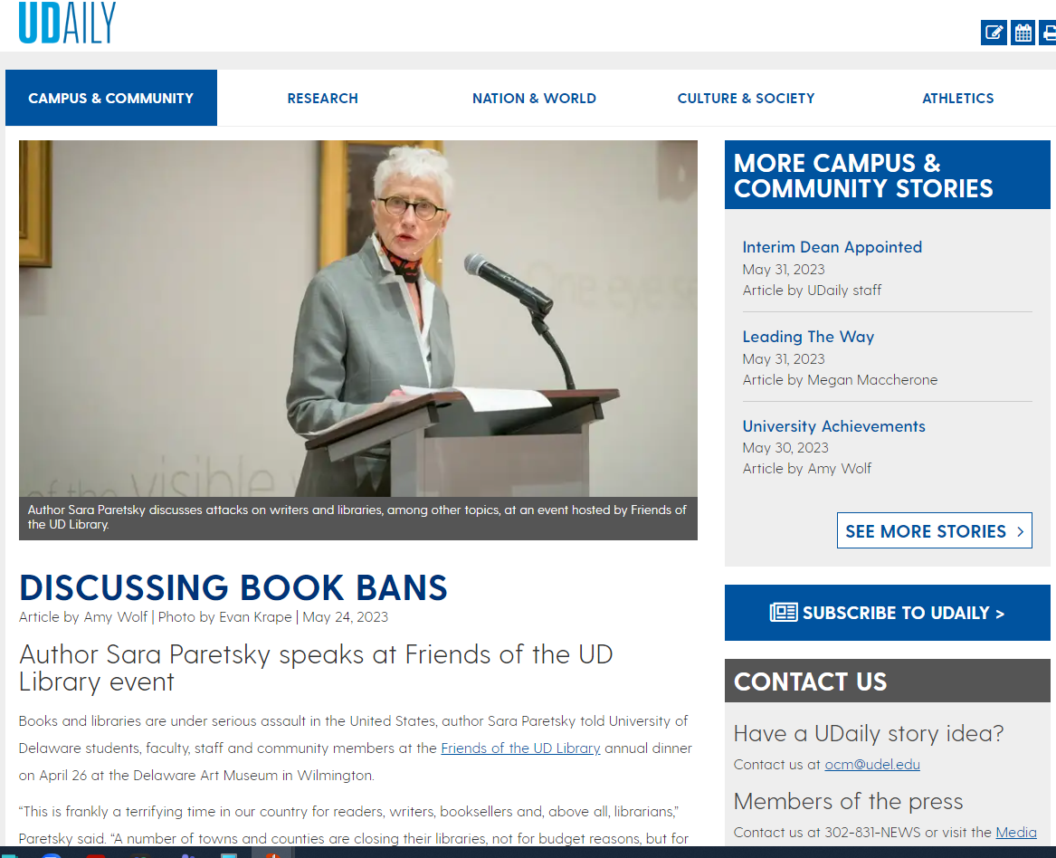
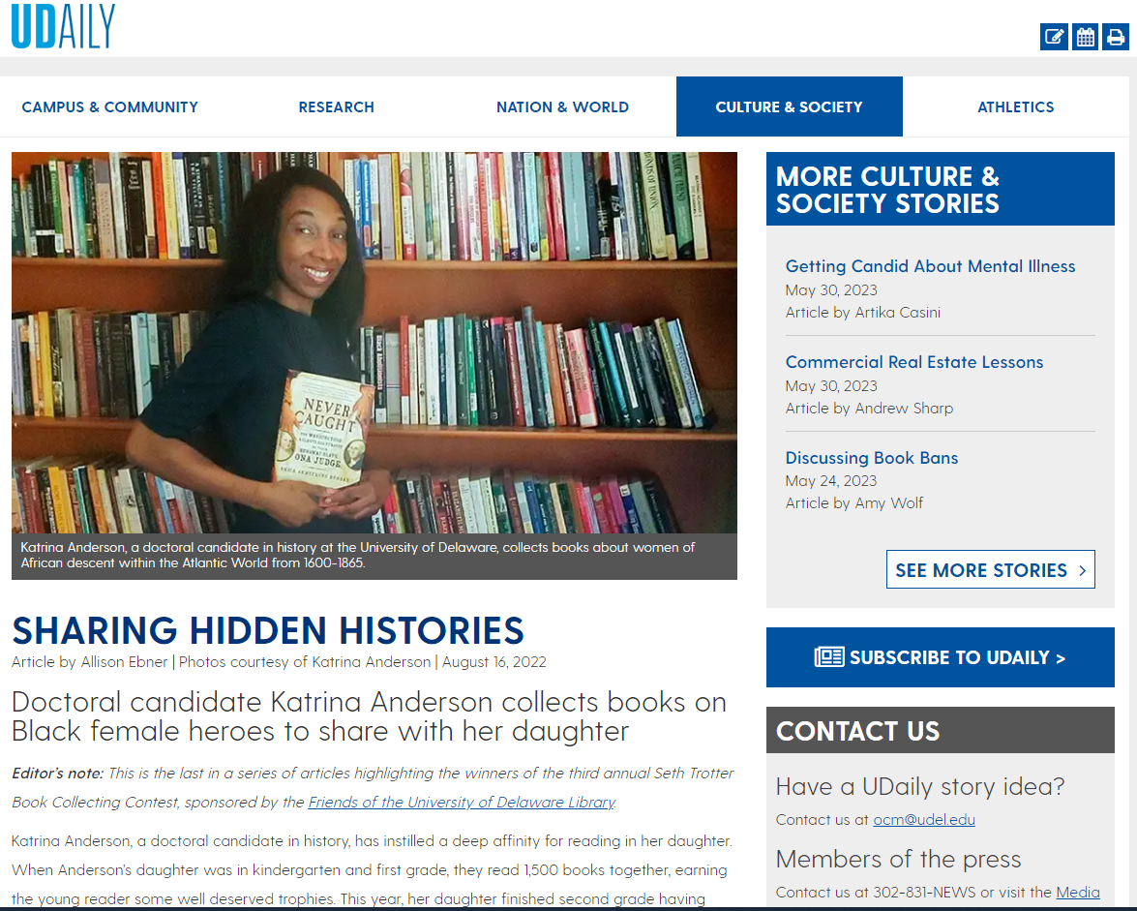
Increasing Community Awareness
Notes:
Nicole
Sharing impact of book collecting contests-
Annual University of Delaware President report- OCM reached out to us to write an article about the work of the Friends.
We get requested to share this part of Friends work by OCM.
Exposure beyond UD- advertisements in Delaware Today.
Friends asking for more exposure in annual LMP Impact report.

Slide 16
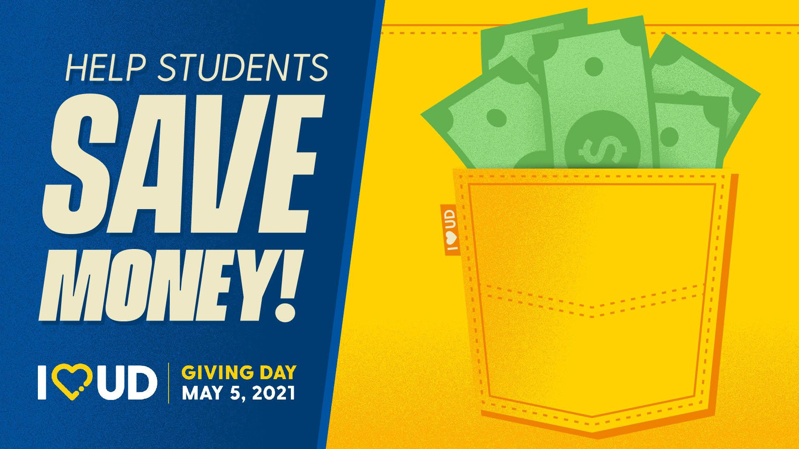
Step 6: Treading Lightly with Fundraising Solicitations
Added explicit ask to bi-annual letter to members.
Added explicit ask at faculty lecture/annual dinner to members.
Solicitation from Library to the Friends for Giving Tuesday as an exploratory gift for $2,500.
Notes:
Tywanda
Explicit ask to bi-annual letters to members

Slide 17
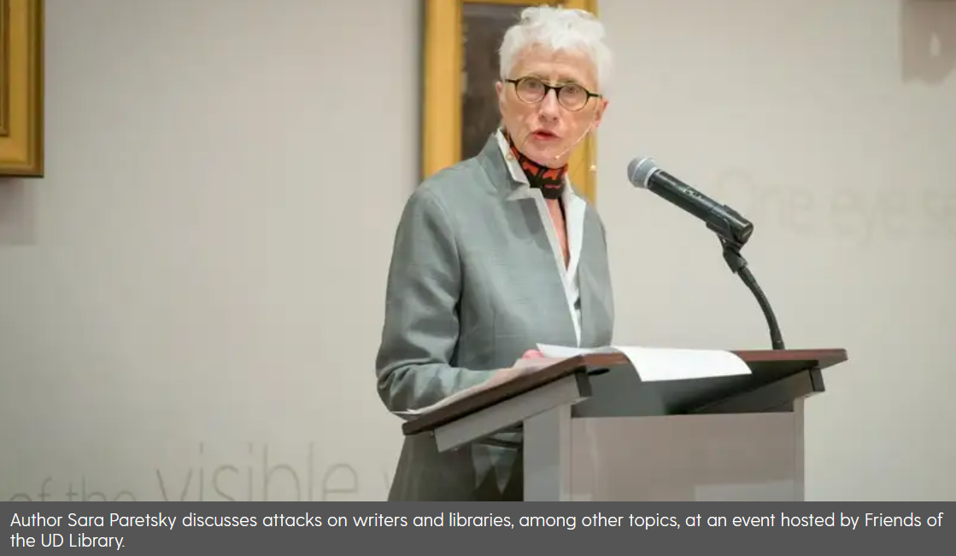
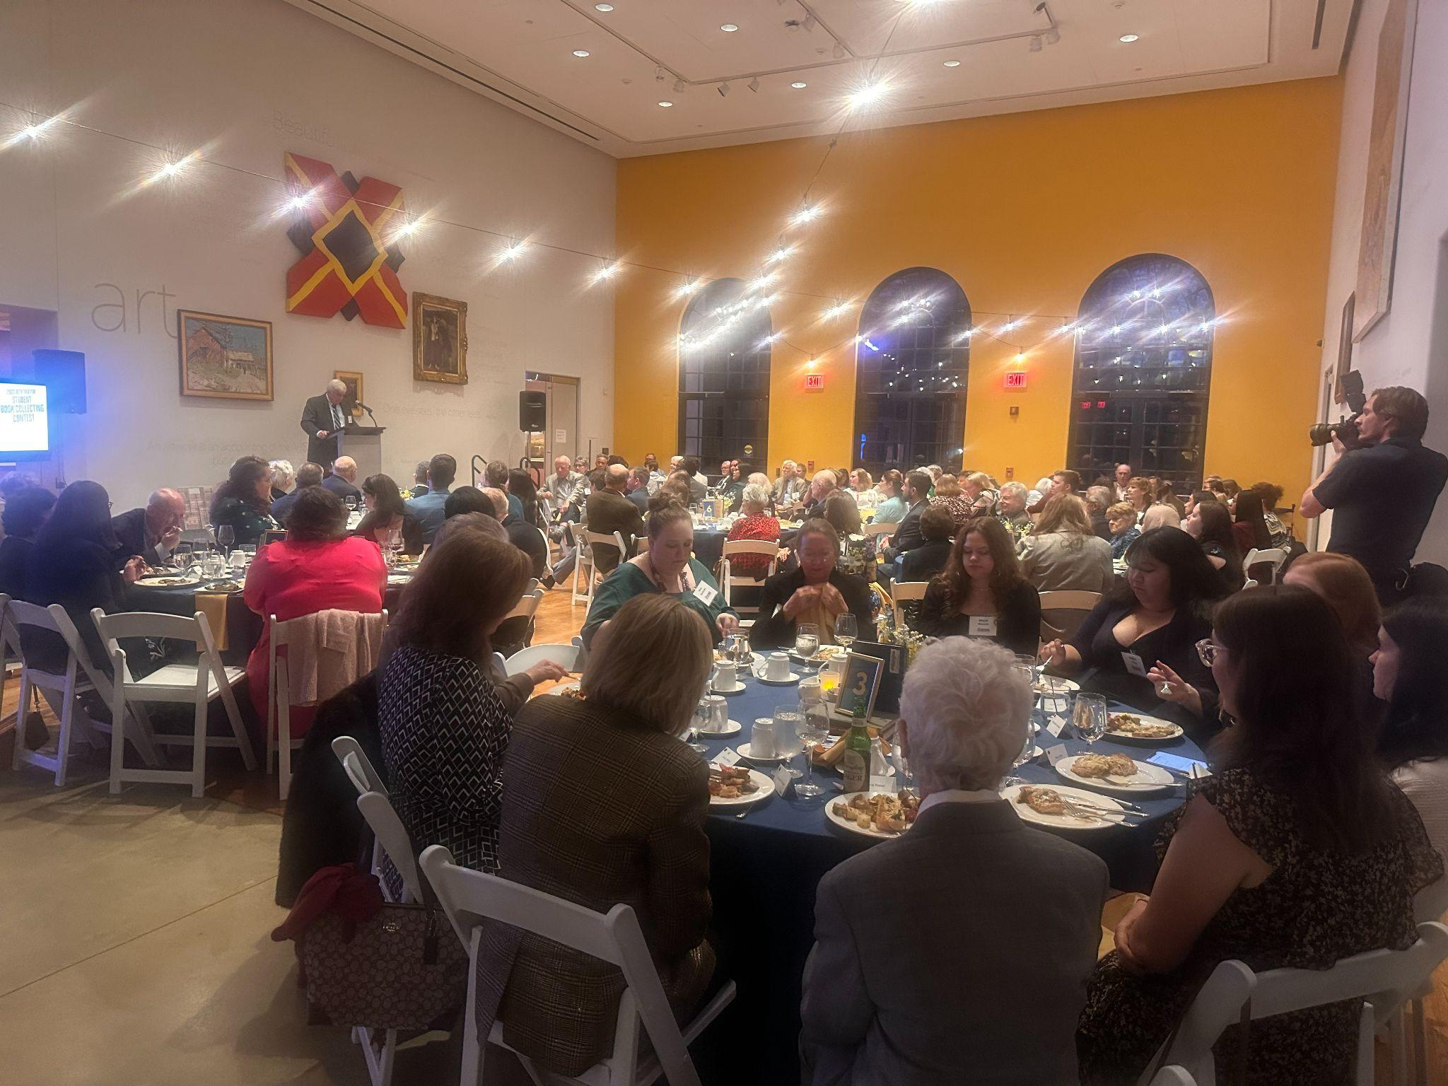
Becoming their own Lifeguard
Began taking own Meeting Minutes
Running own subcommittee meetings
Led event planning aspects for 2023 Annual Dinner: venue, speaker, caterer
Taking over handling of finances
Outreach efforts, Contact cards
Acknowledgement Letters, Solicitations
Notes:
Nicole

Slide 18
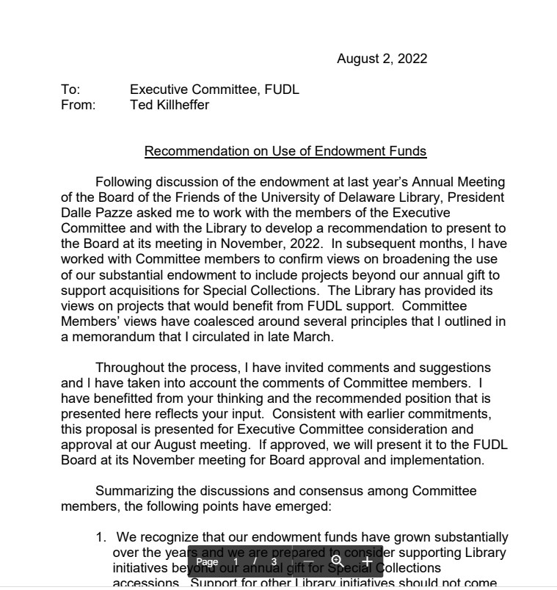
Step 7: Diving Deeper
Brainstorm with Vice Provost and Senior Director of Development on Major Gift
Proposed three options:
Special Collections Renovation
Endowed Position
Digitization Gift
Took a full year of meetings, proposals, gathering additional information, behind-the-scenes tours, etc.
Past President Served as Champion
Notes:
Tywanda
Talking to TJ and Trevor about getting them to do a major gift. Year plus in the making. Multiple project ideas.

Slide 19
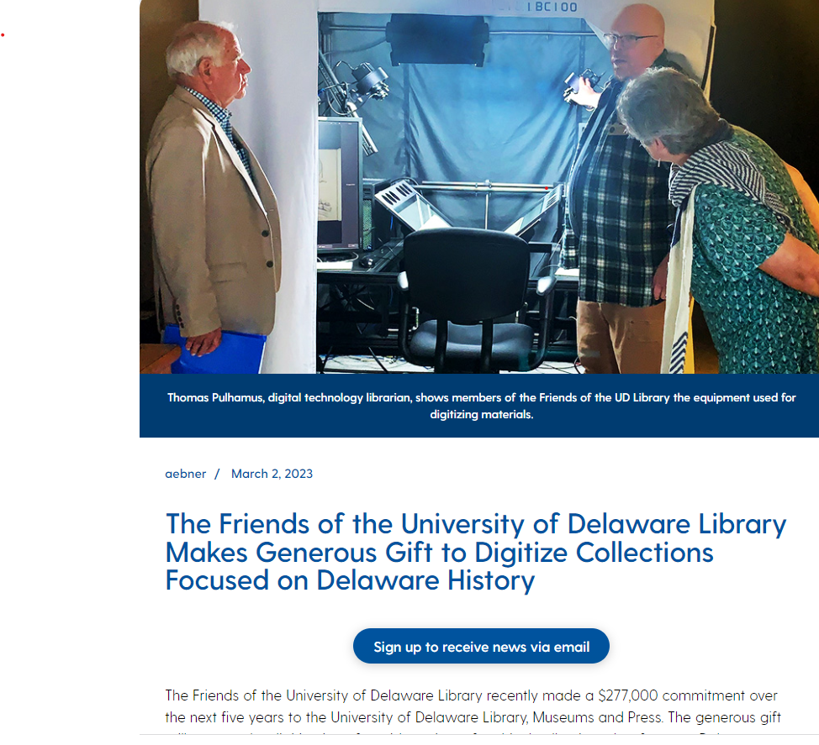
Step 8: Success - $277,000 Gift!
Notes:
Tywanda
$277,000 over 5 years!

Slide 20
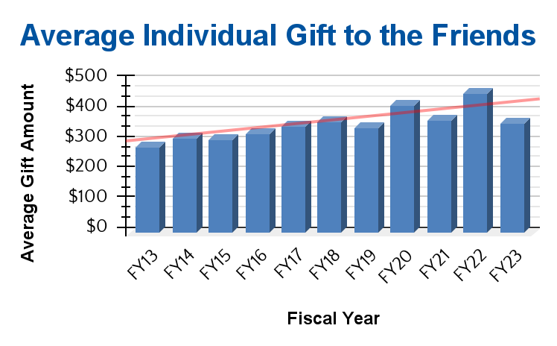
By the Numbers: Quality over Quantity
Notes:
Nicole
Members of the friends trending down, but started to come back up with engagement.
Same for gifts to the Friends.
Average amount of gift increased, even though number of members decreased.

Slide 21
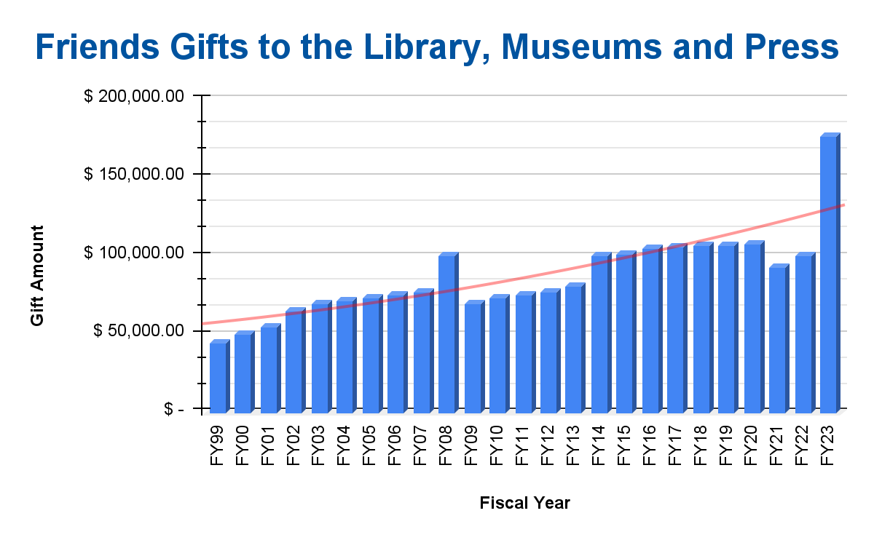
By the Numbers
Notes:
Nicole
Members of the friends trending down, but started to come back up with engagement.
Same for gifts to the Friends.
Average amount of gift increased, even though number of members decreased.

Slide 22
Vision for the Future
Launch additional community event based on survey-results.
Solicit for Special Collections Renovation Capital Project.
3. Work with membership committee to find new non-UD members to join.
4. Partner with Osher Lifelong Learning Institute and other DE Friends groups.
5. Provide more board engagement touchpoints with the Library.
6. Change back-end gift processing and recognition credit to be revered as a
Founders’ Society member with perks/benefits.
Notes:
Tywanda

Slide 23
Questions?
Notes:
Tywanda

Slide 24
Your Turn!
Do you currently have or want a Friends group? Why or why not?
What is or would be the purpose of your Friends group?
Identify five potential leaders/donors for your Friends group.
Identify three Library initiatives your Friends group could support.
How would you measure success/outcomes?
Set a date, time and location for your first/next meeting.
Notes:
Nicole

Slide 25
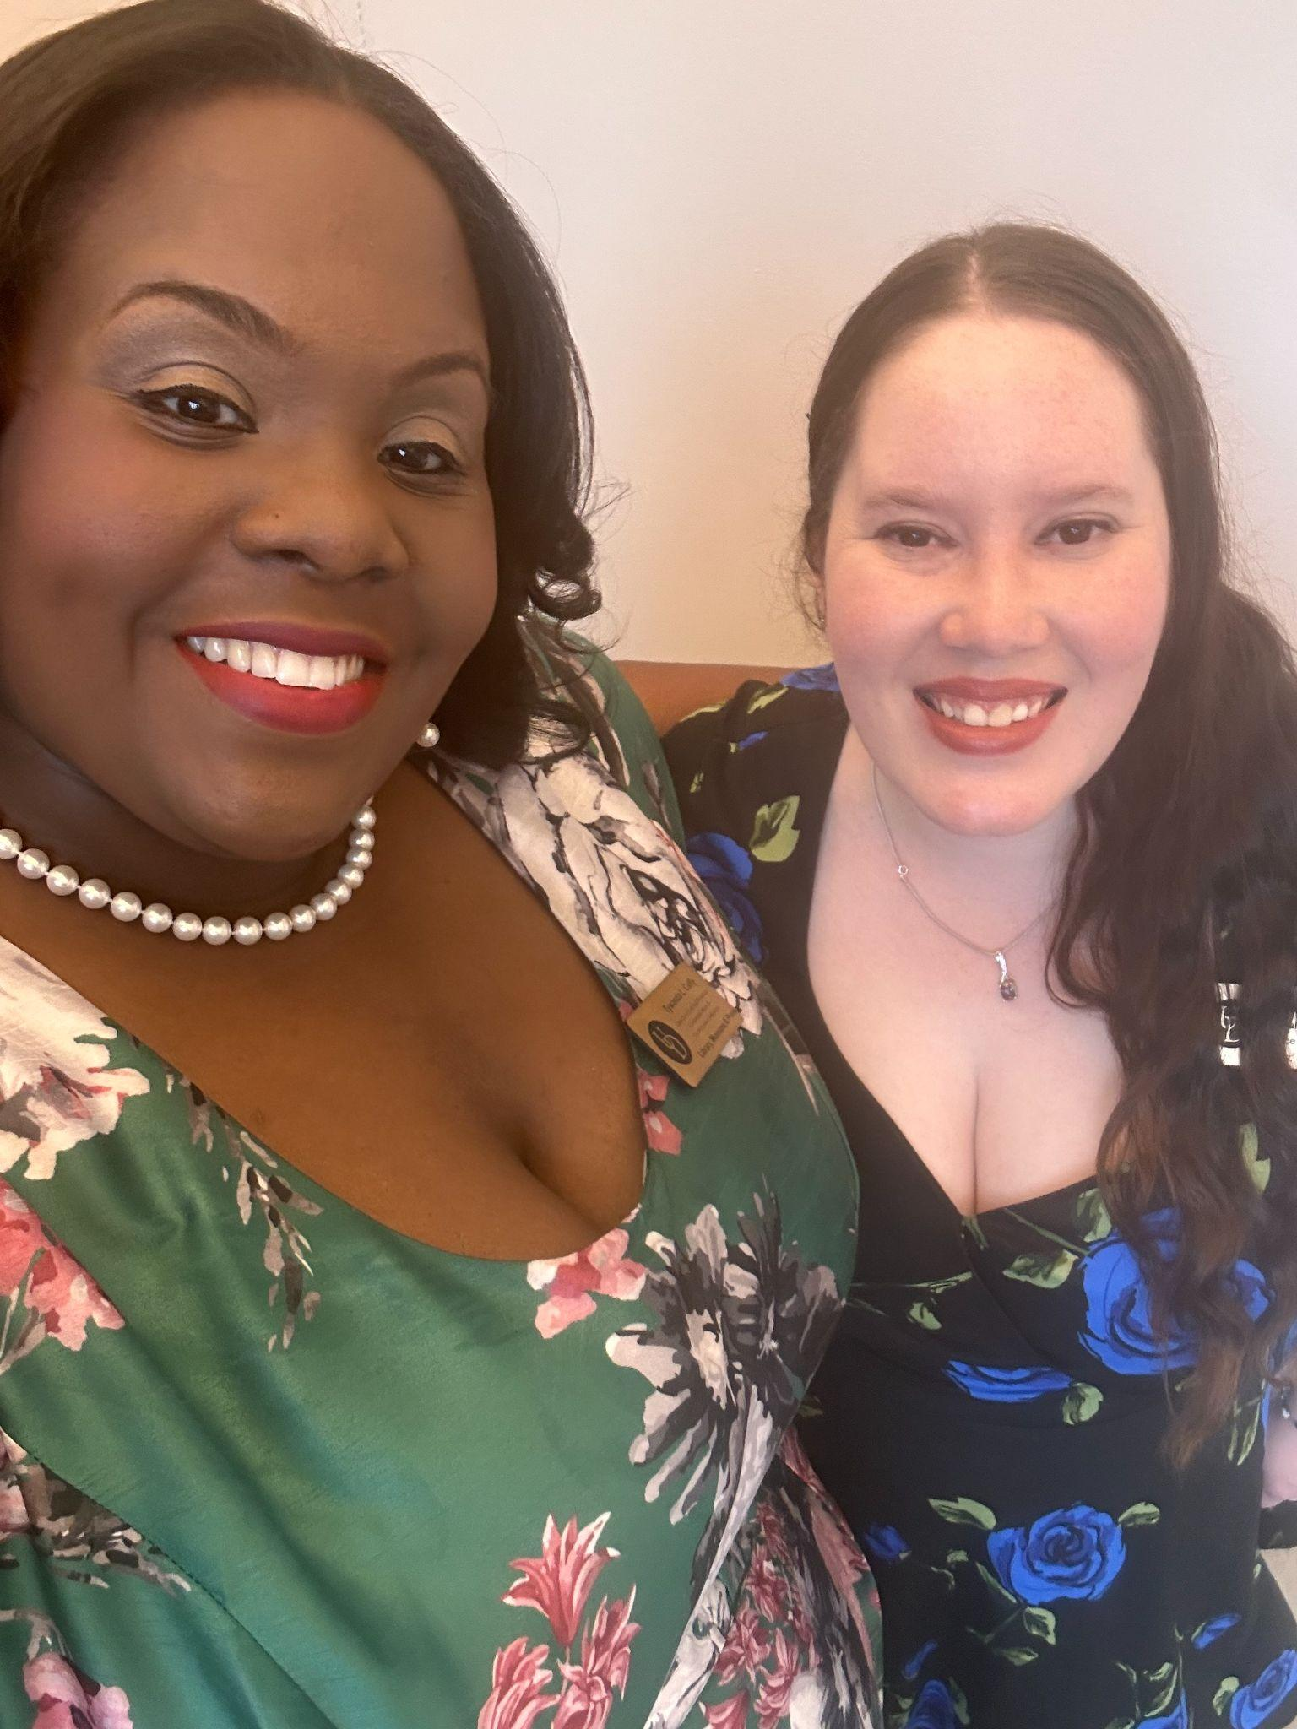
Become our Friend
Tywanda L. Cuffy
tywanda@udel.edu
(302) 831-1719
LinkedIn.com/in/Tywanda
Nicole M. Hernandez
nicolemh@udel.edu
(302) 831-7171
LinkedIn.com/in/NicoleHernandez2

