Slide 1


Is your Staff Supporting
Your Efforts?
ALADN 2023
Mike Crumpton, Dean of University Libraries
Nakia Hoskins, Community Engagement Manager
Kathelene Smith, Head of Special Collections

Slide 2
Presentation Purpose
This presentation is to engage in a discussion of how library staff become involved and can support philanthropic efforts in a post pandemic environment. The education of library staff and the formal creation of a purposeful group moving that education and effort forward is paramount to successful donor engagement. The image of the library, the perceived good stewardship as well as trustworthiness, are all critical components to a donor and are important tools for any development officer, asking for money.
This presentation will cover efforts being made to encourage and promote library staff understanding of donor engagement, how the use of a advisory group can broaden the outreach efforts of advancement/development activities that are centralized to the institution and provide a venue to share similar experiences for participants. Techniques and processes used will be shared as well as development of a common best practices list from the group. We will share our story and encourage others to join in with ideas, concerns and best practices with how employee engagement works in their institutions. This will include a discussion of hierarchy for engagement and levels of confidentiality.

Slide 3
Agenda
What Development Activities Mean For The University
  Campus Initiatives
  Responsibilities Of Each Academic Unit
Development Terminology – Types Of Major Gifts
Why People Give
  Benefits Of Private Giving
  Way Give To Public Institutions
Funding Sources For Library Giving
Everyone Plays A Role:
  Development Officers
  Library Administrators
  Library Staff
Notes:
Rosann

Slide 4
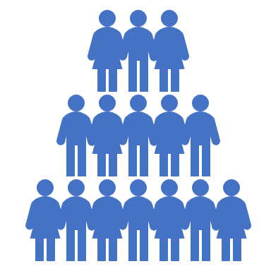
Is Your Staff Supporting Your Efforts?
Elements to consider when garnering support from your staff:
The Three C's
Culture
Clarity
Cultivation

Slide 5
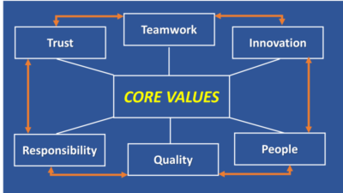
CULTURE
The Three C’s: Culture
Notes:
https://www.invistaperforms.org/the-importance-of-workplace-culture/
“Culture eats strategy for breakfast” is a famous quotation attributed to the late business management guru Peter Drucker.
"Workplace culture is important because it links company culture with things like employee engagement"
Culture guides employee decisions on their technical needs and plans, and how employees interact with others. Good culture creates an internal coherence (logic and consistency) in actions taken by a very diverse group of employees.
Build that culture: share-outs, communication, collaborative work, think tanks, UA training and donor discovery, morale boosting activities
Instilling a culture and environment of support and organization buy-in is an important element when garnering staff support. At UNCG University Libraries the staff meets monthly to discus and share initiatives, upcoming events, vital news. This culture of share out helps build open dialogue and organizational knowledge that helps aid staff support.
As, External Engagement Coordinator, I value collaboration and seek opportunities to involve various departments – ex: iNature, book clubs, author events,

Slide 6
Clarity
The Three C’s: Clarity
What?
  Making your organization's philanthropic efforts clear to your staff. Example - -UNCG UL: Case Statement
Why?
  Making your staff understand the importance of supporting philanthropic efforts
When?
  Making your staff aware of philanthropic events and opportunities to support those efforts.
Who?
  Making your staff aware of the key stakeholders in your philanthropic efforts.
How?
  Preparing your staff know to support your philanthropic efforts.
Notes:
Case Statement:
Kathelene is speaking to "developing unique resources" and how staff are supporting that
Mike can speak to "promoting student success" and how staff are supporting that
Nakia can speak to EDI support with book clubs (How to be an anti-racist, B.Proud, Greensboro Bound and book clubs, panels, etc.)

Slide 7
The Three C’s: Cultivation
Staff
  Training & Education
  Relationship Building
Donor Cycle
Donor identification
Research and qualification
Cultivation
Solicitation
Stewardship
Notes:
Staff: https://blog.clearcompany.com/how-improve-employee-engagement
Donor cultivation is the process of continually adding new donor prospects to your solicitation list, motivating major donors to make repeat gifts, and encouraging small donors to increase the size of their gifts. https://www.boardeffect.com/blog/donor-cultivation/#:~:text=Donor%20cultivation%20is%20the%20process,the%20size%20of%20their%20gifts.
In this step, you're going to focus on cultivating your potential donors. This stage involves a lot of communication and intention. Before you make your first ask, you should educate them about your mission, how you carry it out, and any other questions you anticipate them having. The ultimate goal is to make them feel like they can have a real impact on the world by supporting the work you do.
In order to find out what questions they have or what might compel them to donate, take the time to reach out and talk to them. Asking questions is a surefire way to find out what they’re really thinking and feeling
https://kindful.com/blog/fundraising-basics-understanding-the-donor-cultivation-cycle/#:~:text=In%20this%20step%2C%20you're,questions%20you%20anticipate%20them%20having.

Slide 8
Examples of Philanthropic Staff Supported Initiatives & Events
Events Staff Can Support
Book Clubs
Greensboro Bound Donor Events
"Believe in the G" Day of Giving
Women's Veteran Luncheon
"Columns" e-newsletter
Future Opportunities to Garner Staff Support:
  Include Staff In Thank You Letters And Solicitation Pieces
  "Lighting Rounds" Open To The Community
  Use More Staple Events To Highlight Staff; Bring Staff To The Forefront More

Slide 9
Common Reasons to Give
Supplement Institutional Funding Sources
Collections vs. Projects
Advantages of endowments
Community involvement/investment
Beneficial yet challenging
Continuous program provides steady stream of income over a long period of time
Notes:
Mike

Slide 10

Why Do People Give?
People don’t give because we HAVE a need. They give because we FILL a need.
Because they are asked. People give to people.
Contribution is needed and appreciated.
Confidence/Trust
Involvement
To leave a legacy

Slide 11
Why Do Corporations Give?
Corporations give to help them achieve their business objectives.
  Strengthening relationships with customers, employees, owners (stockholders), the general public, elected officials, regulators, advocacy groups or others whose actions impact the business
  Addressing a specific need of the business
  Belief that the business’s success is dependent on the success of the community
Types of corporate giving
  Cash gifts
  In-kind gifts
  Matching gifts
  Volunteers
Notes:
David

Slide 12
Why Do Foundations Give?
Foundations exist to give money to philanthropic causes. Giving is essentially the only tool they have to achieve their objectives.
  Allowable purposes under Section 501(c)(3) of the tax code: Charitable, religious, educational, scientific, literary, testing for public safety, fostering national or international amateur sports competition, and preventing cruelty to children or animals.
  “Charitable” includes relief of the poor, the distressed, or the underprivileged; advancement of religion; advancement of education or science; erecting or maintaining public buildings, monuments, or works; lessening the burdens of government; lessening neighborhood tensions; eliminating prejudice and discrimination; defending human and civil rights secured by law; and combating community deterioration and juvenile delinquency.
Notes:
David

Slide 13
Importance of Good Housekeeping
Staff believe and support themselves
Supports extra activities
Library is viewed as important source for giving and donating to
As opposed to other organizations that may be unknowing competitors
Library demonstrates trustworthiness
Will be good stewards of monies donated
Library sets goals for use of monies requested, gives benefits
Monies will have specific purpose
Notes:
Mike

Slide 14
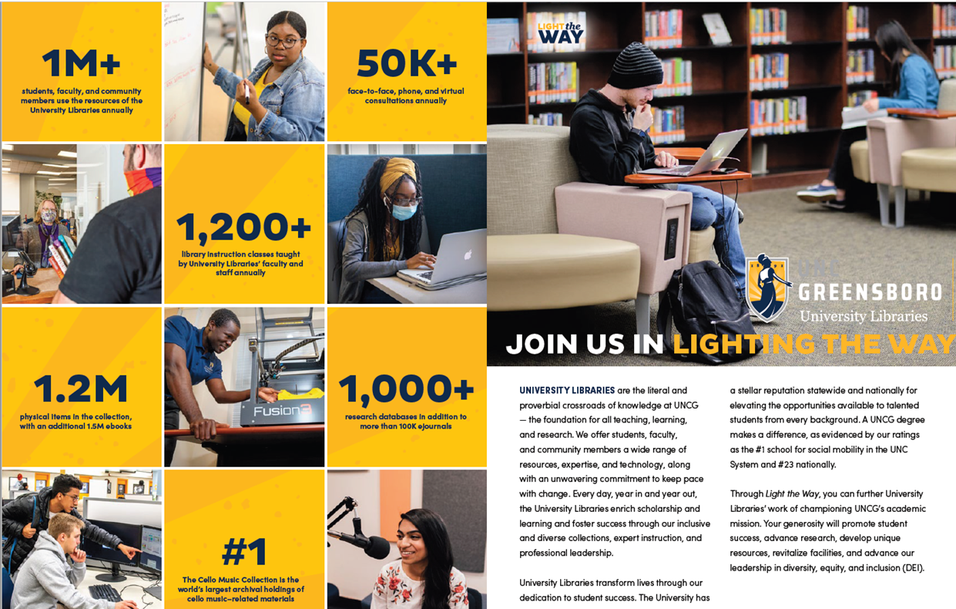
Sharing Campaign Information

Slide 15
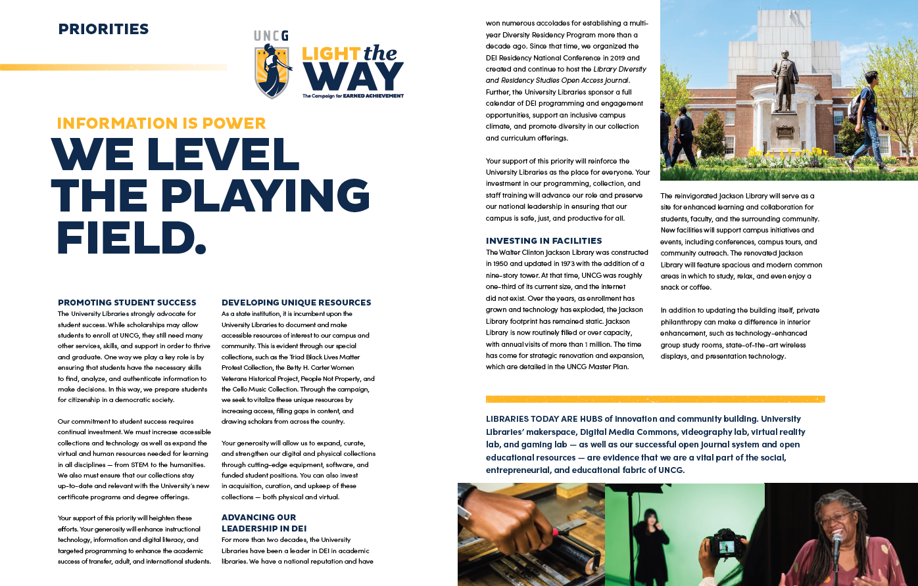
Understanding Library Priorities

Slide 16
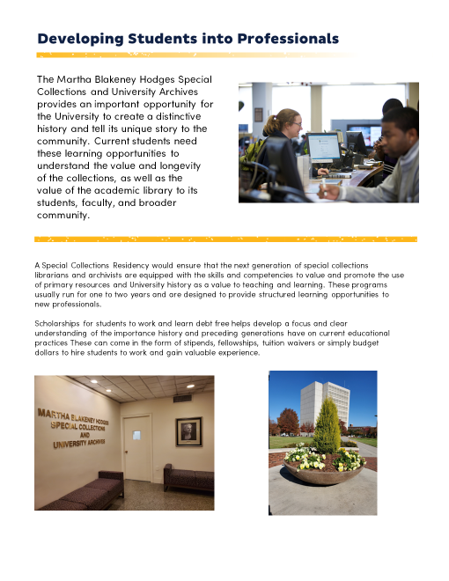
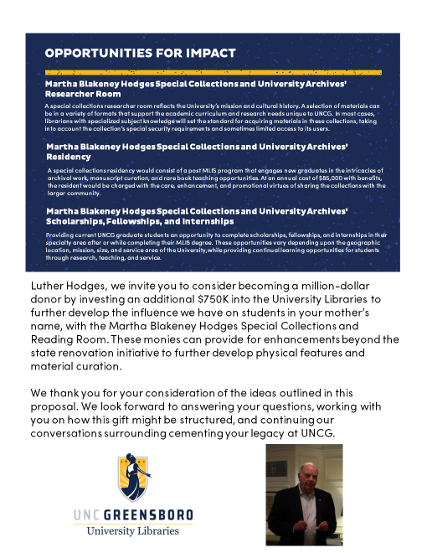
Connecting To Library Goals And Objectives

Slide 17
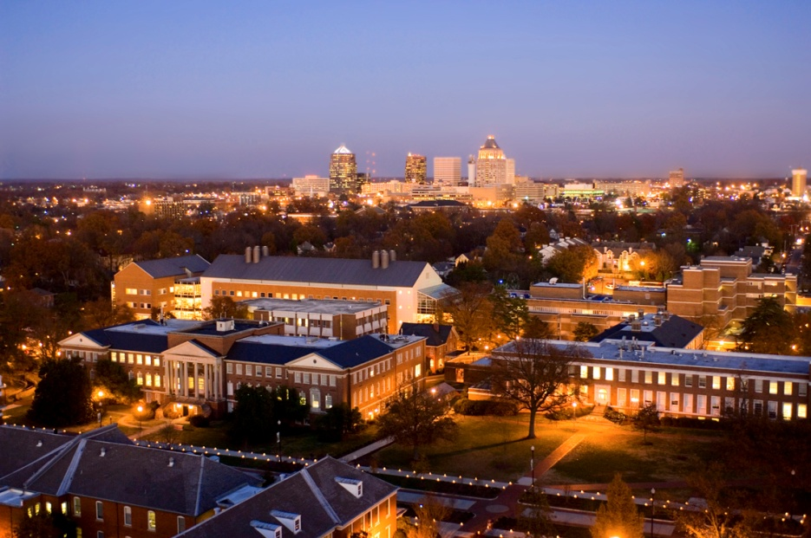
Examples of Academic Library Needs for Development Activities
Develop special collections
Manage and maintain existing collections
Provide access to electronic resources
Launch innovate programs
Provide new services
Building projects!
Notes:
Mike

Slide 18
Strategic Planning
Challenges
Library has no alumni
Finding leads
Link student needs with potential donors
Campus competition
Opportunities
Library constituency is entire university community
Building an environment of giving
Using assessment tools to demonstrate needs
Creating vision and mission that includes development needs
Notes:
Mike

Slide 19

Why Fundraising?
We are funded to be adequate, not funded for excellence!
The budget would not balance.
Buildings might not be equipped.
Services and programs may not be provided.
Scholarships and professorships would not be available.
Research would not be conducted.

Slide 20
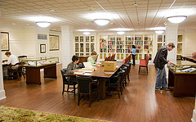
Learning Environment Gifts
Julia Cameron Trice Reference Study Alcove, a gift from Brandon Bensley to honor her grandmother.
BB&T Reading Room
Martha Blakeney Hodges
Special Collections and Archives
a gift of Luther Hodges and Betsy Bernard
Notes:
Linda

Slide 21
Types of Giving
Cash/pledges
In-Kind gifts – works of art, books, papers
Capital Assets – property, stock
Matching Gifts
Planned Gifts
Notes:
Linda

Slide 22

Types of Planned Gifts
Will Bequests
Charitable Gift Annuities
Trusts
Life Insurance
IRA’s
Estate Gifts
Notes:
Linda Deferred until after death
Will bequests – Hermann Trojanowski
CGA – Joyce Calloway

Slide 23
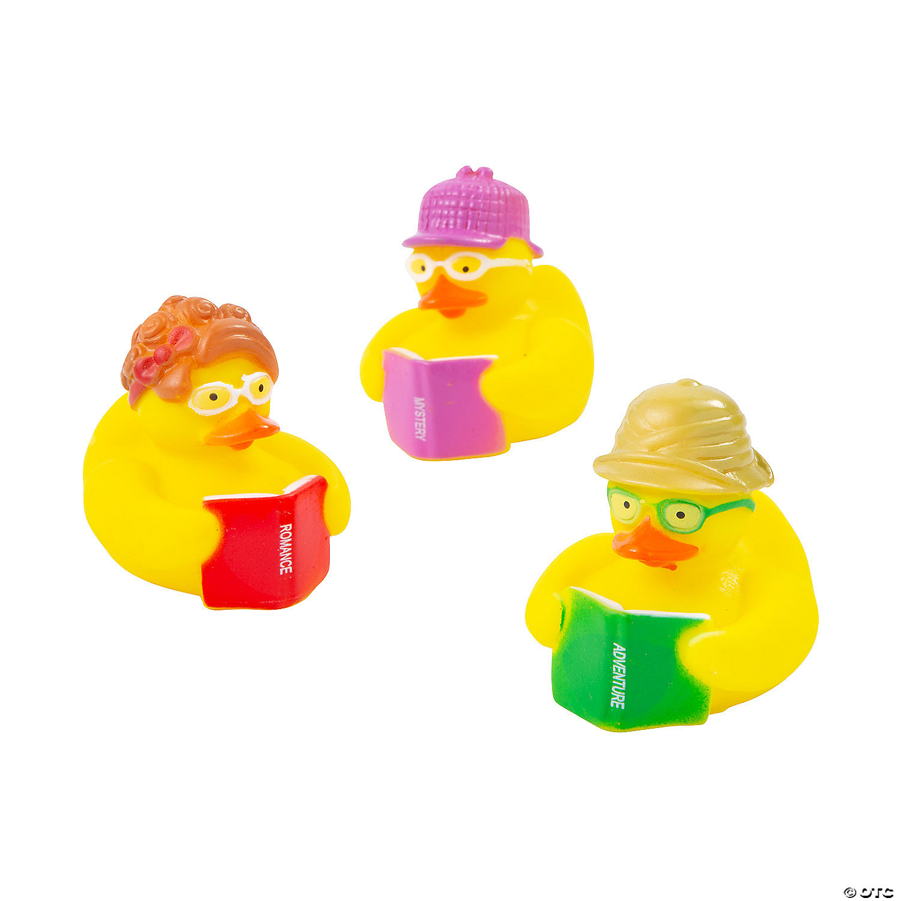
Ways to give to the University Libraries
Friends Of The Libraries
Annual Gifts (Enrichment Fund)
Naming Opportunities
Major Gifts (Planned Or Outright)
Endowments
Current Restricted
Notes:
David

Slide 24
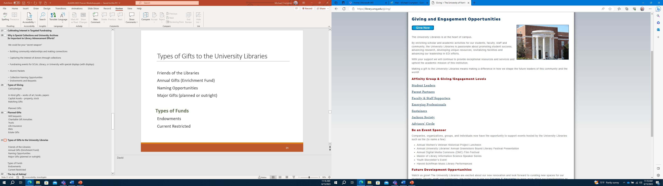
Giving Page of Library Website

Slide 25
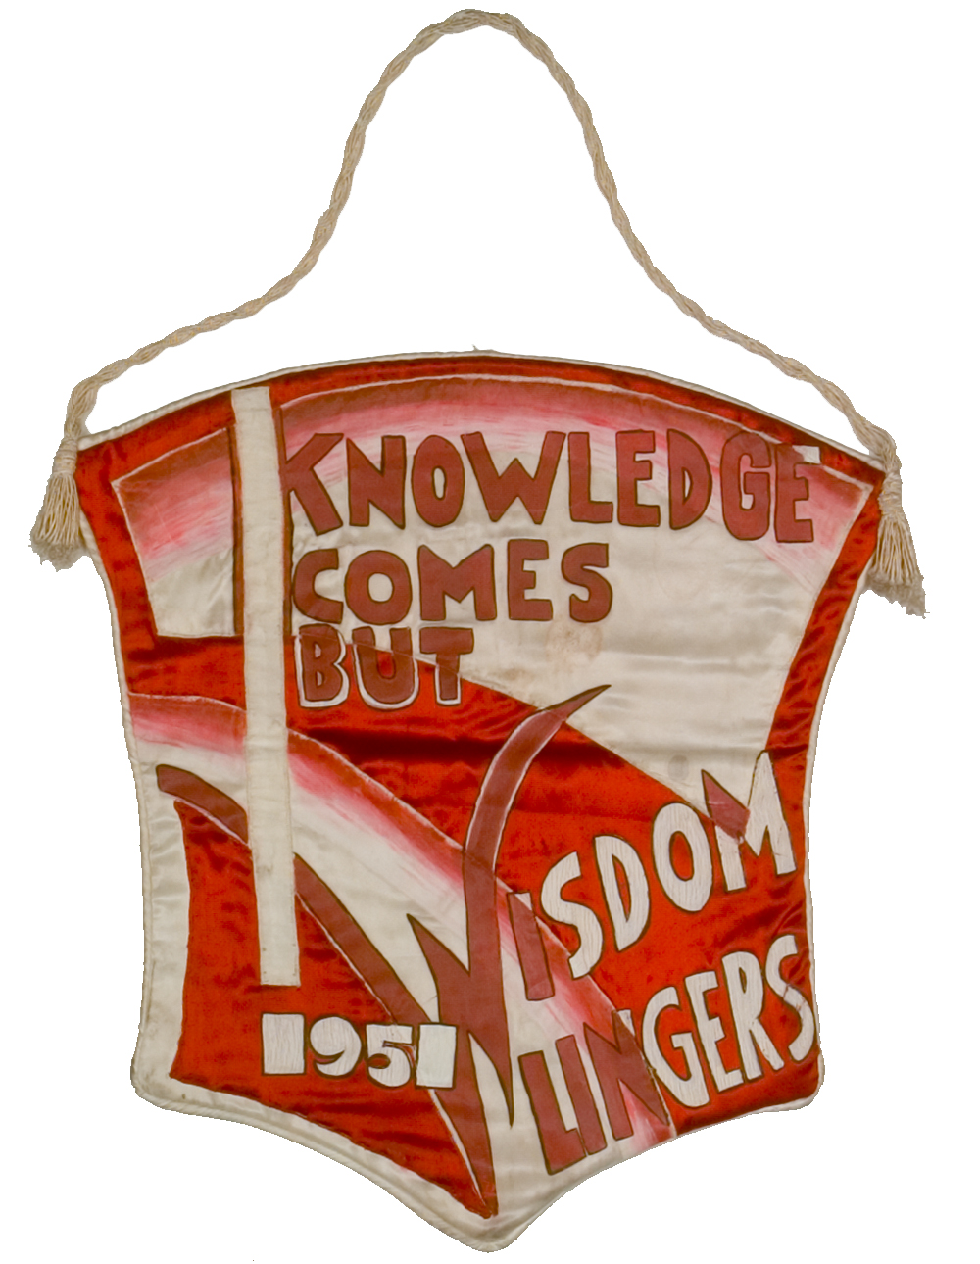
Why are Special Collections and University Archives (SCUA) “Special?”
Special Collections and University Archives (SCUA) is home to some of the most historically significant treasures at the University
Collections include rare books, manuscripts, record groups, scrapbooks, clothing and other items that are of value and importance to the study of material culture, history, literature, etc.
These collections of distinction are a unique part of the school’s identity
Material is used for research, teaching, exhibits, presentations, and school events

Slide 26

Development in SCUA: How is it Different and How is it the Same?
Code of Ethics for Special Collections Librarians
Development and Donor Relations
Special collections practitioners who interact with donors have a dual imperative: to develop and maintain responsible relationships with donors, and to ensure responsible custody of materials and financial gifts by balancing donors’ interests with institutional goals, priorities, and capacities.

Slide 27
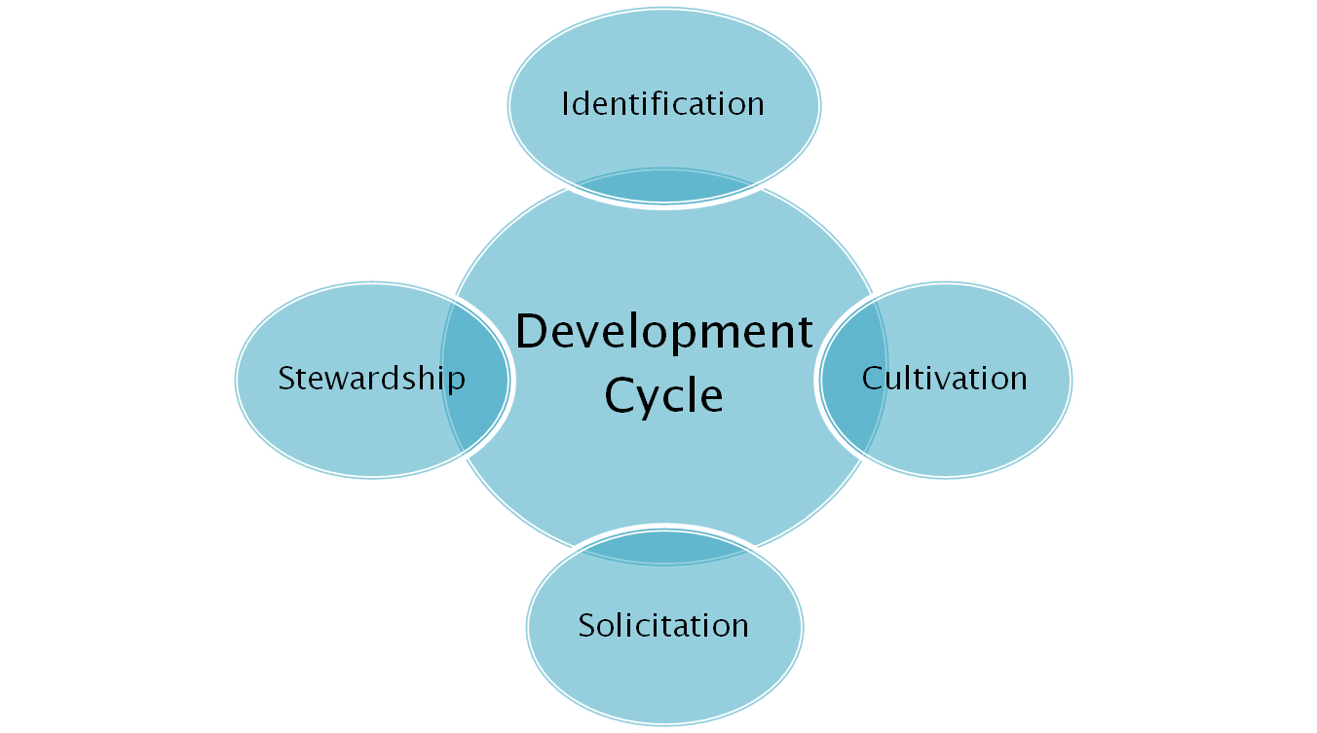



Development SCUA: How is it Different and How is it the Same?
We identify them
Continual
Stewardship
Financial
Asks
Collection
Asks
Notes:
Linda

Slide 28
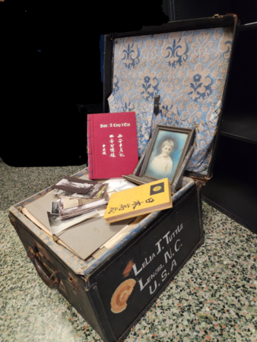
Why Do People Give to SCUA?
Their family has no interest in their material
They want a safe space for their collection with long-term preservation assurance
They want to ensure that their collections become a part of the community’s collective memory
They feel that providing research access to the contents of their collection is important
They want to financially support their collection, a “pet project,” or the department
They would like immediate or future tax deductions

Slide 29
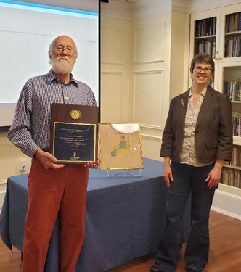
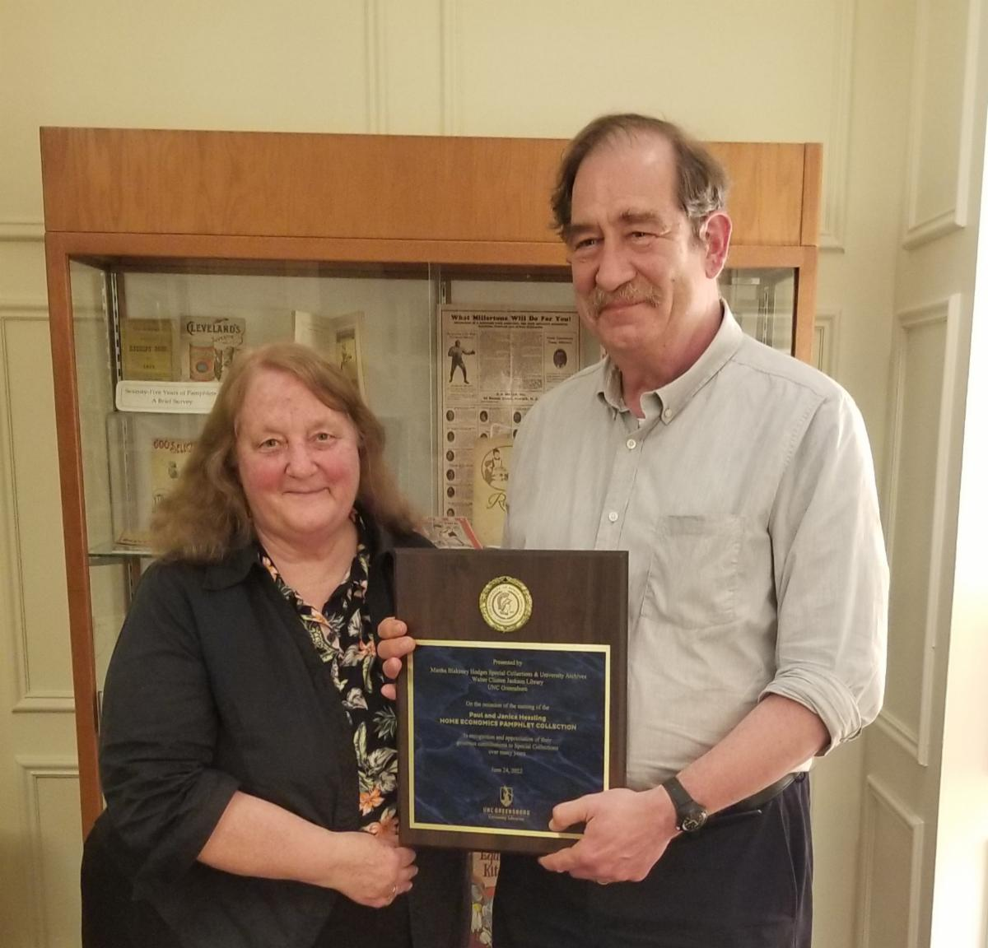
How SCUA Staff Participates in Development
Build good will (and recognition) on campus and in the community
Act as "walking ambassadors" for the Collections, the Library, and the University
Generate a "buzz" through presentations, projects, events, articles, exhibits, etc.
Create opportunities for endowments, bequests, and gifts in kind
Develop interest in collection and space naming opportunities
Encourage patron endorsement of projects

Slide 30
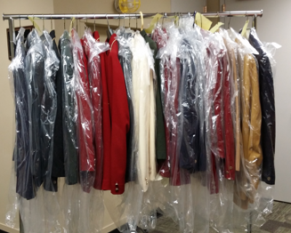
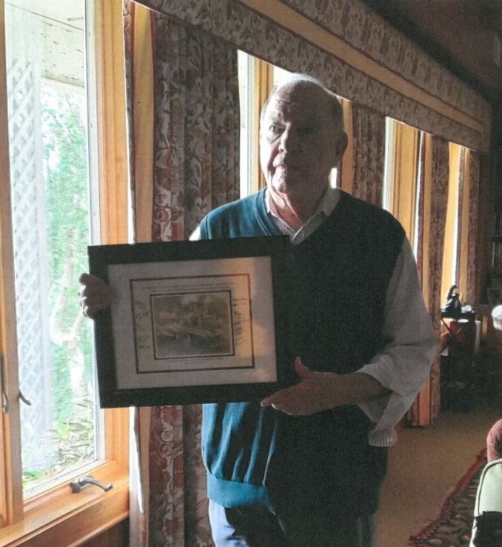
SCUA: Working Together with Advancement
The efforts of advancement and SCUA can overlap – mostly successfully, sometimes not!
“Unexpected” gifts in kind
Collaborative stewardship
Interesting collections provide natural outreach opportunities
Assist advancement in “making connections”
Help with “gift packets” for donors
Walk through the donation process with patron's and SCUA/Library/University's needs and goals in mind

Slide 31
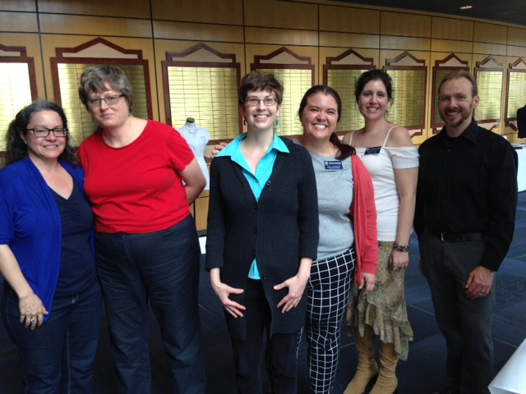
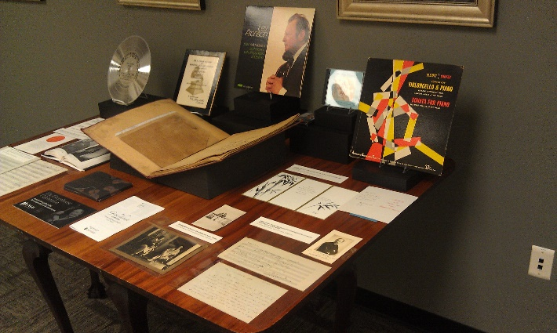
SCUA Staff Developing and Maintaing Community Partnerships
The power of the “elevator speech”
Take every opportunity to put in a good word about SCUA, University Libraries, and UNCG
Be passionate about SCUA’s collections
Know what we need and what we don’t
Provide a sympathetic ear and be willing to steward donors for years!
Actively build relationships

Slide 32
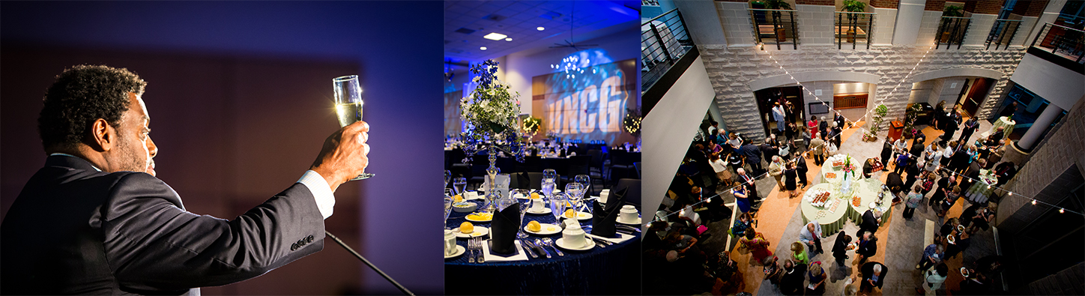
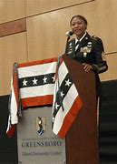
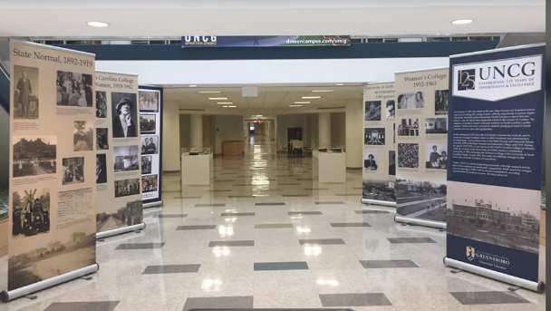
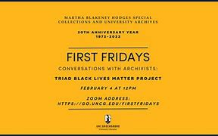
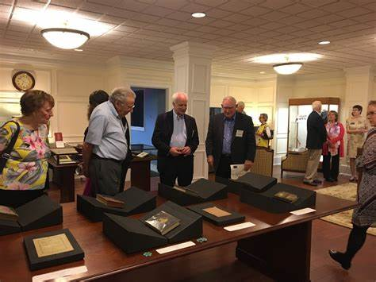
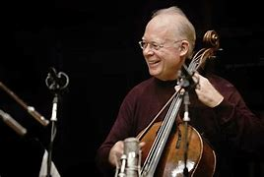
The Importance of Events

Slide 33
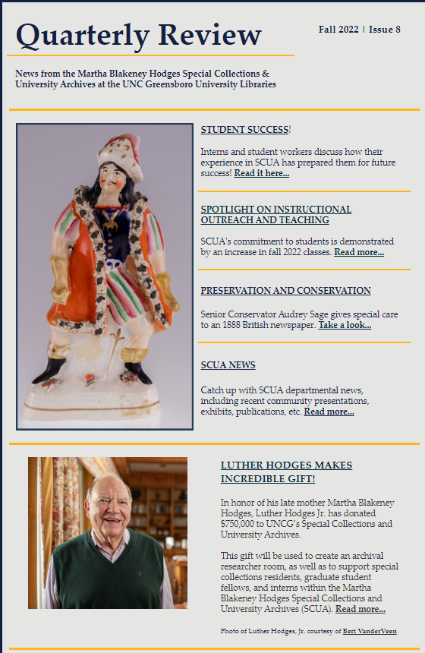
The Benefits of a Newsletter!
Provides information about collections and events
Creates excitement about giving to a successful repository (great collections lead to other great collections and financial support)
Recognition for donations and gifts
Contextualizes how donated collections are used – teaching, research, exhibits, etc.

Slide 34
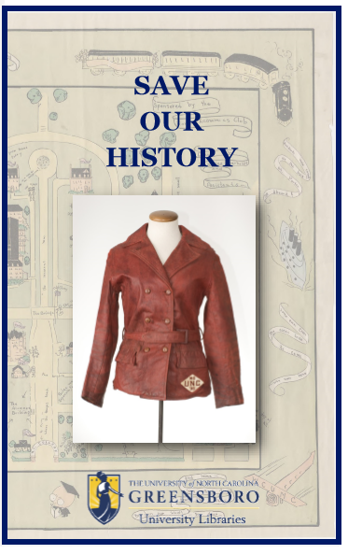
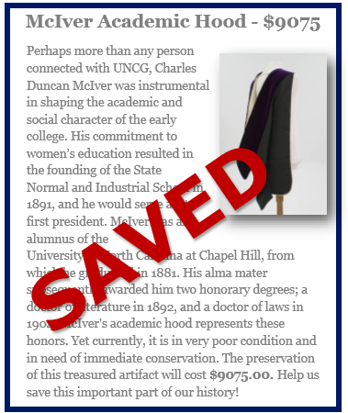
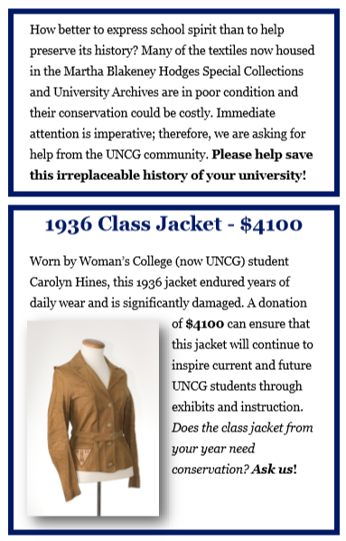
Cultivating Interest in Targeted Fundraising

Slide 35
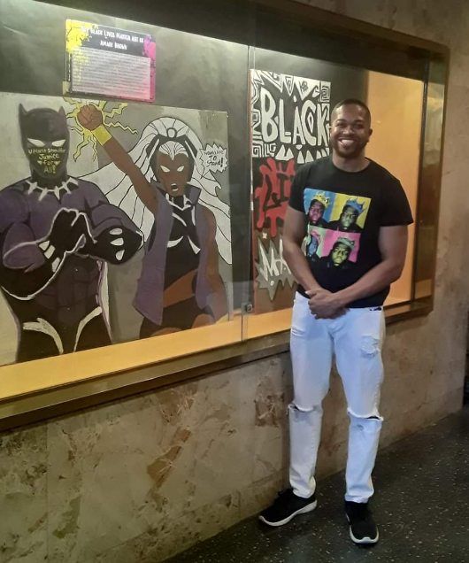
SCUA: Why Are They So Important to Library Advancement Efforts?
We could be your “secret weapon”
  Building community relationships and making connections
  Capturing the interest of donors through collections
  Holding fundraising events for SCUA, Library, or University with special displays (with displays)
  Creating Alumni Packets
  Providing Collection Naming Opportunities, Endowments, and Bequests

Slide 36
Contextualizing Development For Your Staff
Importance of fundraising roles and advancement/development in the library
Responsibilities of fundraising professionals to the library and larger institution
Identifying opportunities within the development cycle in which staff can participate and/or support
Recognize and provide guidance on the variety and diversity of philanthropic opportunities within the libraries
What makes the libraries a good choice for giving?

Slide 37

Professional Development Organizations
ALADN
Academic Library Advancement and Development Network
CASE
Council for Advancement in Support of Education
AFP
Association of Fundraising Professionals

Slide 38
Association of Fundraising Professionals
AFP exists
To foster the development and growth of fundraising professionals and the profession
To promote high ethical behavior in the fundraising profession and to preserve and enhance philanthropy and volunteerism
Members of AFP want to improve the quality of life through the causes they serve. They serve the ideal of philanthropy, are committed to the preservation and enhancement of volunteerism; and hold stewardship of these concepts as the overriding direction of their professional life.
They recognize their responsibility to ensure that needed resources are vigorously and ethically sought and that the intent of the donor is honestly fulfilled.
Donor Bill of Rights
Code of Ethics
Notes:
Linda Many of you may not know the extent of professional fundraising. The Code of Ethics was created in the late 1960’s go govern our work with donors. Example: AFP members cannot accept % based salaries. Must sign document indicating we subscribe to the code of ethics.

Slide 39
Educating Your Staff What Fundraisers/Development Officers Do?
Know the accepted practices of fundraising.
Help to make the case for giving.
Identify, cultivate and involve donors and volunteers.
Work with volunteer leaders and staff to cultivate donors.
Steward gifts
Notes:
Linda

Slide 40
Major Steps in Development Cycle

Slide 41

How can you help?
Be aware of people who may express an interest in being more involved or who may have access to collections.
Refer interested people or companies to Mike, Kathelene or Nakia for follow-up.
Keep us abreast of developments that may be of interest to prospects, donors, foundations.
Help make the case for giving.
Notes:
Mike You don’t have to say we are in such bad shape, we really need money, etc. You could however, express how proud you are to be a part of this Library experience, what it means to you and how you envision the future with help from donors.

Slide 42
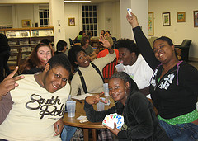
University Libraries
“When you ask men and women for a gift to strengthen and expand the work of your organization, you are inviting them into a new spiritual communion. The donor and the asker are at an intersection of hope and joy where great things happen for noble causes.”
- Jerald Panas

Slide 43
Readings
Brown, Walter A., and Barbara A. Gonzalez. "Academic Libraries: Should Strategic Planning Be Renewed?" Technical Services Quarterly 24.3 (2007): 1-14.
Crumpton, Michael . “Cultivating an Organizational Effort for Development." The Bottom Line: Managing Library Finances 18.1 (2005): 40-42.
Foley, Chris . "Thoughts on Endowment Fundraising for Libraries." The Bottom Line: Managing Library Finances 29.2 (2016): 97-113.
Huang, Samuel T. "Where There's a Will, There's a Way: Fundraising for the Academic Library." The Bottom Line: Managing Library Finances 19.3 (1981): 146-151.
Swan, James. Fundraising for Libraries. New York, NY: Neal-Schuman Publishers, 2002.

