Slide 1
Donor Engagement with Facebook and Social Media
Lipi Turner-Rahman
Washington State University

Slide 2

Washington State University
Land Grant-R1
Pullman, WA
Phenomenal Alumni Base

Slide 3
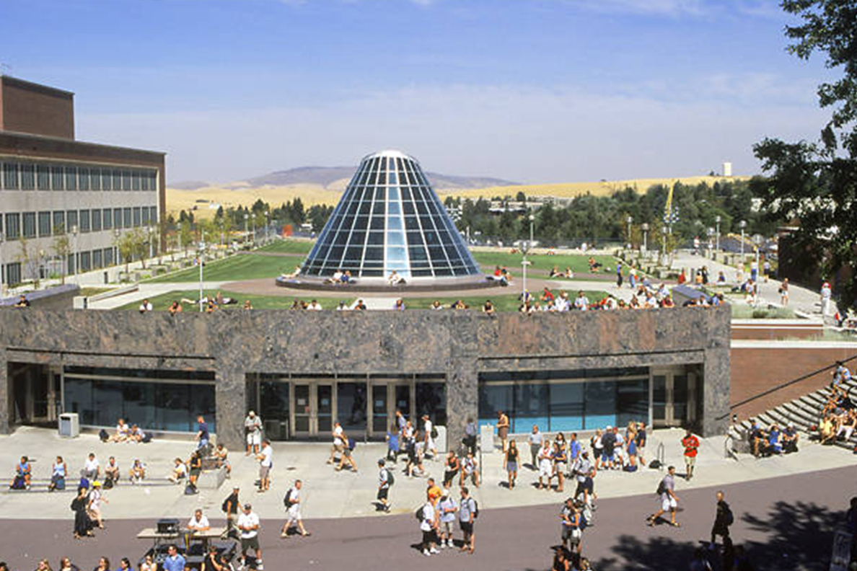
WSU Libraries
“We love the Libraries”
No natural constituents
Fixed idea about the library
Aging donor base
Tell our story, engage and start new donor pipeline
Media Engagement- Twitter, Facebook, Instagram, and YouTube

Slide 4
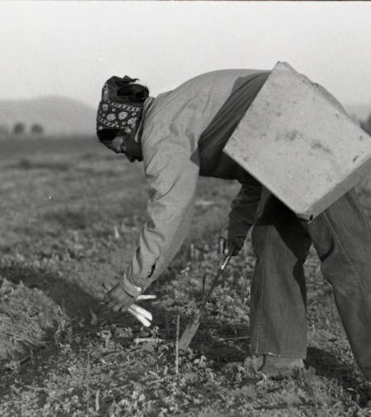

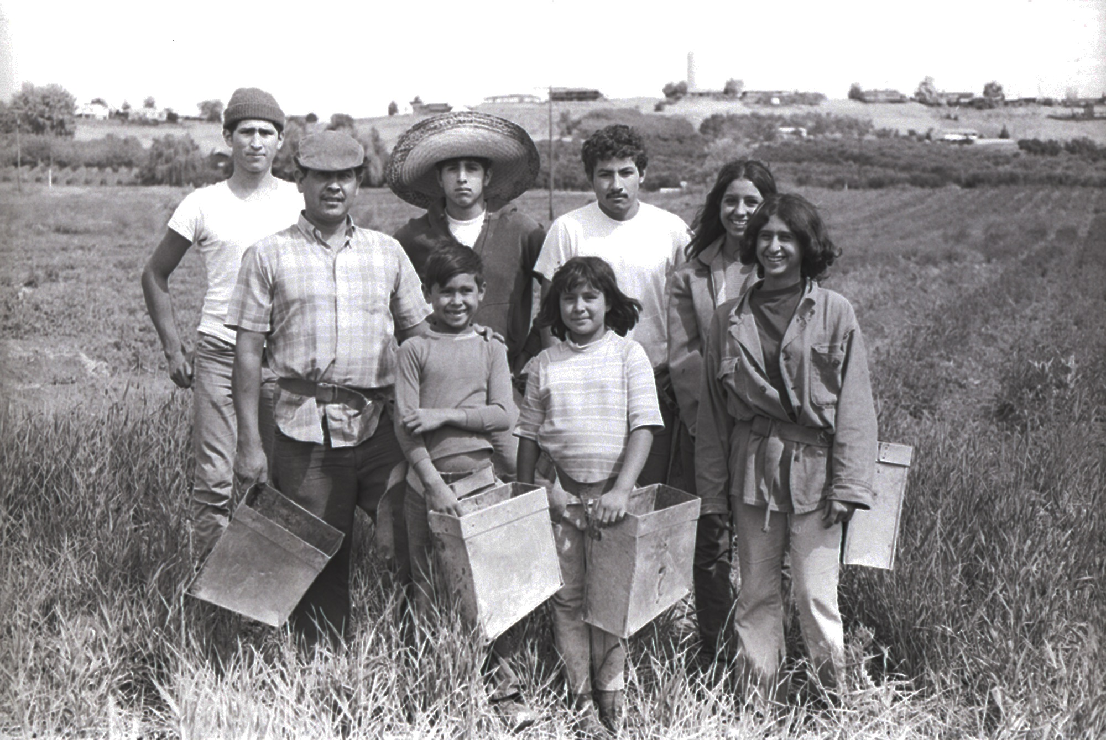
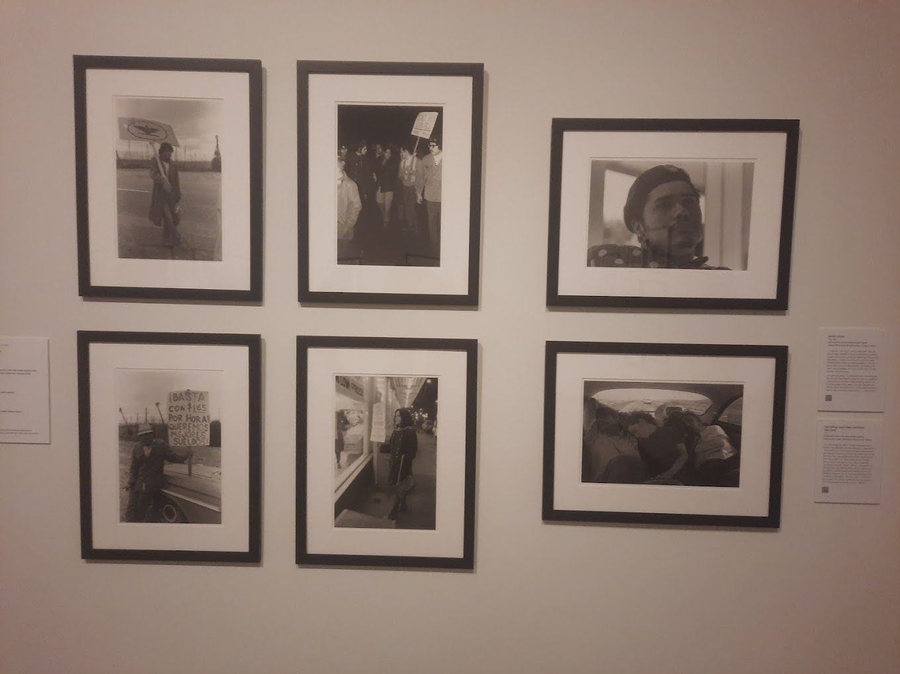
Nash Collection
Digitization- opening new lines of fundraising
Crowdsourcing Facebook
Community
Library Lecture
Jordan Schnitzer Museum of Art WSU
Travelling exhabit

Slide 5
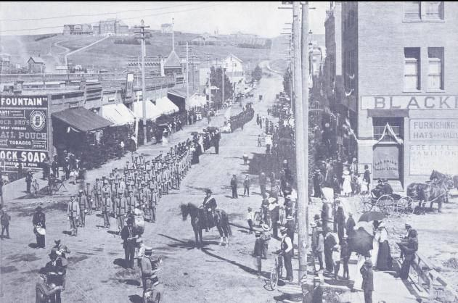
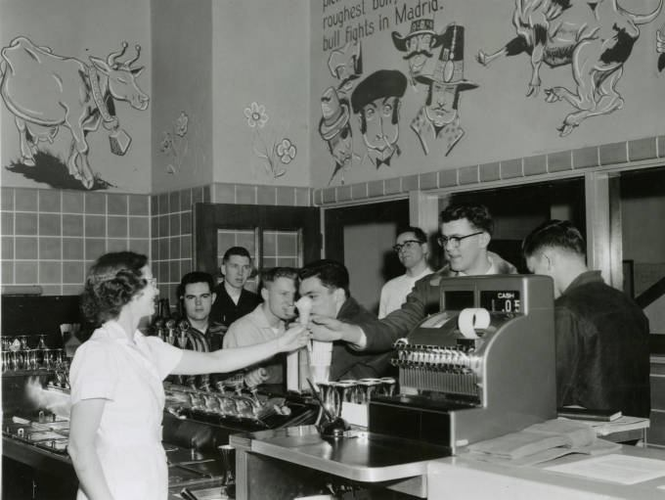
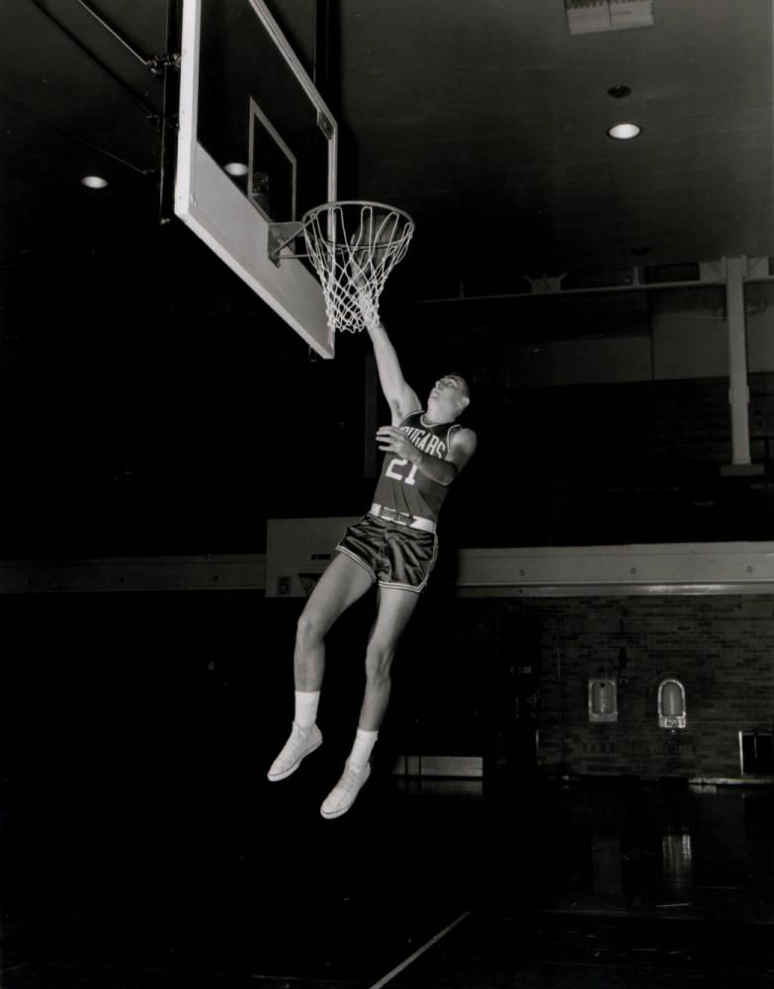
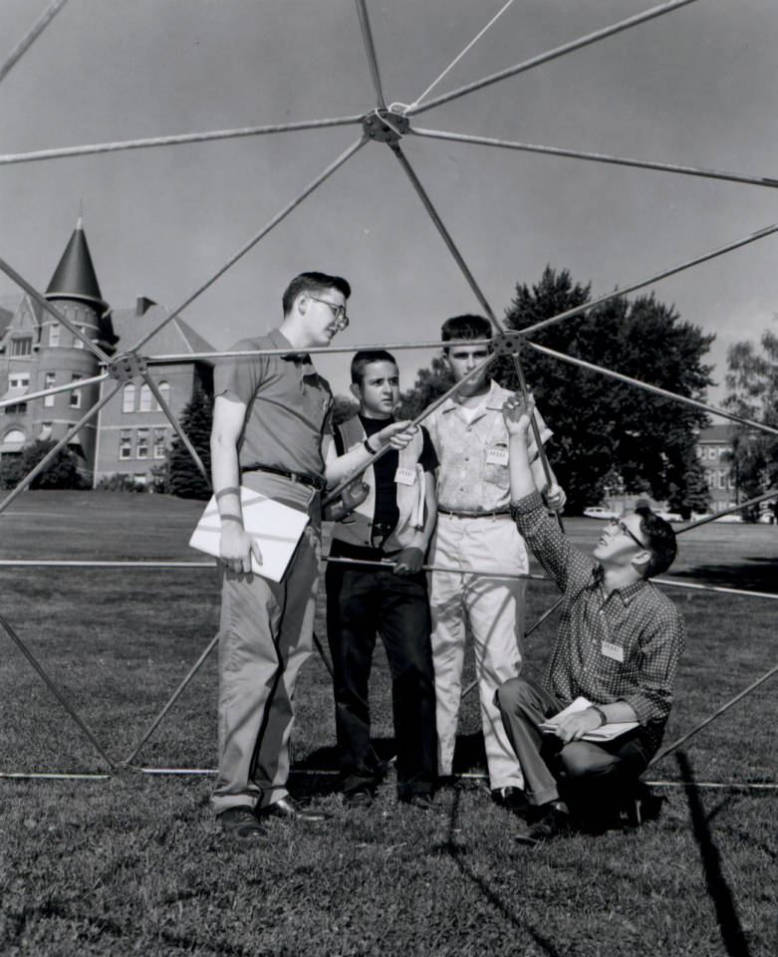
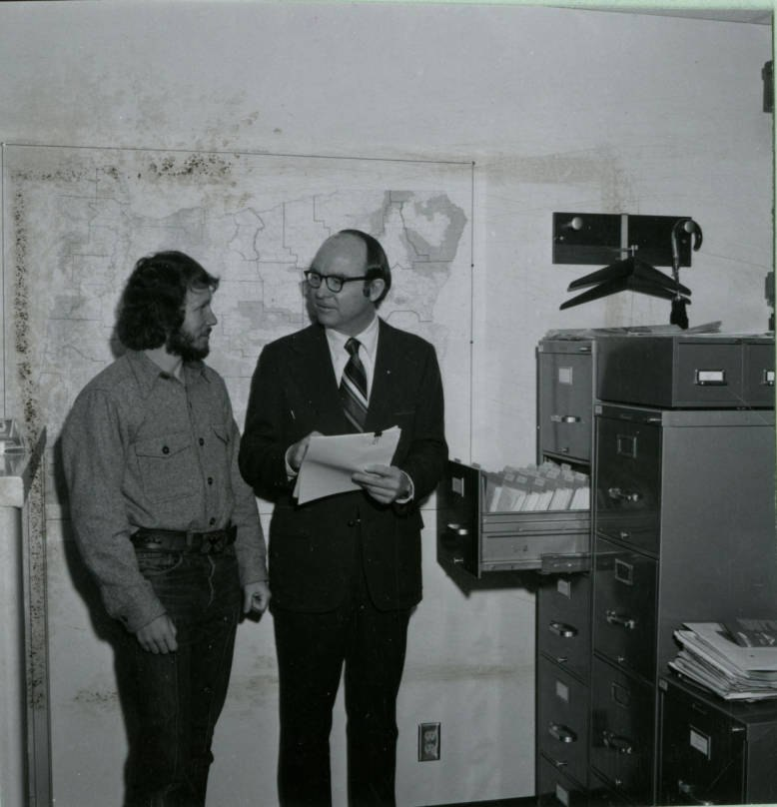
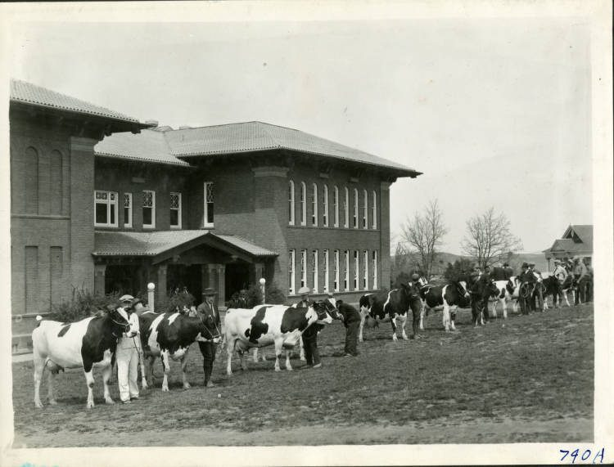
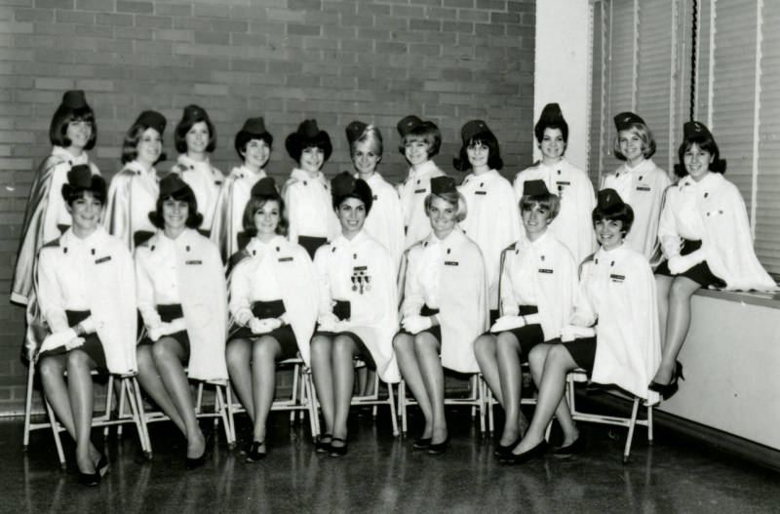
WSU Historic Photos
Nostalgia

Slide 6
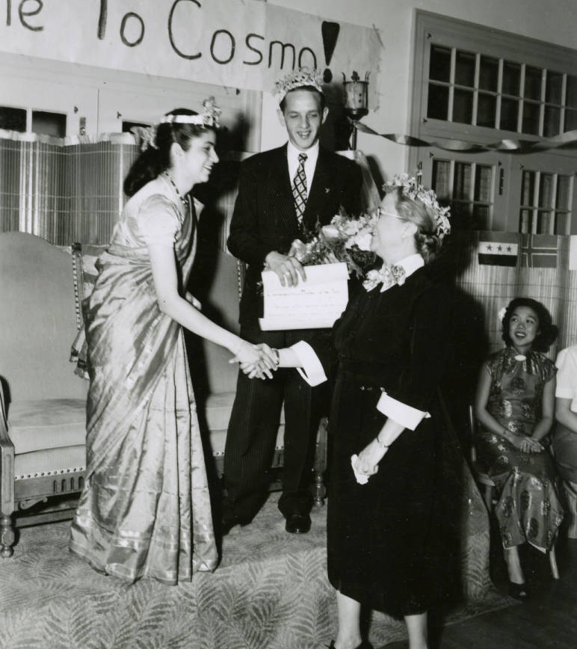
Issues to Think About
Site owner
Administrators
Facebook group questions/ emails
Frequency of posts
Moderating
Privacy/ Confidentiality
Culturally sensitive narratives
Time

Slide 7


Generational divides
Professional help
Interns- skills
Mix of stories- tell our story and theirs- balance
Concerns and expectations
Donor lists- expansion
Facebook, Instagram, Twitter and TikTok
Is it worth it?
https://mailchi.mp/1f09e63d07f7/may-2023-browse-news-notes-from-the-wsu-libraries?fbclid=IwAR0qrP-Zeik8p9j9-sjokvDHORw8FPuCMYs_JrKgu_wDWW4koL7zIuB5JlI
https://www.tiktok.com/@wsulibraries/video/7213157121637109035
https://www.tiktok.com/@wsulibraries/video/7203522378289188138
https://www.tiktok.com/@wsulibraries/video/7221072521666497838

