Slide 1
The Essential
Tracy Elliott,
Florida Gulf Coat University
Pre-Conference Presentation June 18, 2023

Slide 2
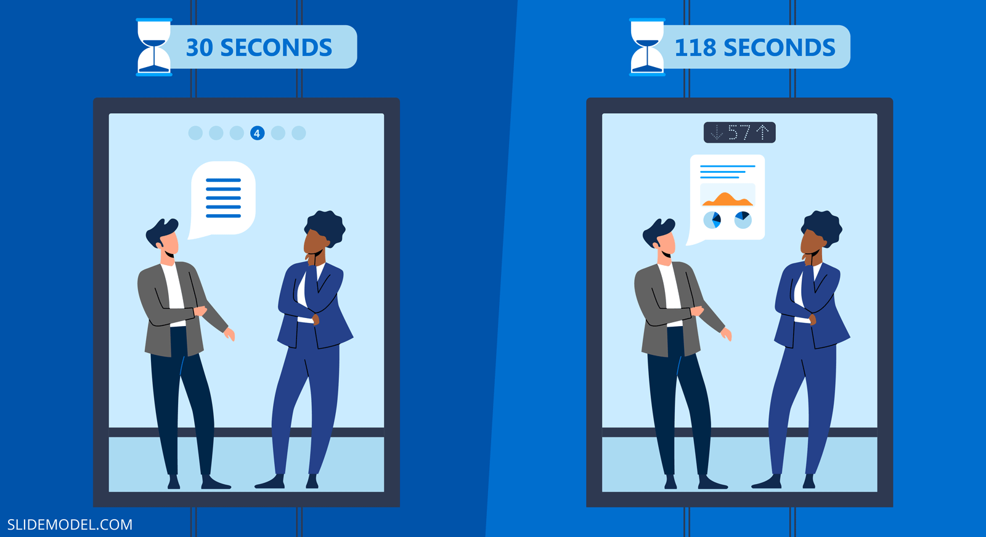
Tracy Elliott, FGCU : ALADN Pre Conference 2023

Slide 3
Elements of an Elevator Pitch
1
4
Introduction
Plan/Solutions
2
5
Experience/Successes
WHY US?
3
6
Goals/Problem
CALL TO ACTION
Tracy Elliott, FGCU : ALADN Pre Conference 2023
PROJECT REPORT

Slide 4
Tracy Elliott, FGCU : ALADN Pre Conference 2023

Slide 5
Establish the problem, with a hook
The problem is what will resonate most with your audience, so it’s the best way to start off your elevator pitch. You can simply state the problem, or you can make things more interesting with a hook.
When was the last time you…
Picture this:
Have you ever noticed…
You know how…
Is it me or…
You know that feeling when…
Ever wished you could…
Let’s be real here:
Did you know that….
Tracy Elliott, FGCU : ALADN Pre Conference 2023

Slide 6
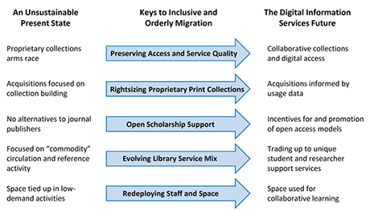
Graphic from: The Education Advisory Board (EAB) 2011 report sent to member Presidents and Provosts
Tracy Elliott, FGCU : ALADN Pre Conference 2023

Slide 7
Introduce the Solution
Once the problem has been established, you can then introduce the library as the solution, the hero.
Be specific about how you solve the problem.
Mention features here rather than benefits. – How will this solution improve people’s lives?
Tracy Elliott, FGCU : ALADN Pre Conference 2023

Slide 8
State the Benefit
So your audience now knows that you can solve their problem and take away their pain point, but you need to also talk about how this benefits them.
Why is the elimination of this pain point important? What do they stand to gain by solving this problem? This is essentially your value proposition. What is the ROI?
Tracy Elliott, FGCU : ALADN Pre Conference 2023

Slide 9
Differentiate the Library
So the audience now knows what you do, how you do it, and what’s in it for them, but why should they choose you over other departments/colleges on campus?
How can they be sure that they’ll get this benefit? This is where you include things like your unique selling proposition, social proof, trust signals, or anecdotes.
[Solution] is the only [category] that [unique feature].
For over [x years], we’ve helped over [X target personas] [achieve benefit].
Backed by/recommended by [known/influential/trusted institution or person].
Tracy Elliott, FGCU : ALADN Pre Conference 2023

Slide 10
Close with a CTA or Question
Finish off with some sort of action item. This is typically a classic call to action—like register, call, download, sign up—with a reinforcement of the benefit.
Sign up now so you can experience {feature or benefit} for yourself.
Give me a call so we can plan your [ideal outcome].
Let’s get together for lunch and library tour on … to discuss your ideas.
Tracy Elliott, FGCU : ALADN Pre Conference 2023

