Slide 1
All Aboard!
Making the Case for Creating a
Development Ambassador Group at Your Library
Tywanda L. Cuffy, Director of External Relations, Communications and Development Initiatives
Nicole M. Hernandez, External Relations Coordinator

Slide 2
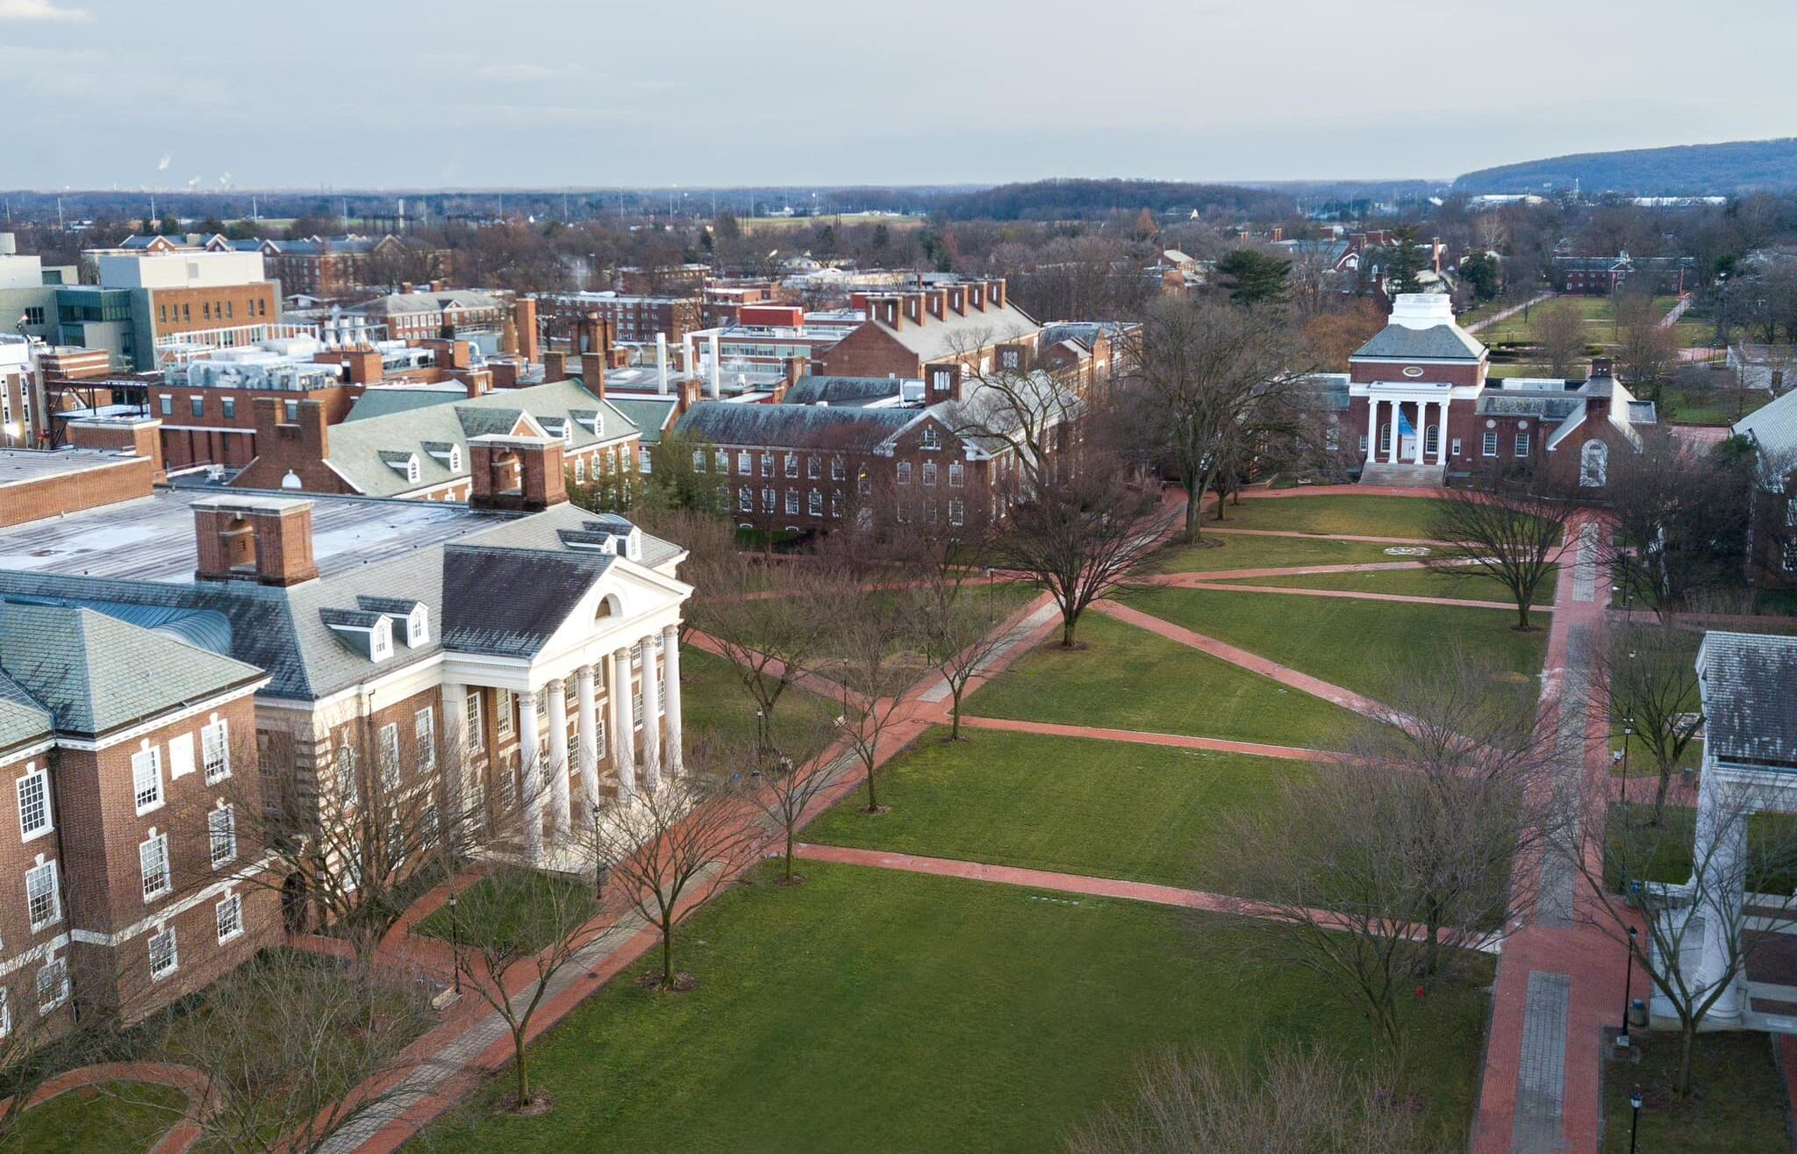
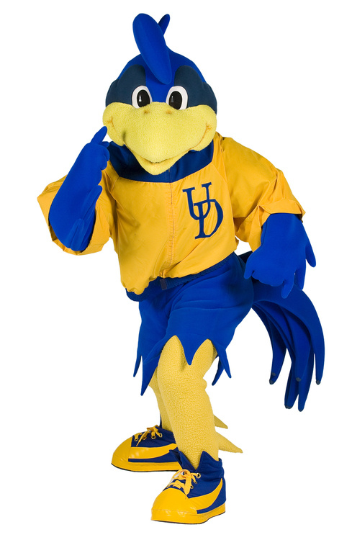
University of Delaware
Roots trace back to 1743
Land-grant, Sea-grant and Space-grant Public Institution
R1, 80 research centers
21 NCAA D1 Teams
10 colleges/schools; 150+ majors and minors; 250+ graduate/post-baccalaureate programs
23,613 total enrollment; 4,746 employees; 200,000+ Alumni around the world
First U.S. institution to study abroad in 1923
And there’s Joe

Slide 3
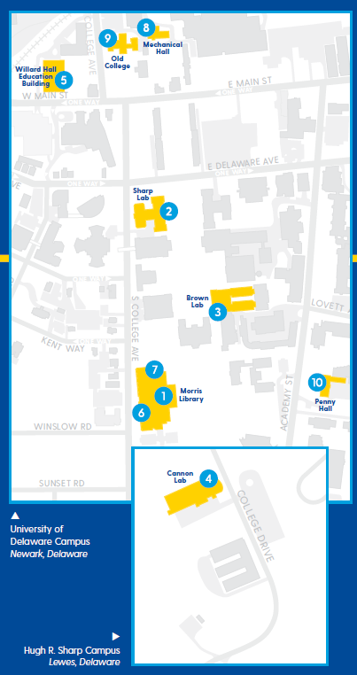
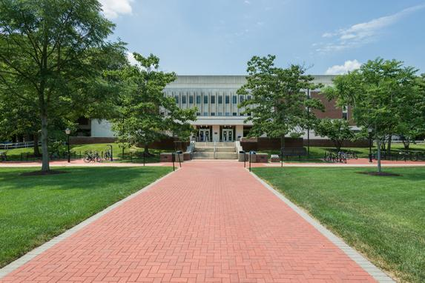
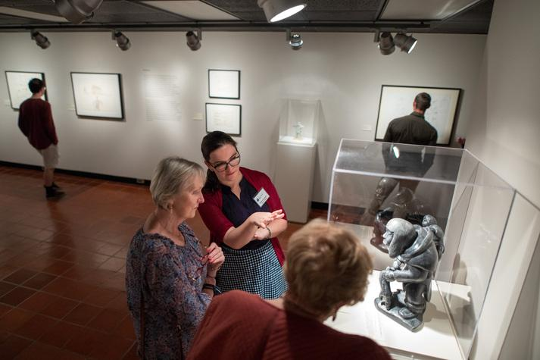
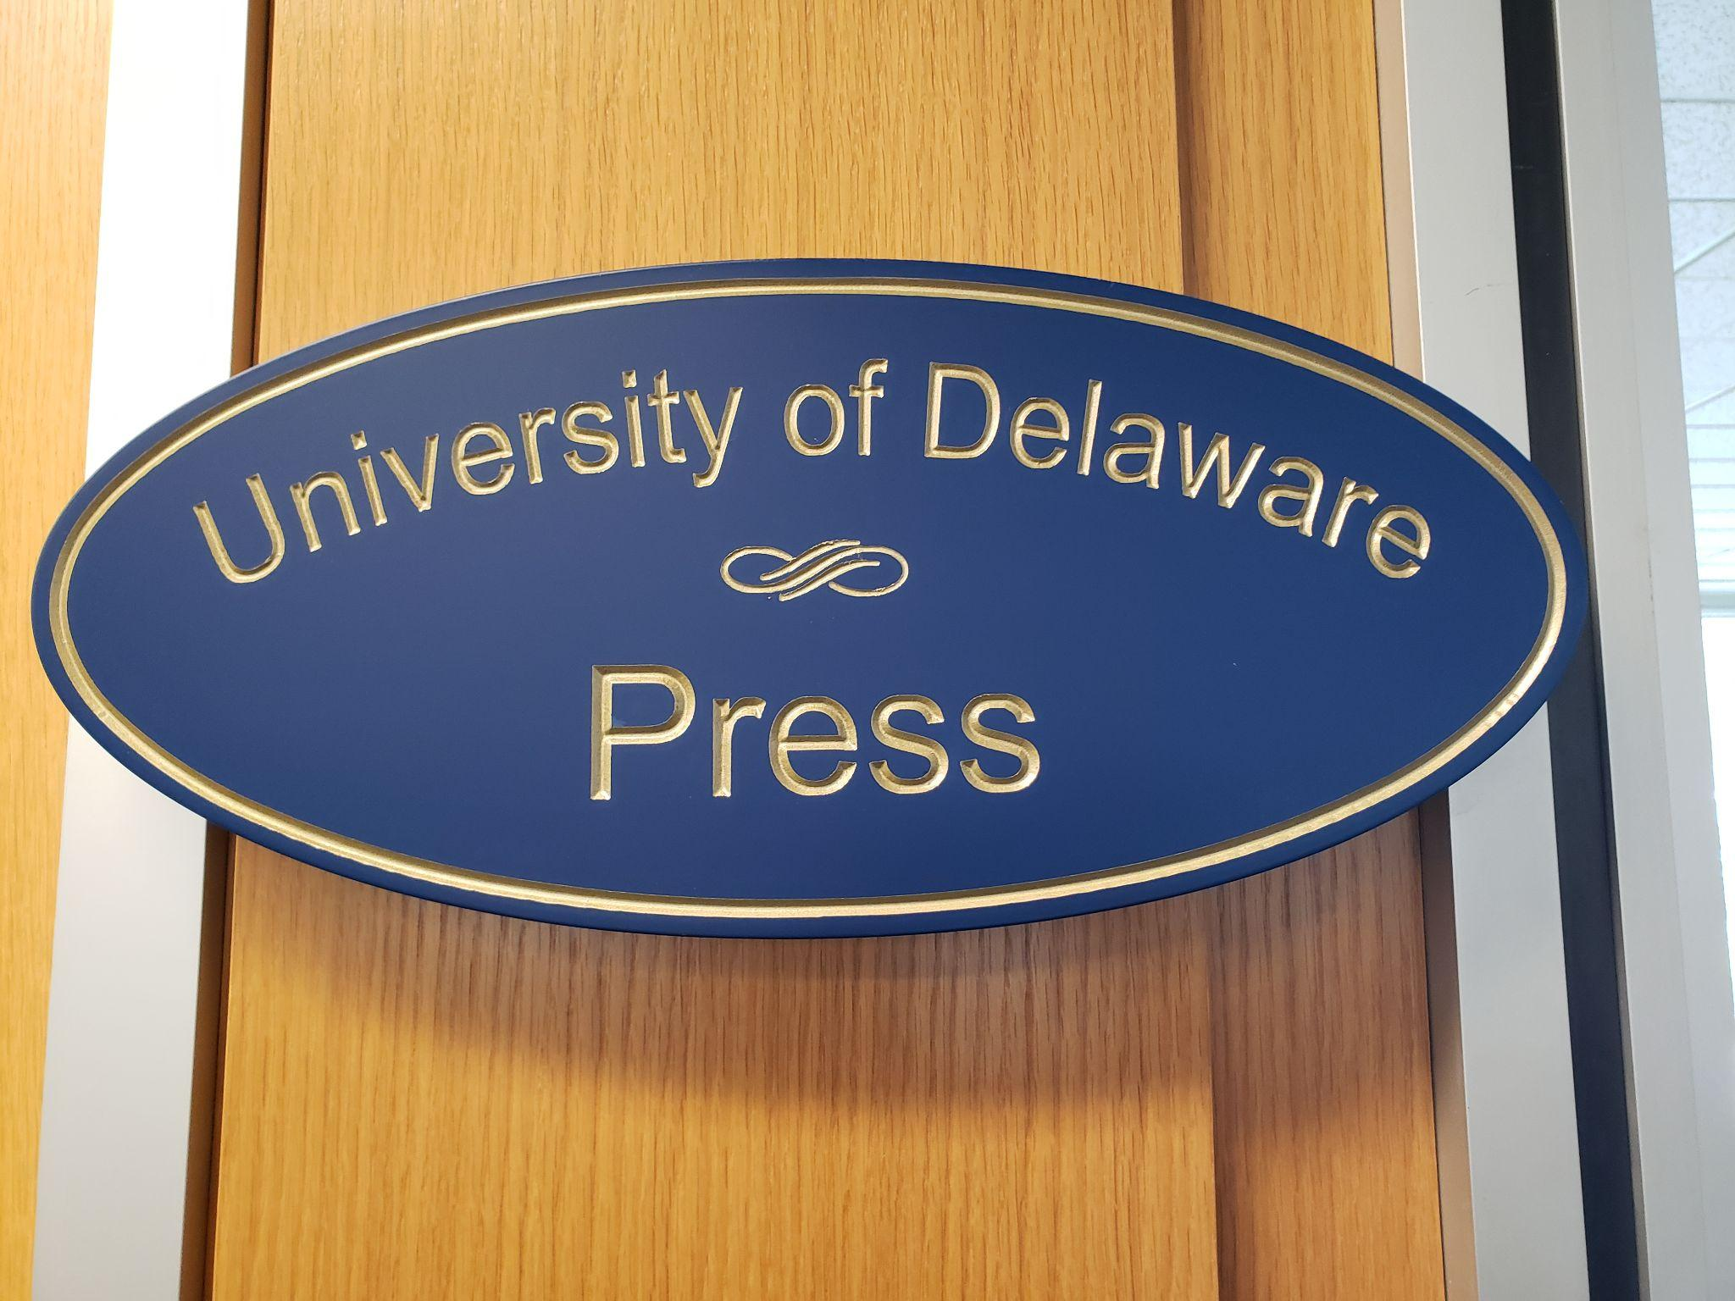
UD Library, Museums and Press
One flagship library
Four branch libraries - chemistry, physics, marine science and education resource center.
Four Special Collections and Museums Gallery Spaces
One University Press
124 Full-Time Staff; 121 Student Staff

Slide 4
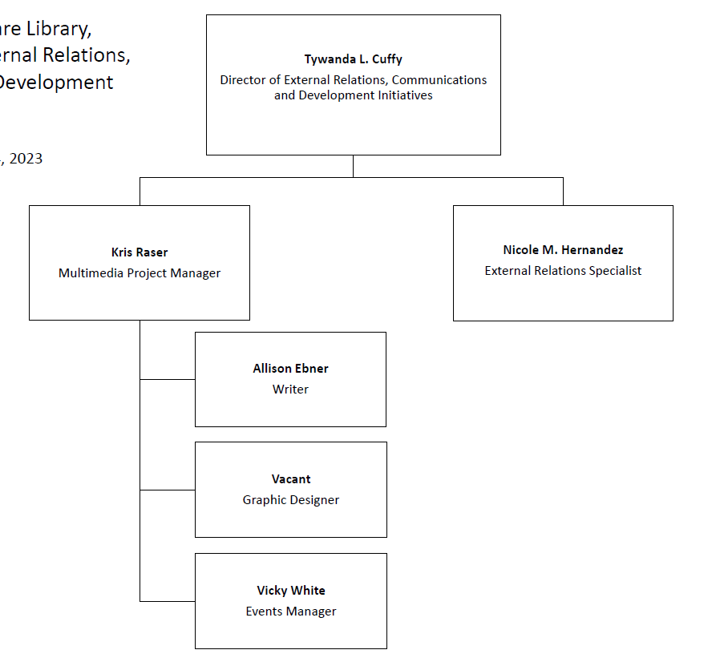
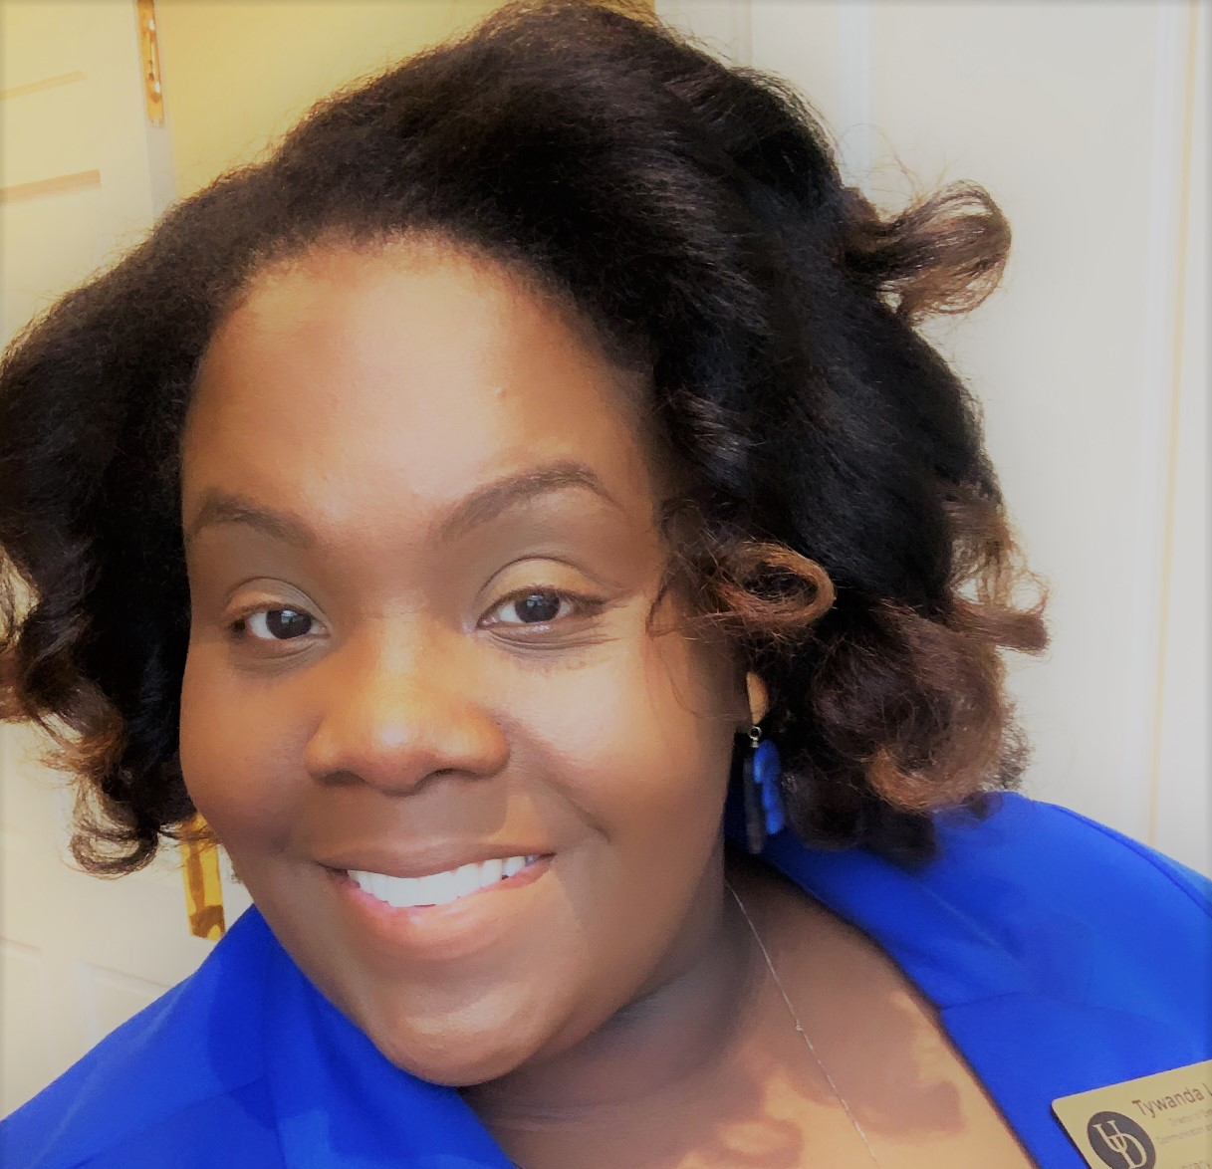
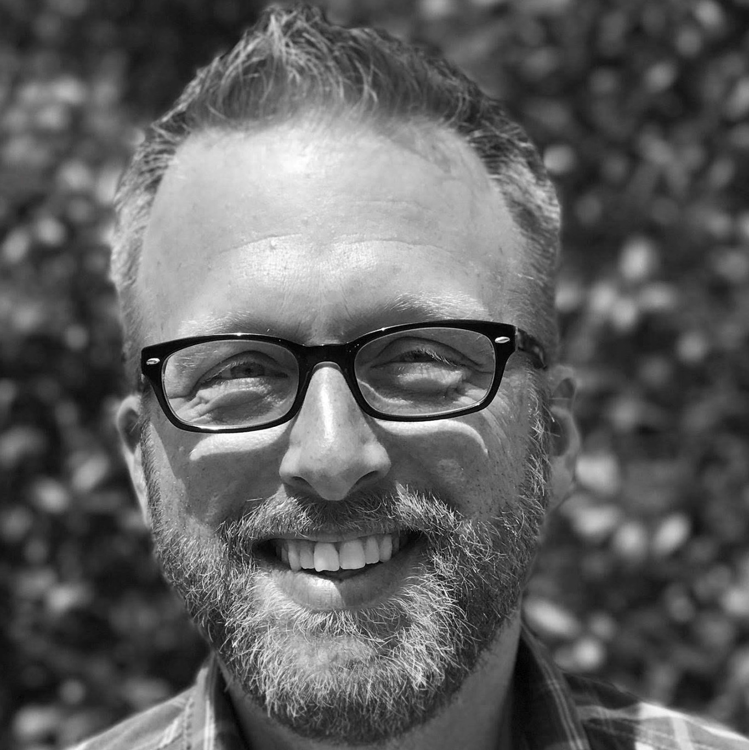
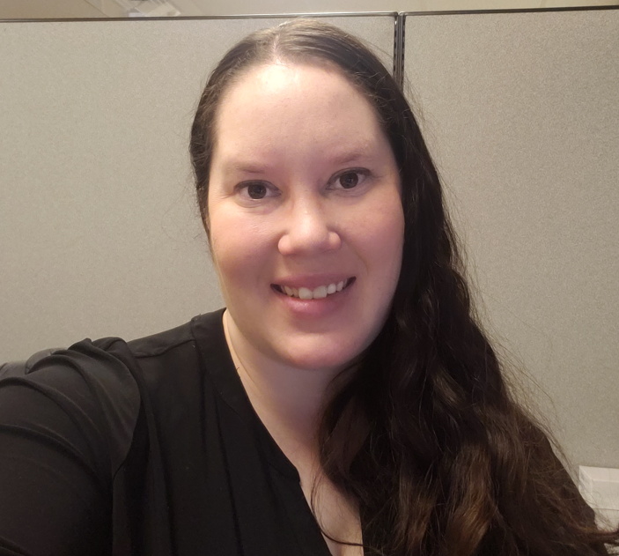
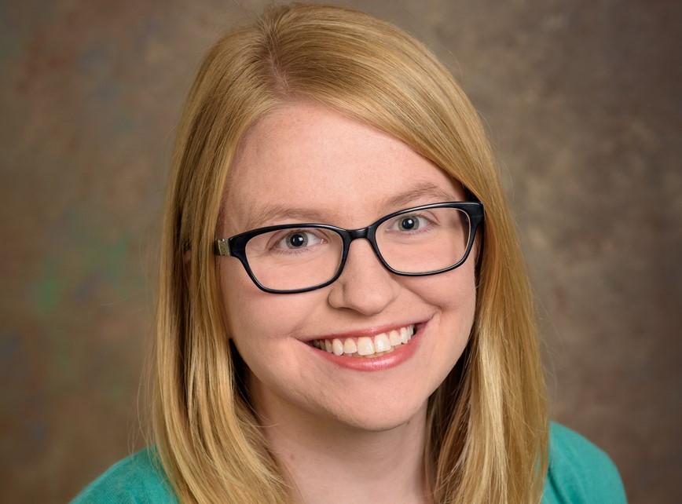
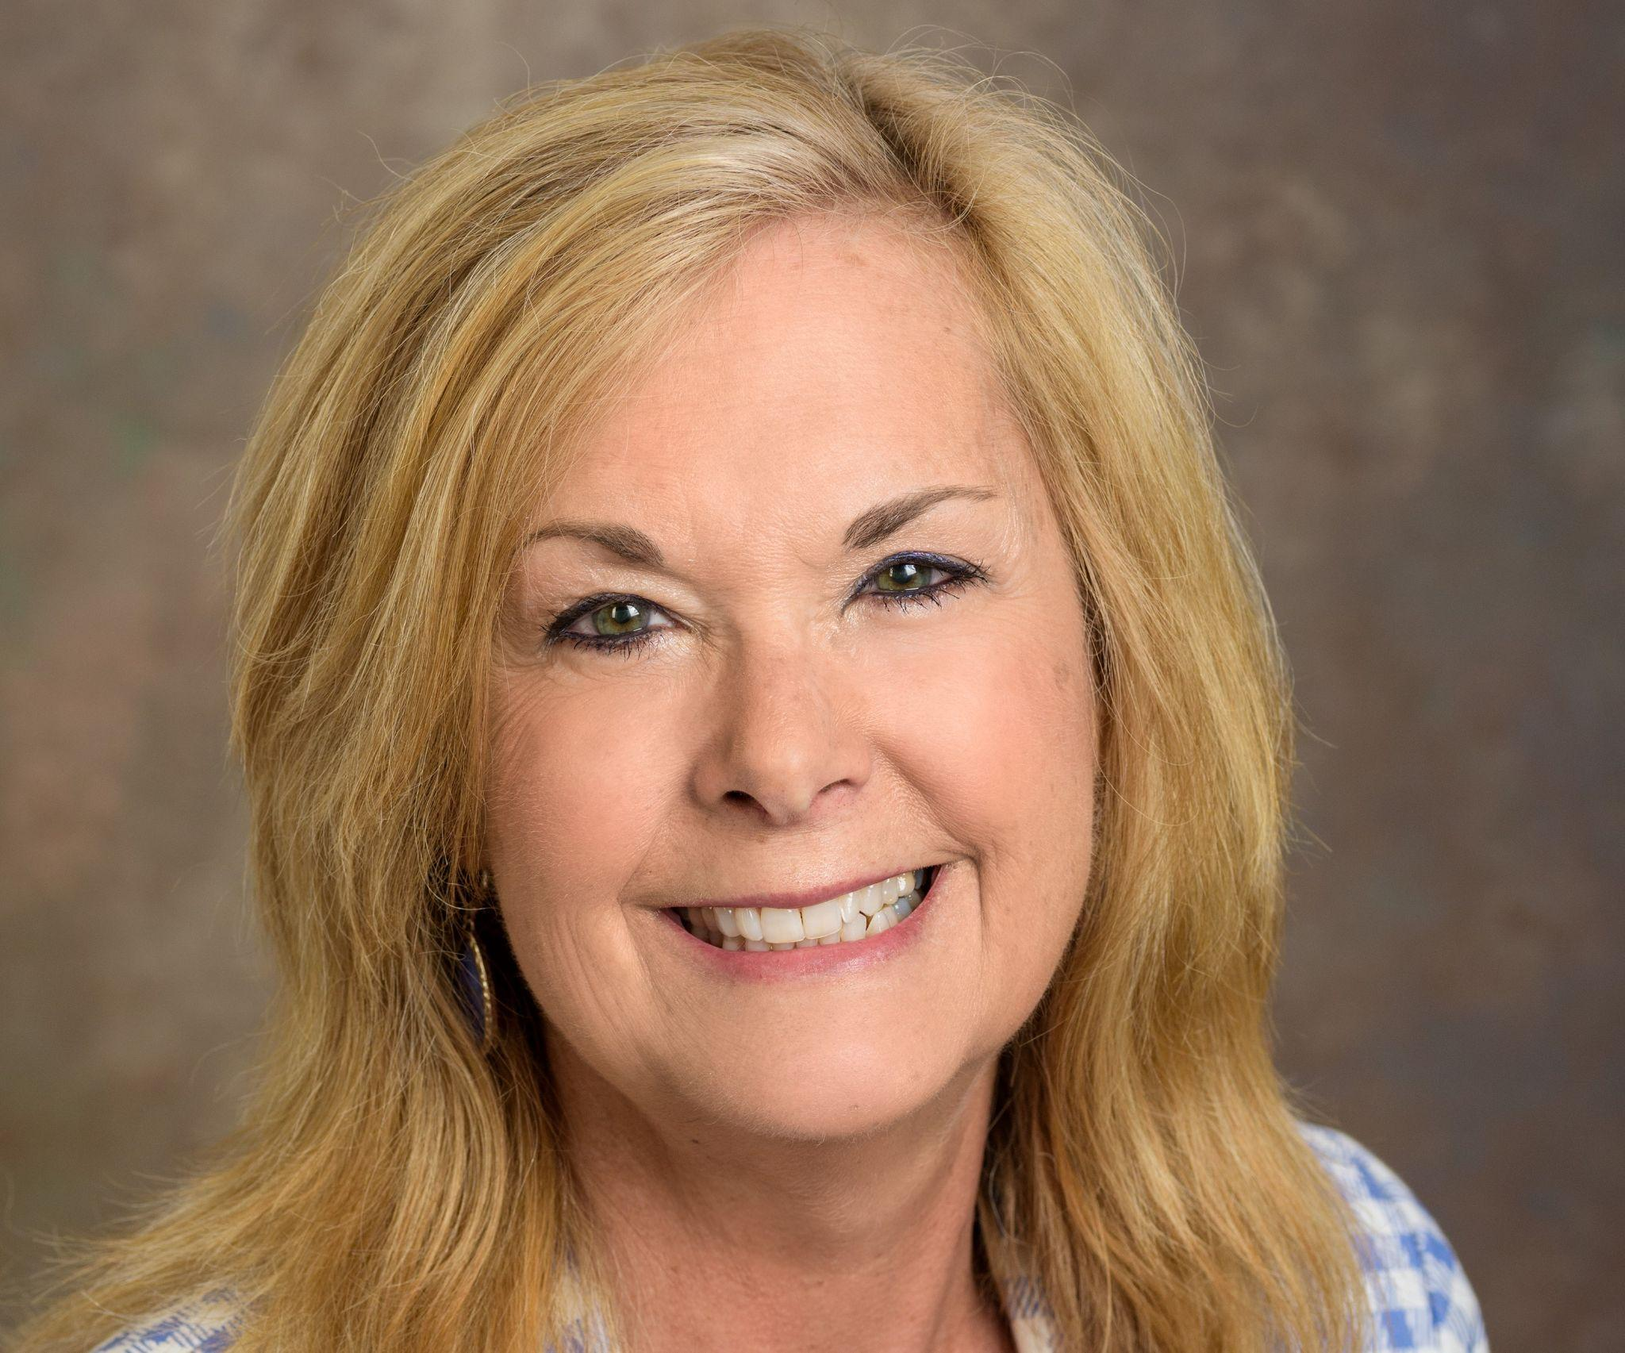
External Relations, Communications and Development Initiatives Team

Slide 5
Collaboration with
the Office of Development and Alumni Relations
Donor
Relations
Team
Gift Processing
Team
Senior Director of Development
Communications Team
Annual
Giving
Team

Slide 6
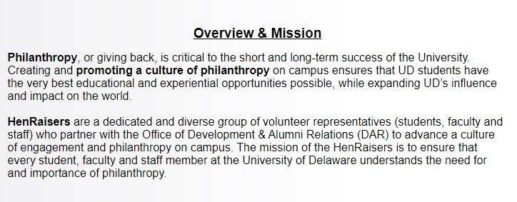
Inspiration for Creating a
Development Ambassadors Group
In 2019, Office of Development and Alumni Relations launched a short-lived University-wide HenRaisers Program (Campus Philanthropy Representatives).
Recognized apparent gap in understanding and appreciation from UD Library, Museums and Press staff for development, donor relations, alumni engagement, stewardship and fundraising efforts.
Decided to recreate HenRaisers Program within our UD Library, Museums and Press in 2019, also.

Slide 7
Creating the Library Development Ambassadors
Purpose was to strengthen the culture of engagement and philanthropy among Library, Museums and Press staff.
Identified a core group of staff members for the role and vetted their names with Vice Provost and their direct supervisors/managers.
Sent emails inviting staff members to serve, then scheduled a first meeting.

Slide 8
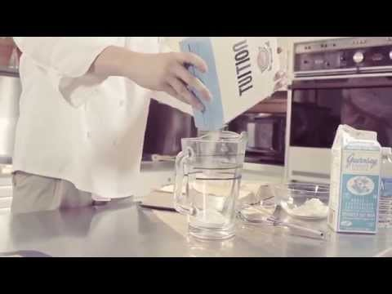
Planning for and Executing First Meeting
Solicited questions from the prospective Library Development Ambassadors about Development prior to the meeting.
Prepared a presentation on Philanthropy at the University.
Topics included: Where Support Comes From, Breakdown of the Development Office, Fundraising Campaign, Donor Relations, Fundraising Priorities, Reasons to Give
Met on Oct. 29, 2019 with free food/drinks over lunch.
A funny thing happened at the meeting …

Slide 9
Focus on Grant Writing
The group took a deep interest in understanding how grants work, are
applied for and are awarded.
Identified a tangible project they could work on and created three subcommittees:
Creating Division-wide Grant writing Policies and Procedures
Developing a Learning and Development Training Series to Educate Staff
Addressing Systemic and Tactical Ways to Enhance Staff Culture around Grants
Brought in experts from the University’s Research Office and the Office of Development’s Corporation and Foundation Relations to glean expertise.
Notes:
Tywanda
How UD is funded.
Three subcommittees

Slide 10
Results of Efforts
COVID happened
Developed official Grant Writing Policies and Procedures for Division and vetted them throughout the organization for approval and awareness finalized in Summer 2021.
Created a robust LibGuide on website to house wealth of information.
Changed PI requirements.
Developed a seven-part workshop series on Grant Writing, launched in Winter 2021/Summer 2022.
Conducted one successful summer cohort, gearing up for another.

Slide 11
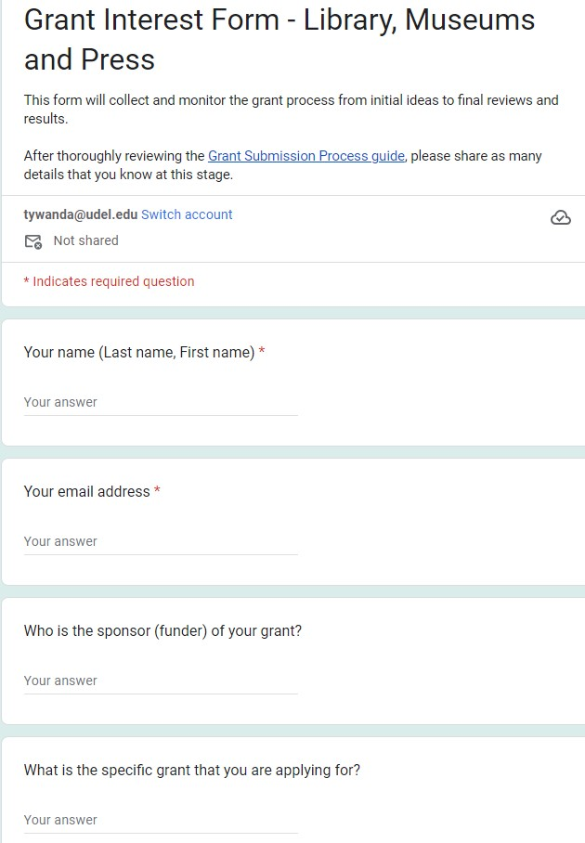
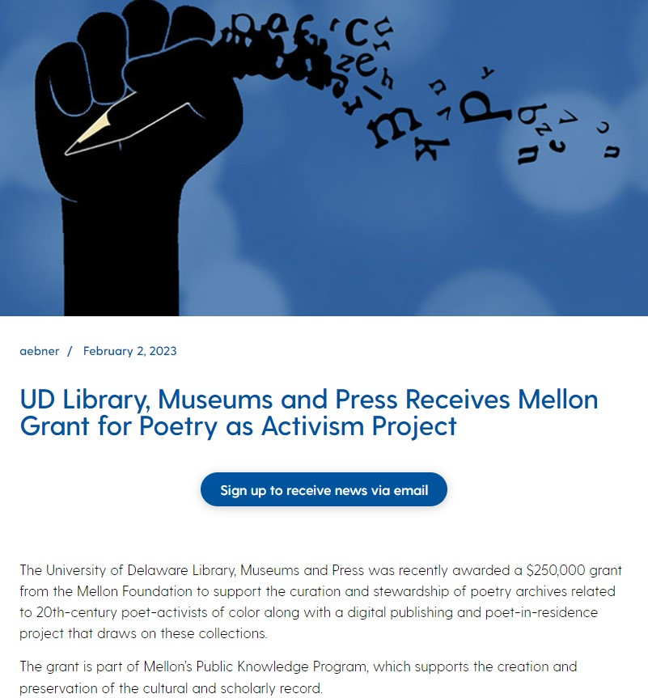
Results of Efforts (cont.)
Gathered historical documentation of all past grants applied for and/or awarded throughout the Library, Museums and Press.
Established a Grant Interest Form to keep record of future grants.
Began to highlight awarded grants on website, in staff newsletter and in UDaily.

Slide 12
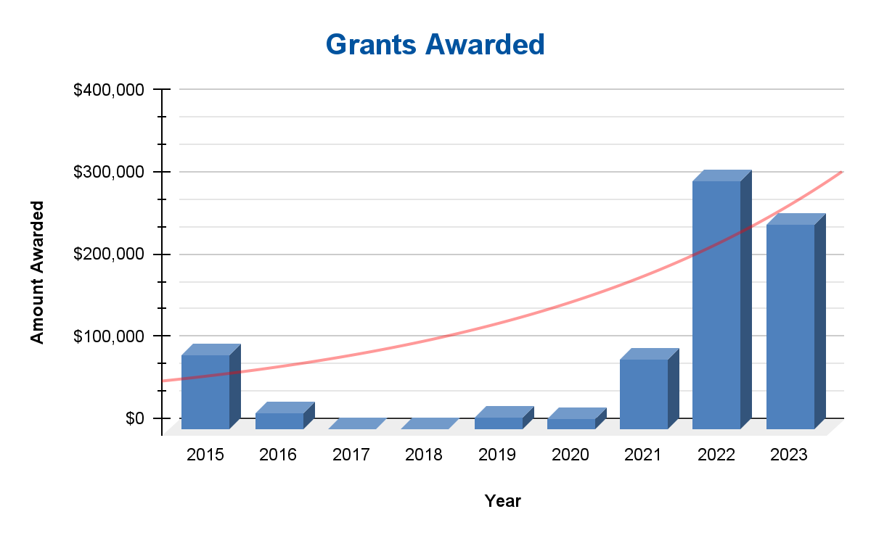
By the Numbers

Slide 13
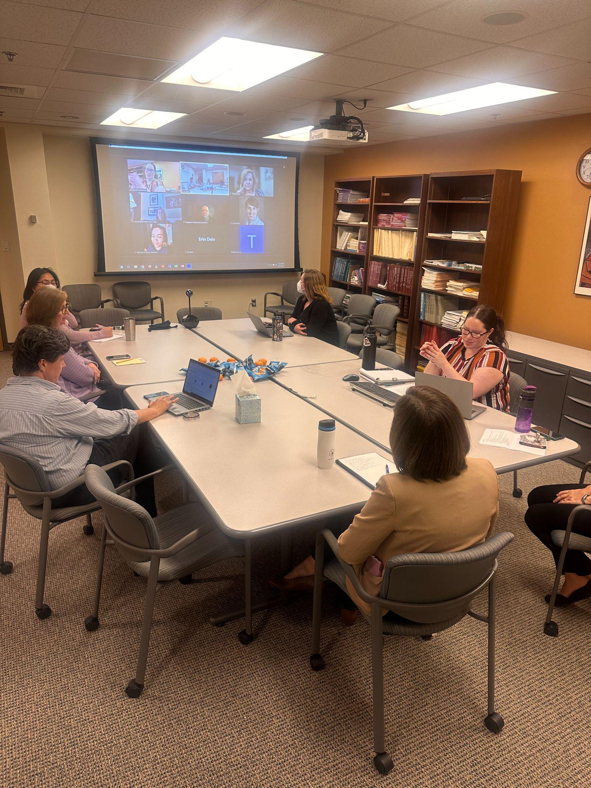
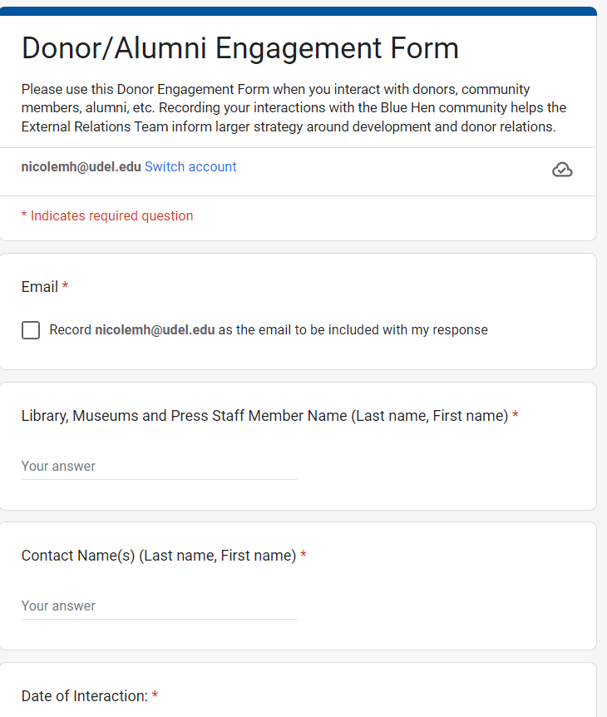
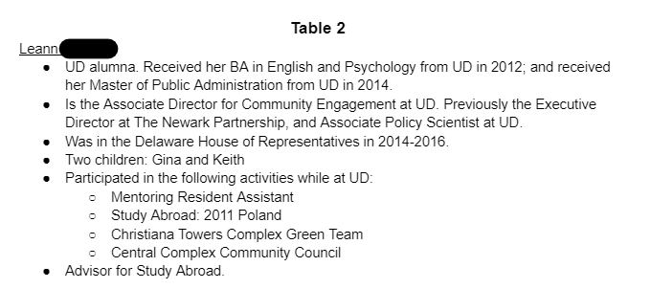
More than just Grant Work …
Developed an Art of Networking Lunch Workshop to prepare ambassadors to network with donors at donor events.
Created a Donor and Alumni Engagement Form for staff to inform Development Team of interactions with prospective and current donors for CRM database.

Slide 14
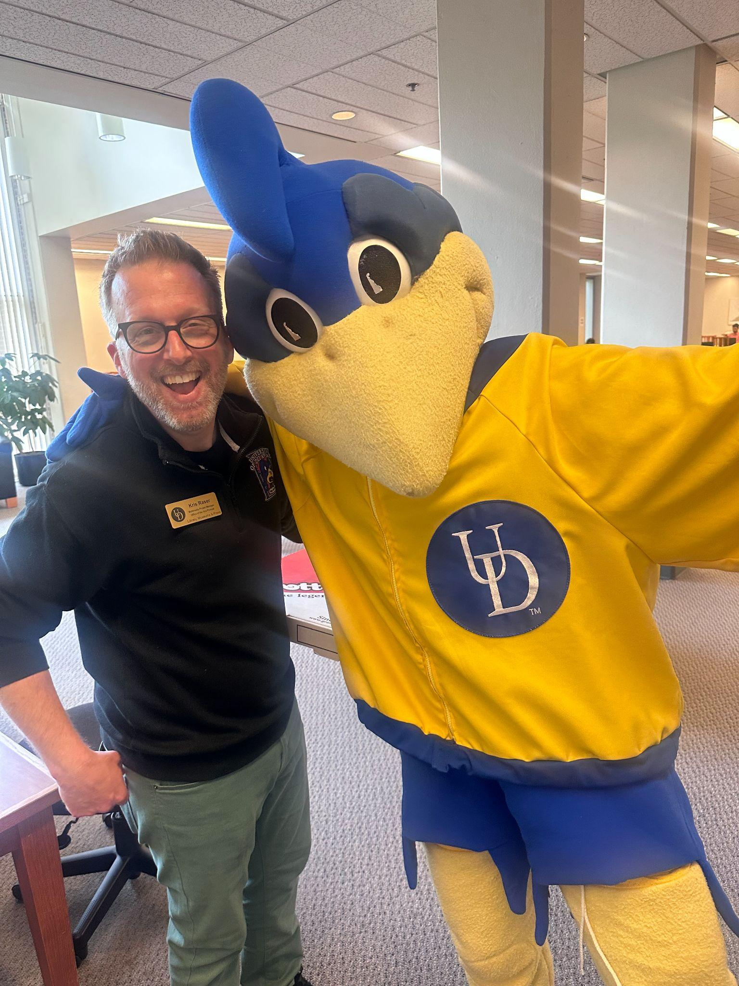
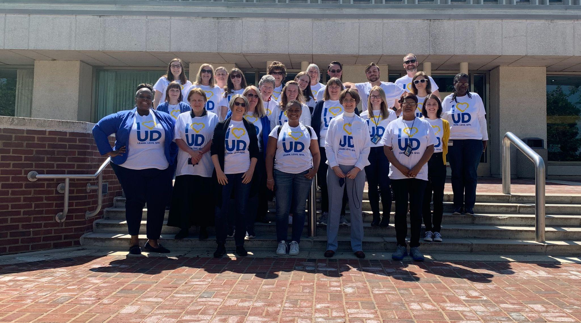
Impact of Ambassadors Across Library
Increase in curiosity and involvement in development work.
ie. Forwarding grant opportunities
Recognition of team as subject-matter experts for all things donor-related.
Emails and meeting invites brainstorming strategies for work and events.
Greater engagement and collaboration with crowdfunding initiatives.

Slide 15
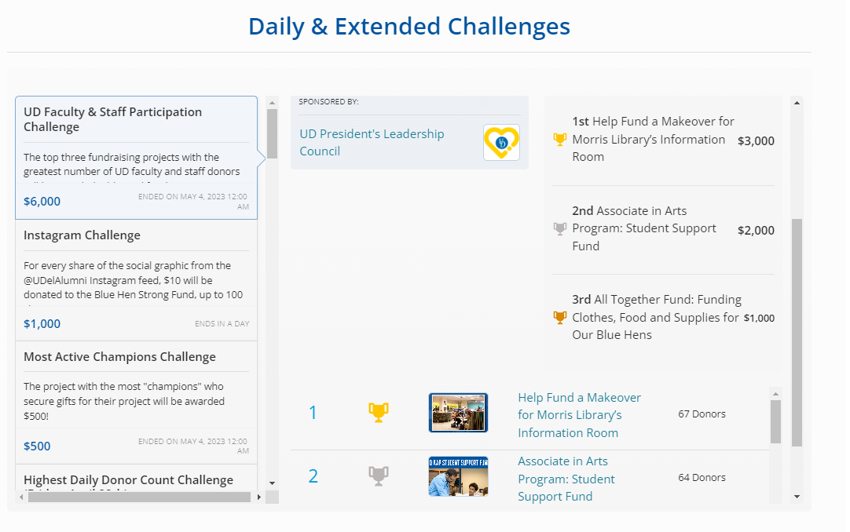
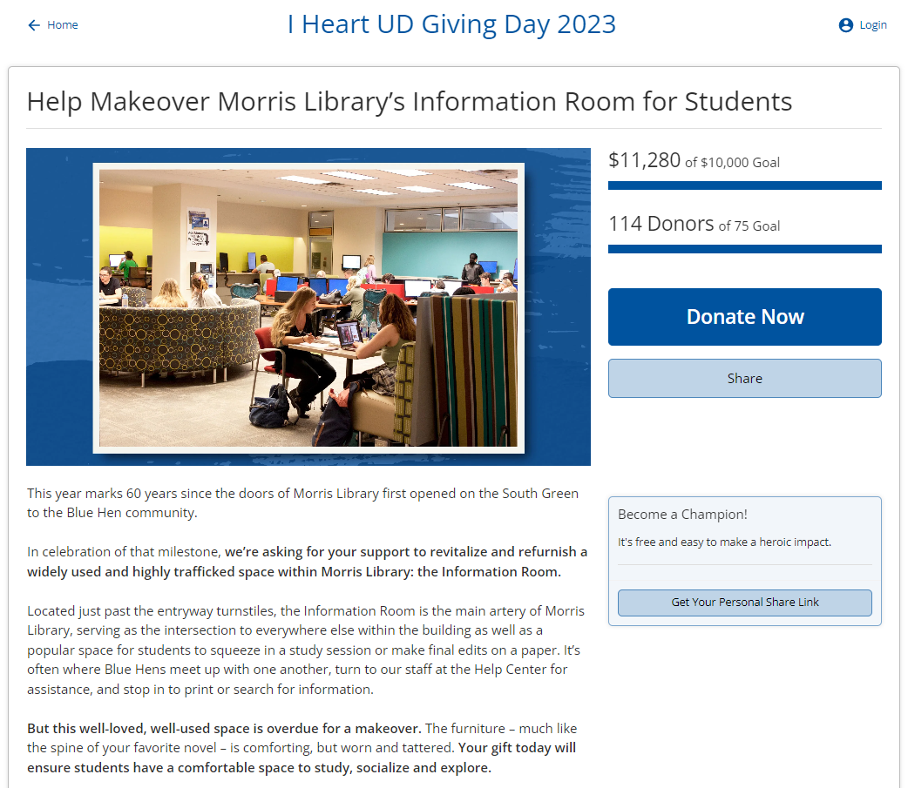
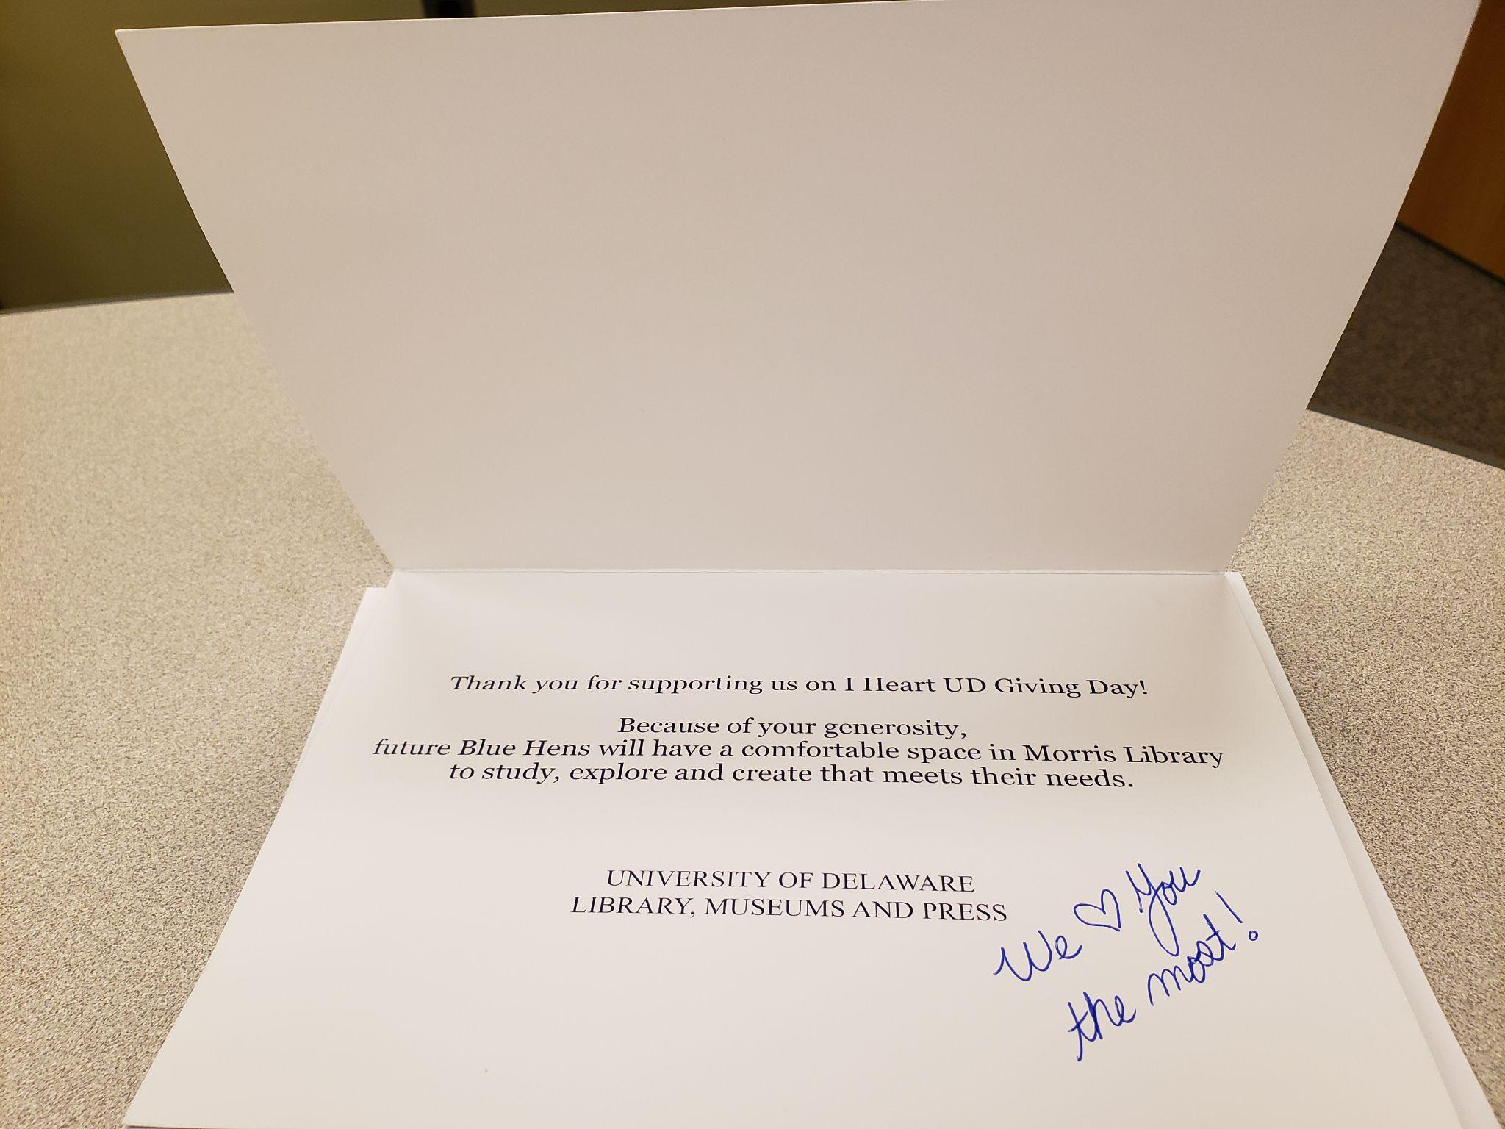
Let’s Talk Giving Tuesday + I <3 UD Giving Day

Slide 16
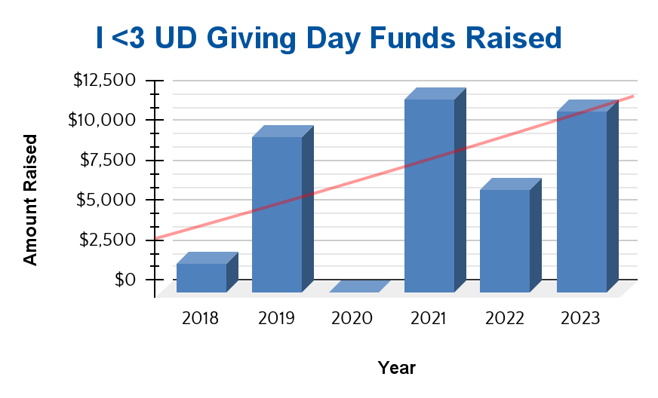
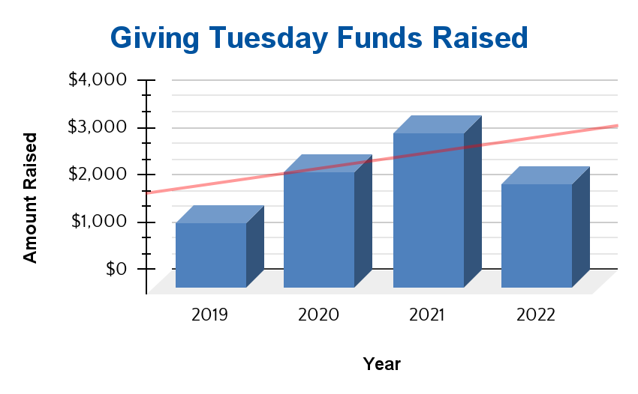
Crowdfunding Results Over the Years
COVID

Slide 17
Vision Moving Forward
Volunteer Fatigue, update New Ambassadors across departments
Expand program to include students
Facilitate the Art of Networking to all Library, Museums and Press staff
Another round of grant writing workshop series is underway
Freshen up Funding Priorities

Slide 18
Questions?

Slide 19
Strategic Planning Time!
What would be the purpose and some benefits for establishing a Library Development Ambassador Group at your institute?
Who would you identify as key staff members to include in the group? List 8-10 staff members.
How frequently would the group convene?
Identify top three projects/objectives for the group to work on.
Plan your first meeting: date, time, length of meeting, topics to cover.
How will you measure success/outcomes?

Slide 20
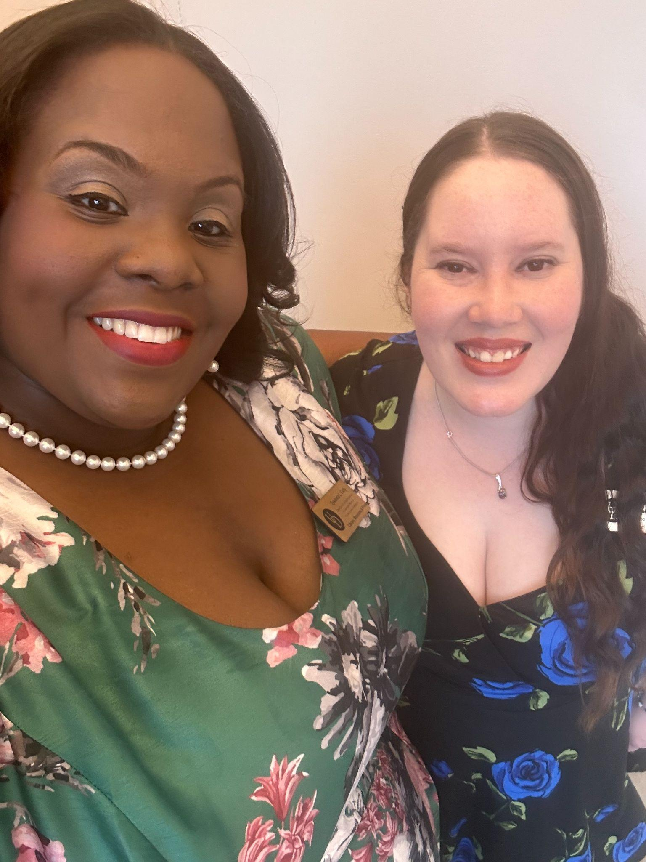
Keep in Touch
Tywanda L. Cuffy
tywanda@udel.edu
(302) 831-1719
LinkedIn.com/in/Tywanda
Nicole M. Hernandez
nicolemh@udel.edu
(302) 831-7171
LinkedIn.com/in/NicoleHernandez2

