Slide 1
Aligning Fundraising with Academic Library Trends, From F2F to Virtual ALADN 2023
Nakia Hoskins, nahoskin@uncg.edu
Mike Crumpton, macrumpt@uncg.edu

Slide 2
ABSTRACT
As higher education institutions have made many pivots and changes due to impacts from the recent pandemic, academic libraries have as well as we undergo change to administrative organizational structures, donor preferences for contact and the need to move forward with philanthropic initiatives. As technological and educational environments evolve, the impact to advancement activities can be overlooked if not kept in consideration as new methods must to developed to continue engaging donor investment. Strategically these opportunities for the organization may be hidden and not as visible to stakeholders as traditional or legacy options.
This presentation will explore academic library trends and lead discussion regarding impact to donors, potential modification to fundraising strategies and challenges to library administrators. This will also be a case study in how the use a Donor Experience Officer (DXO) transitions traditional donor contact methods from physical, personal engagement to virtual activity across the spectrum from solicitation to stewardship. This pivot is especially critical during a campus campaign and a renovation project for the main library.

Slide 3
Print Materials
The University Libraries house 1.2 million printed volumes, and provide access to more than 110,000 journals, more than 1.2 million electronic books, and more than 750 electronic databases. The Libraries also offer nearly 300,000 streaming media titles (films and music).

Slide 4
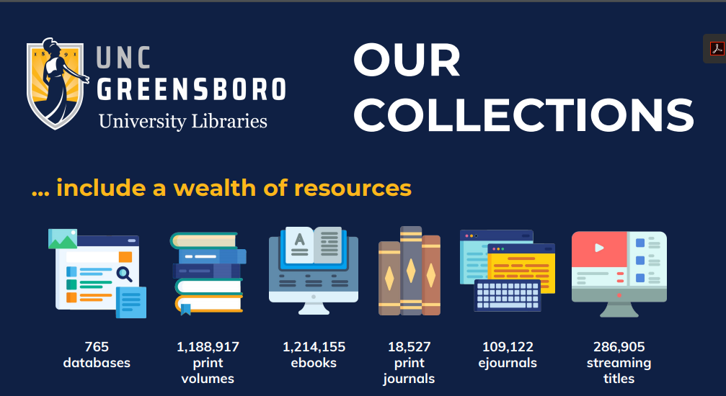

Slide 5
01 CHAT + EMAIL REFERENCE
04 ZOOM CONSULTATIONS
02 RESEARCHING MATERIALS
05 CREATING TUTORIALS
03 LEADING ORIENTATIONS/WEBINARS
06 TEACHING IN CANVAS
Virtual Services
We are logged in and answering chat and emails, available even before the library opens M-F!
We’re meeting with students & faculty in Zoom for research help, instruction, and demos
We are working with faculty, Tech Services, and ASD to find, evaluate, and order class texts, films, and more
We are creating interactive tutorials, videos, LibGuides, and other online learning objects
We are leading virtual trainings on research methods and library services for new graduate students/faculty
We are teaching synchronously & asynchronously, designing assignments, and grading

Slide 6
Academic Library Trends
Some of the academic library trends identified are:
From the renovation project, reimagined and reengineered spaces; how 21st century students present a different set of needs for bricks and mortar fundraising.
Emerging technology including invisible infrastructure; and how to convert these “soft” opportunities into student success needs.
Unique resources; seeking support for needs beyond the traditional special collections mantra and exploring other avenues for technology enhanced learning opportunities, digitization projects and non-print materials needs.
Virtual services, such as “chat” or integrated library systems (ILS) systems; and the potential to leverage these effective and desired tools for donor investment.
Entrepreneurship; the power of sponsorships, partnerships with stakeholders and private monies for new and engaging initiatives.

Slide 7
Learning Objectives and Discussion
Better recognize and conceptualize current academic library trends beyond traditional targets
Collaborate with campus Advancement to apply their knowledge of these trends to their own methods that can support the libraries’ fundraising programs.
Utilize trends and circumstances to develop new and different donor engagement strategies that addresses societal changes and new donor expectations.

Slide 8
Trends in Higher Education
College enrollment reaches its peak.
The value of the degree undergoes further questioning.
The business model faces a full-scale transformation.
Talent management becomes a strategy.
The magnitude of risks demands a new response paradigm.
Notes:
Source: https://www2.deloitte.com/us/en/insights/industry/public-sector/articles-on-higher-education/higher-education-topics.html?utm_source=google&utm_medium=search&utm_campaign=Vert_Deloitte_HigherEducation&utm_content=Trends&gclid=CjwKCAjw-b-kBhB-EiwA4fvKrO8vUpMcjYGWUtBbyEpEW1Gn2FqmfZH4XMoQe1sH0Af0FwN4sXg1TRoCwRAQAvD_BwE

Slide 9
Key Library Trends
Library spaces and the trend toward libraries housing tenants including other services on campus directed toward student success.
Emerging technology including invisible infrastructure; and how to convert these “soft” opportunities.
Digital Scholarship and resources; seeking support for digitization and non-print materials.
Virtual services, such as “chat” or ILS systems; and the potential to leverage these effective and desired tools through sponsorship and/or donor support.
Reimagined and reengineered spaces; how 21st century students present a different set of needs for bricks and mortar fundraising.

Slide 10
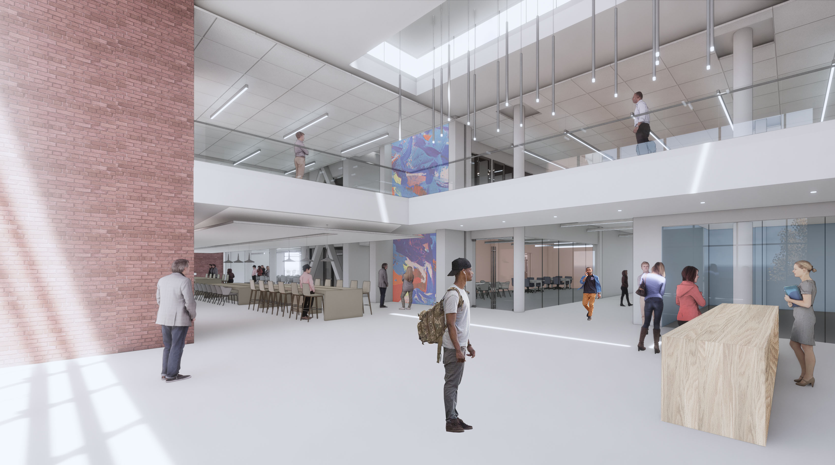
Library spaces and the trend toward libraries housing tenants including other services on campus directed toward student success.
Notes:
(2-Georgette [building], 1-Michael [getting started])

Slide 11
Getting Started
Vision
Concept
Assessment
Cross over needs
How it will work together

Slide 12
Digital scholarship
“The use of digital evidence, methods of inquiry, research, publication and preservation to achieve scholarly and research goals.” – Wikipedia
What might this encompass?
Digitization
Research Data Management (RDM)
Intellectual property and open access
Big Data
Geographic Information Systems (GIS) support
Digital collections and exhibits
Subject-based digital archives
E-journal publishing
Media content creation – audio, video, still image, web, and more
Notes:
Definition: https://en.wikipedia.org/wiki/Digital_scholarship
Digital scholarship components:
Brenner, A. (2014). Audit of ULS support for digital scholarship: Report of findings and recommendations. Retrieved from: http://d-scholarship.pitt.edu/25034/
Lippincott, J. K. & Goldenberg-Hart, D. (2014). CNI workshop report: Digital scholarship centers: Trends & good practice. Retrieved from: https://www.cni.org/wp-content/uploads/2014/11/CNI-Digitial-Schol.-Centers-report-2014.web_.pdf

Slide 13
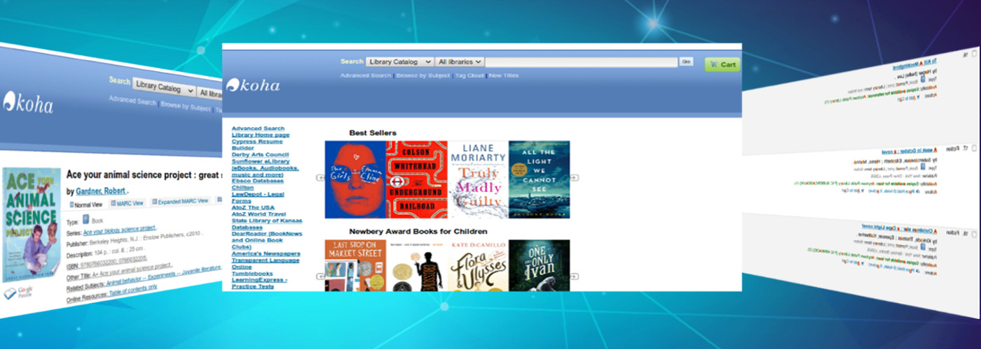
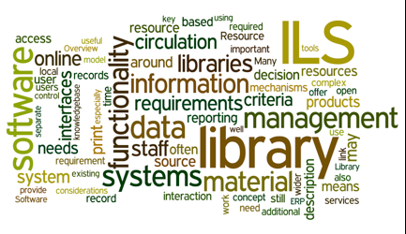
Virtual services, such as “chat” or ILS systems; and the potential to leverage these effective and desired tools through sponsorship and/or donor support.
Notes:
(1-Michael)

Slide 14
6th Trend (Overarching)
Change in leadership
UNCG – NEW Provost, Chancellor, Dean
UA organizational model
Need to show value/assessment
New Trends are out there!

Slide 15
Changes in Philanthropy
Economic inequality
Political polarization
Shifting demographics
Advancing racial justice
Climate and social changes and priorities
Changing technologies

Slide 16
Value of Social Media
Americans spend more than two hours a day on social media each and every day and the number of users on social platforms continues to climb, making it impossible to ignore social media for fundraising.
72% of people use some social media today; people are spending 88% of their time on mobile using apps rather than web.
Reach a larger population with many options
Keep Donors engaged
Help recruit and activate volunteers
Increase SEO
Keep track of your success
Some will be more likely to support or follow if they see you have an active social presence.

Slide 17
The Donor Experience
Contact and communication
Stripping out inefficiencies
No travel
No committee meetings
No event planning
No time lost through spreadsheets
Focus on closing and stewarding gifts
Identifying new major gift lead
Understanding the relationships
Managing 10x’s the potential pipeline
Make donor’s feel valued and prime them for a life-time of giving
Personalization is the priority; based on donor’s interest, affinity, giving history, and more!

Slide 18
Pipeline Development
High volume - personalized outreach
Automatic prospect alerts
Continually updated engagement, wealth, interest, and giving data
Portfolio management tools
In-depth activity and revenue reporting
History of giving/loyalty to institution
More capacity

Slide 19
Donor Experience Trend: DXO’s
Basic knowledge of advancement process
Basic knowledge of institution and units
Enhancing and utilizing donor management database in different ways
Utilize software to identify non-obvious connections and development opportunities
Productivity expectations
Given a daily quota to contact in various ways
Metrics driven

Slide 20
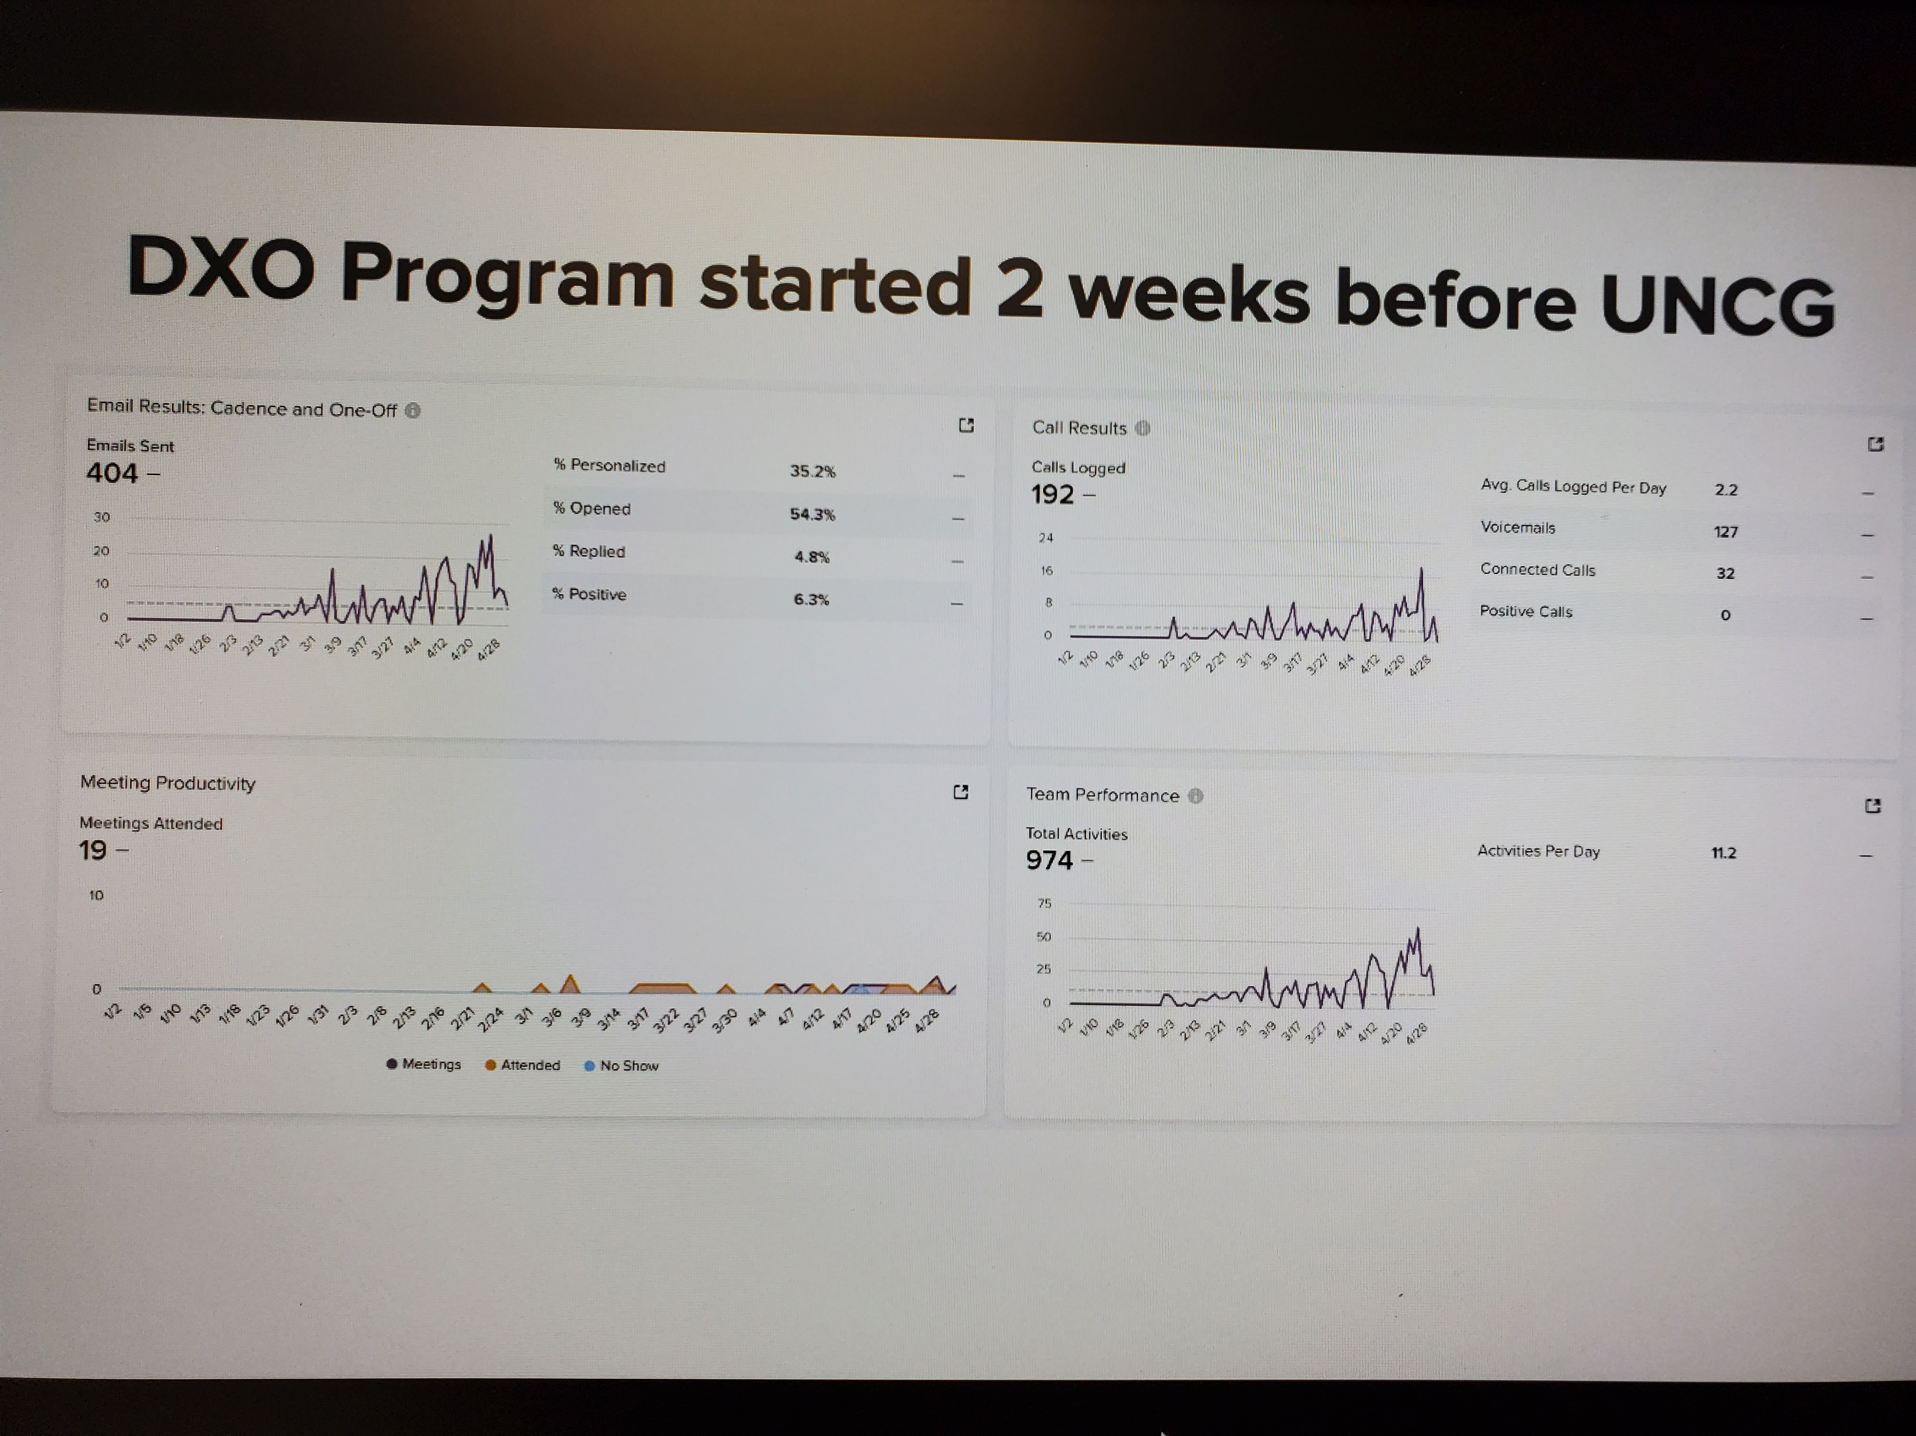
Initial Results for UNCG

Slide 21
Pros and Cons
Pro’s:
Identified a donor with higher capacity
Efficient technology and program capabilities→ greater bandwidth
Contemporary communication
Con’s:
Duplicated efforts
Overlooking traditional donor needs and/or desires
Lack of unit knowledge
Lack of communication

Slide 22
Discussion Questions
What is your experience with donor management software?
Does your organization employ DXO’s?
What is your engagement with Donor Experience Officers?
Are you aware of these types of trend in your profession?
Tips and advice?

Slide 23
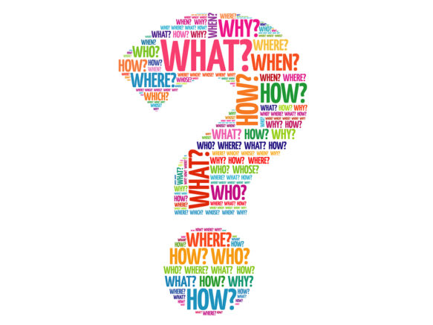
Questions??

Slide 24
References
https://www.evertrue.com/
Higher education’s new era (https://www2.deloitte.com/ )
6 ways to use social media to reach your fundraising goals (https://blog.philanthropy.iupui.edu/2021/07/23/6-ways-to-use-social-media-to-reach-your-fundraising-goals/ )
The Evolving State of the Industry (https://www.classy.org/state-of-modern-philanthropy )

