Slide 1
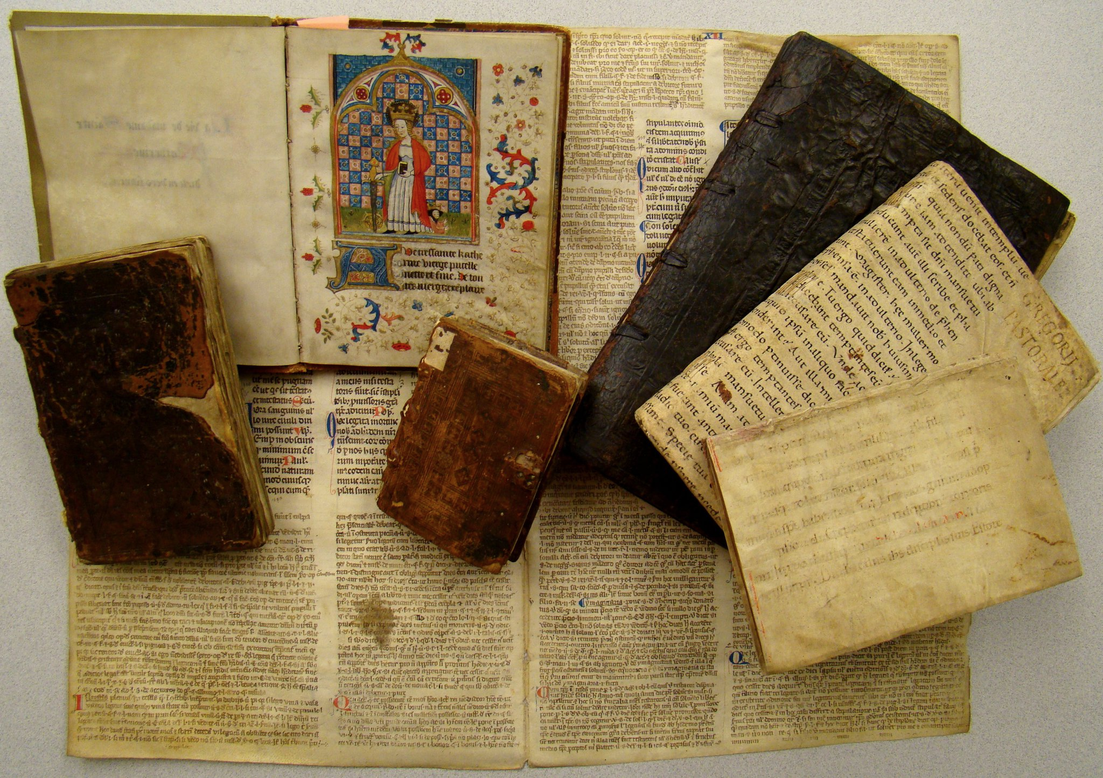
Building the Perpetual Motion Machine: Bringing together books,
students, and donors in the Special Collections environment
Eric J. Johnson
ALADN 2023: 20 June 2023

Slide 2
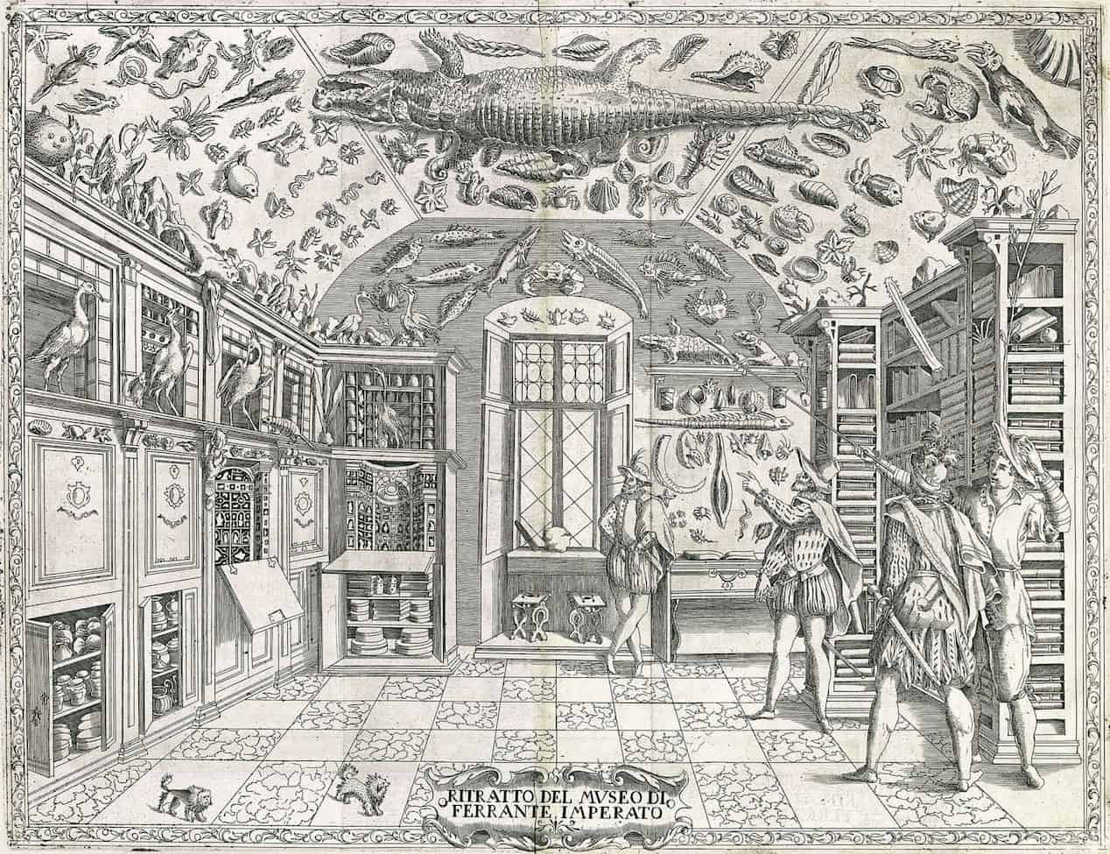
Traditional view of special collections as:
“Just in case” collections
Treasure rooms or curiosity cabinets
Special collections librarians as gatekeepers
“Sacro-power” as predominant value of collection items
“Collections in waiting”: Little to no use of special collections in direct or active ways as purposeful sites of exploration and experimentation other than by the “initiated few”
Traditionally “donor-centric” and dependent
Ferrante Imperato, Dell'Historia Naturale. 1599

Slide 3
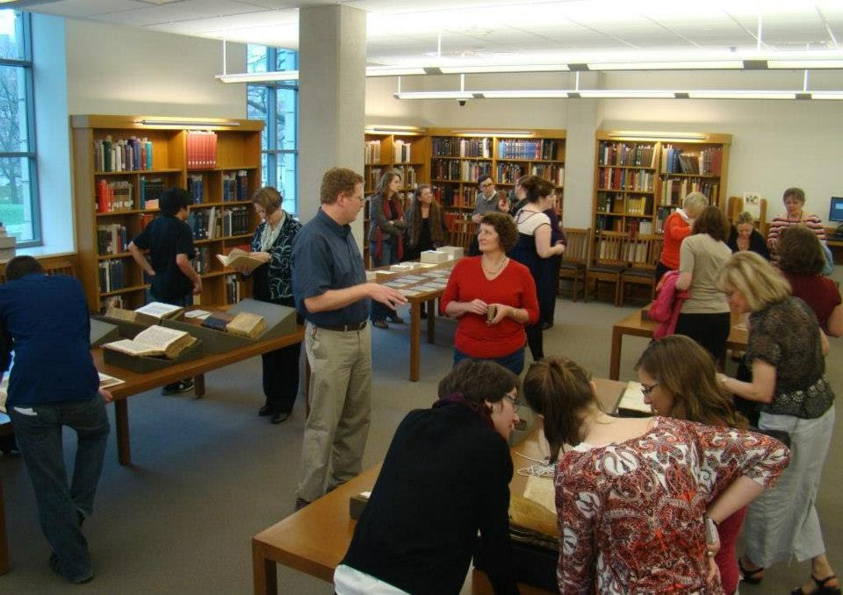
My personal philosophy of Special Collections:
Informed by:
A four-year drought
A five-second shock
From tradition to redefinition:
From treasure room to laboratory
From gatekeepers to recruiters, teachers, interpreters, and knowledge creators (curating not just collections, but experiences and opportunities)
From special to mundane, and mundane to special
From the initiated few to the masses
From “donor-centric” to “user-centric”

Slide 4
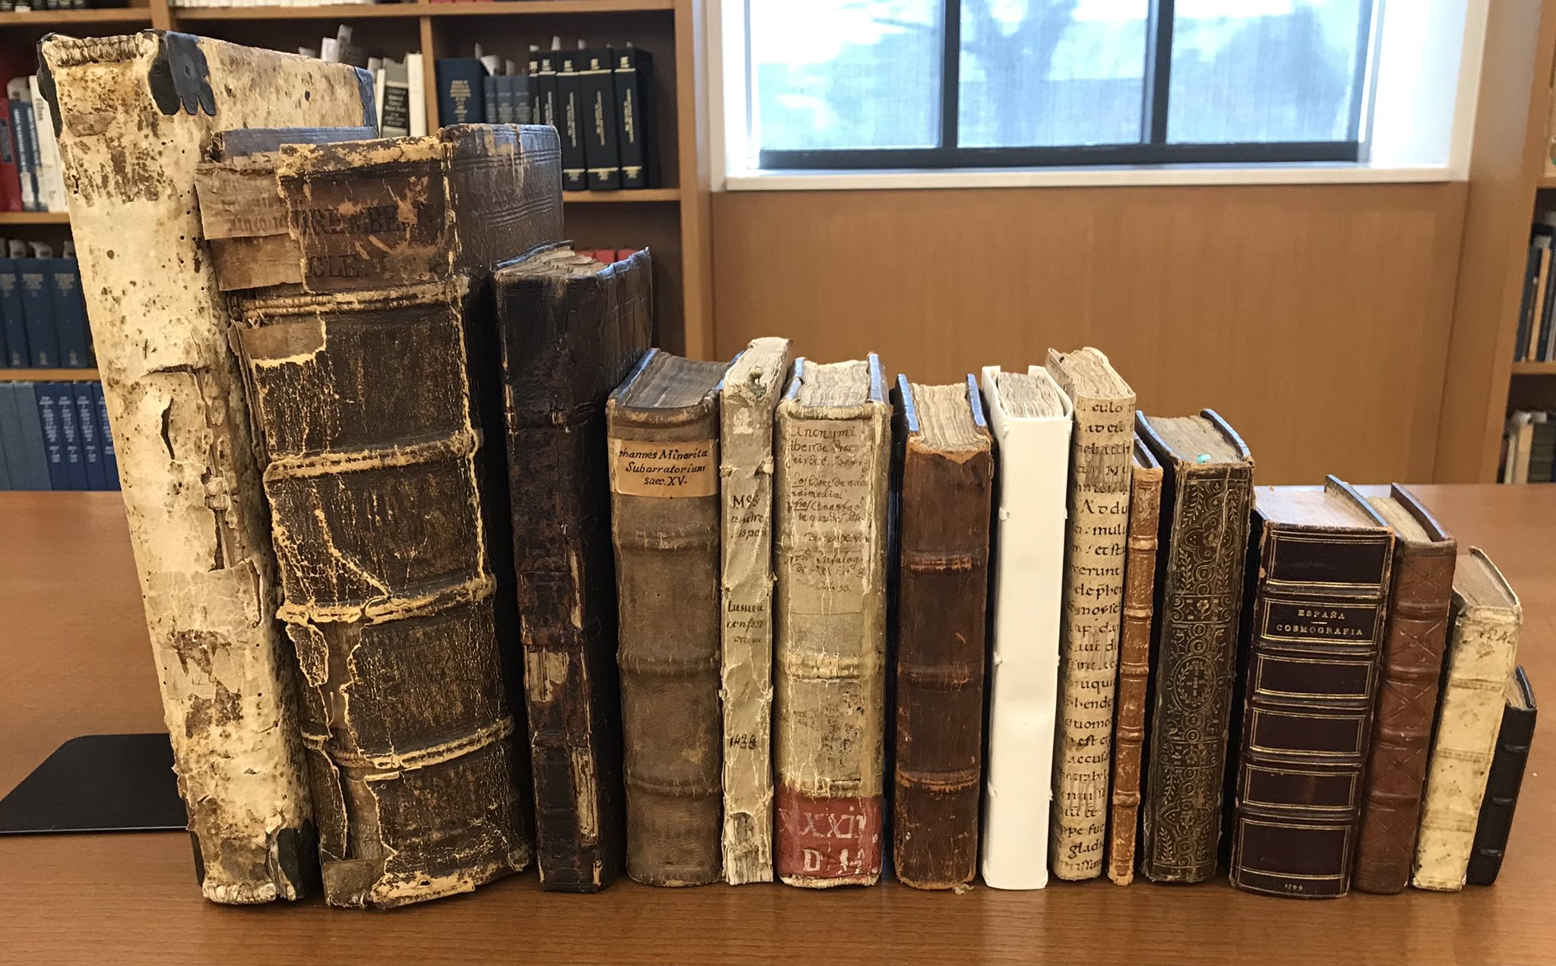
Medieval manuscripts at Ohio State: Where we were as of Fall 2010
Codices: 15
Fragments: 650 (from
90 different codices)
Hardly any use
No dedicated funding
for targeted collection
development

Slide 5
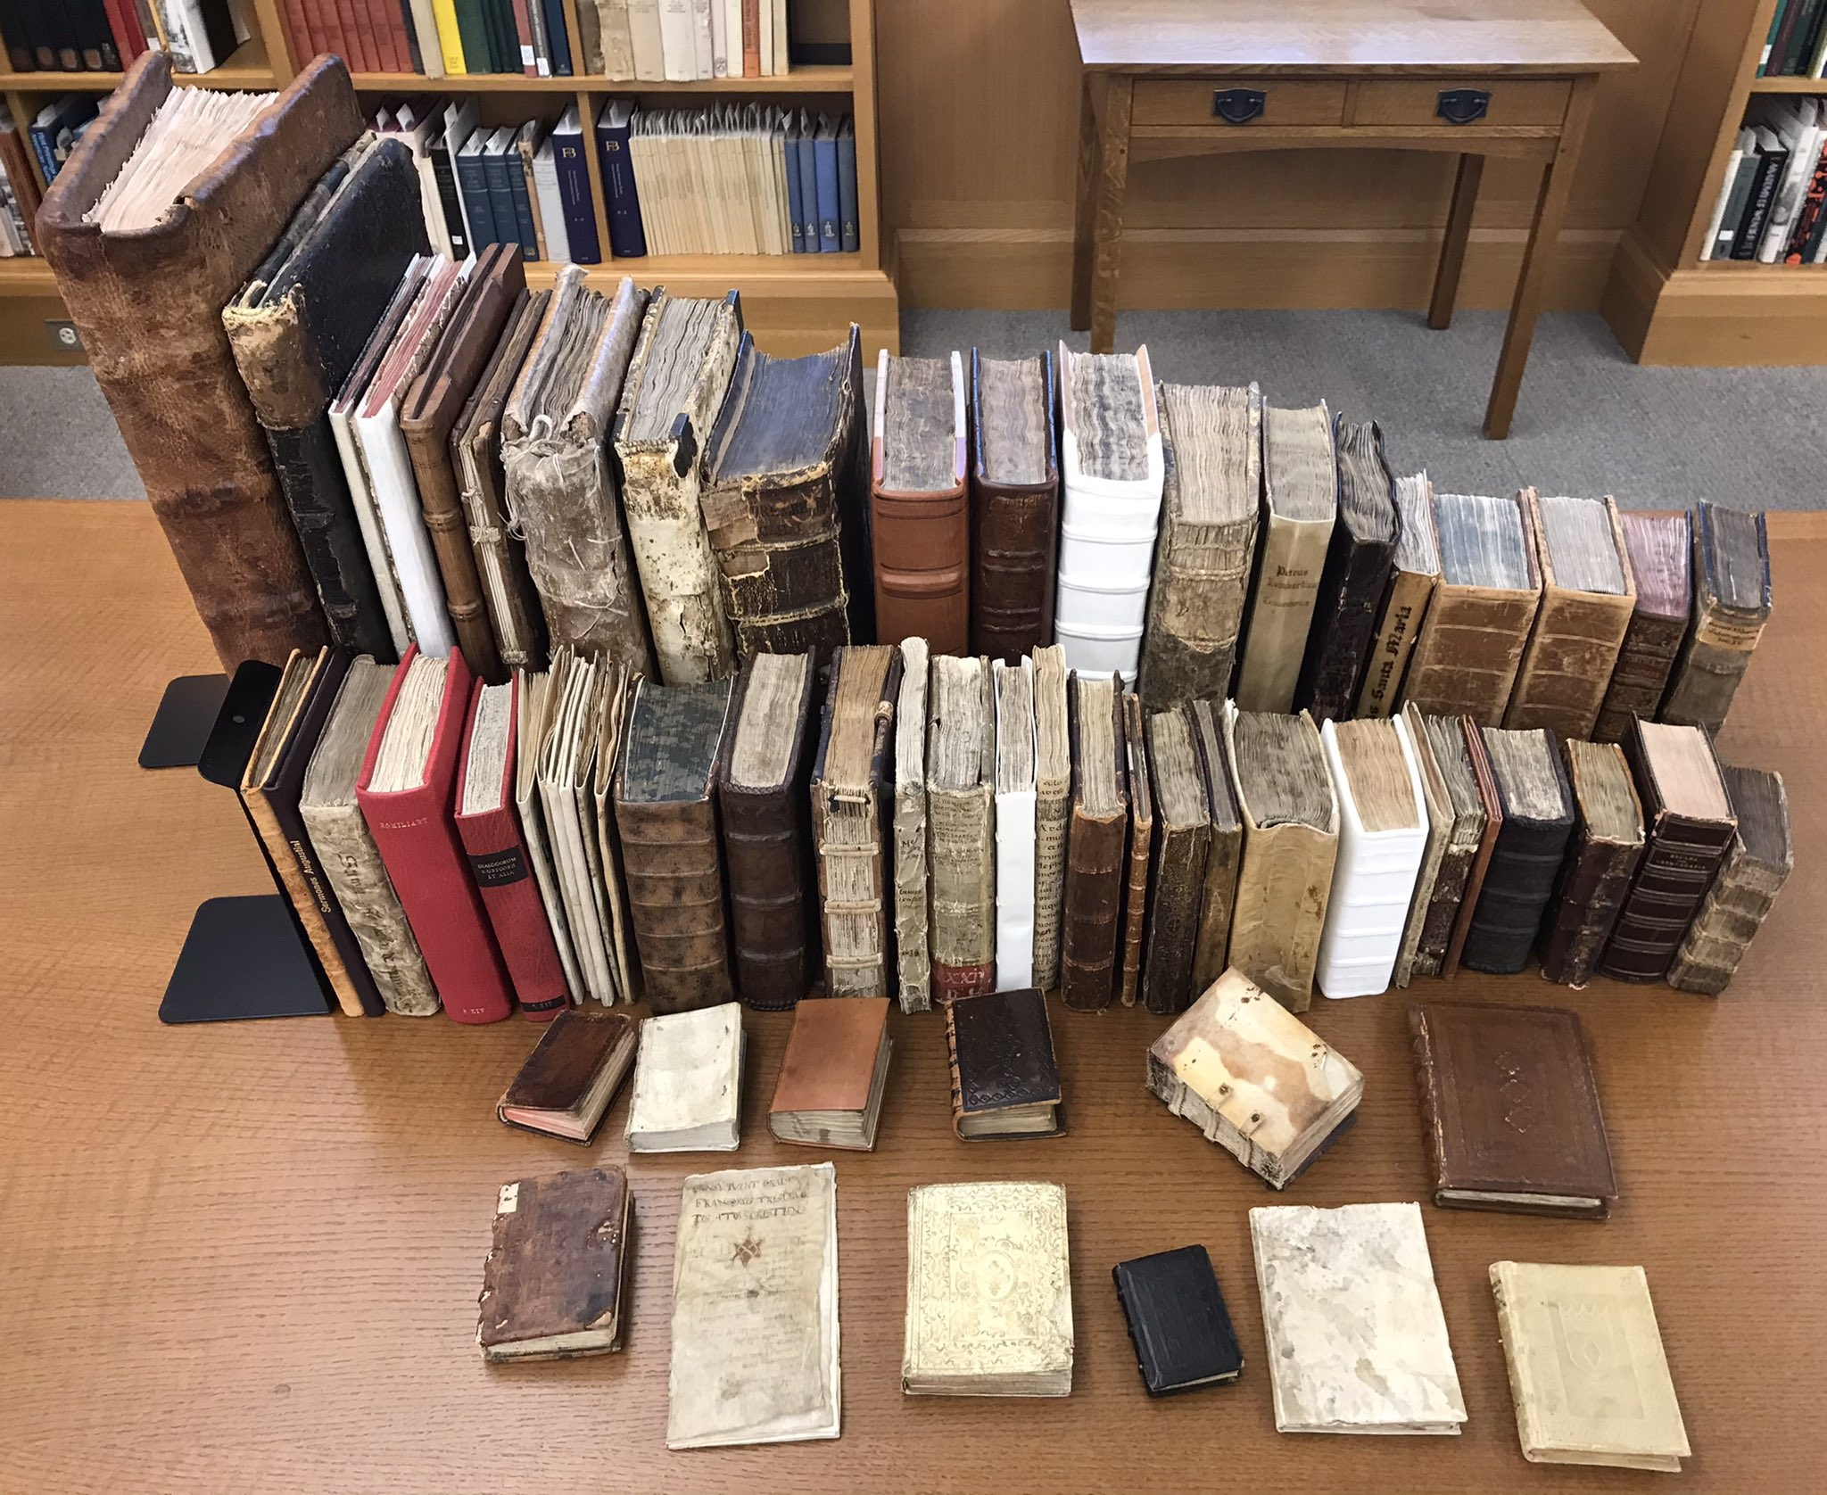
Medieval manuscripts at Ohio State: Where we are today
Codices: 76: +61 gain
Fragments: 1,438 (from
468 different codices):
+788 / +378 gain
With 100+ other MS and
MS-related items
Numerous deposit collections
Most heavily used special
collection at OSU
Regular dedicated and donor
funding for additional growth

Slide 6
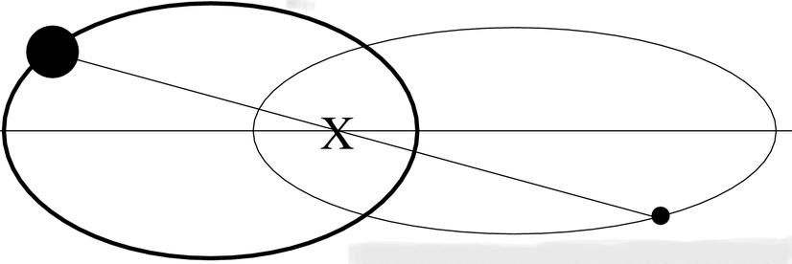
The two-body problem
The library orbit
(or collecting)
The end-user orbit
(or teaching/using; donor development)
Collections: the center of gravity

Slide 7
The “problem” becomes opportunity: Unifying the orbits
Occasional intersection…
Collaborative action

Slide 8
Traveling in multiple orbits simultaneously (the two-body solution): My situation at OSU:
Librarian/Curator:
Reference and research liaison
Curricular support
Collection management
Description and access
Collection development
Purchasing
Donor development
End-user (teacher/faculty):
Direct teaching
Full courses
Embedded teaching
Student research supervision
Public outreach
K-12 education
Exhibitions
Programming
Program of research
Donor development
CMRS/Libraries
liaison

Slide 9
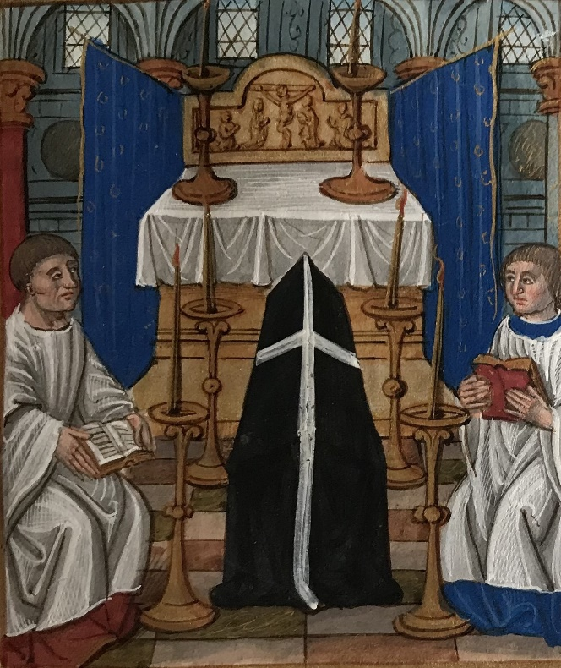
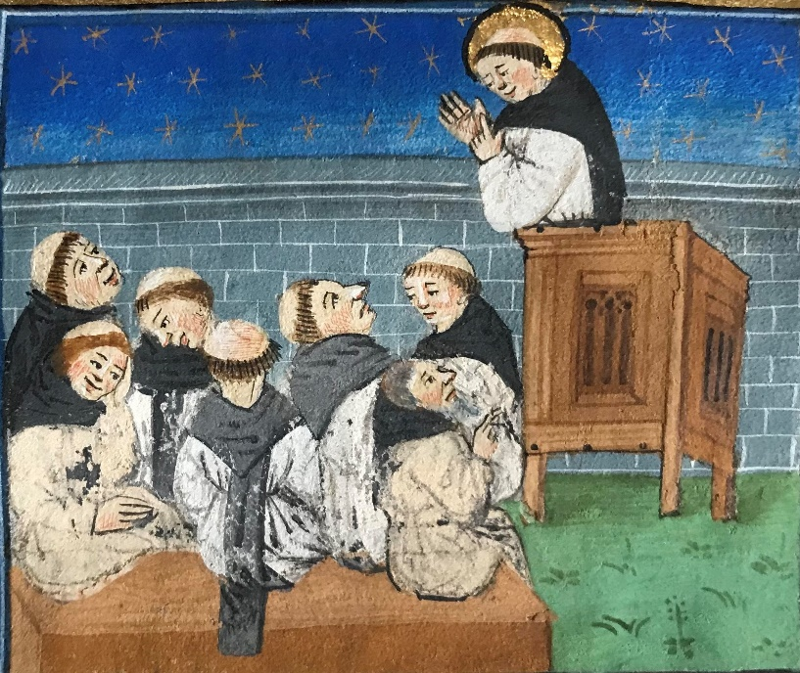
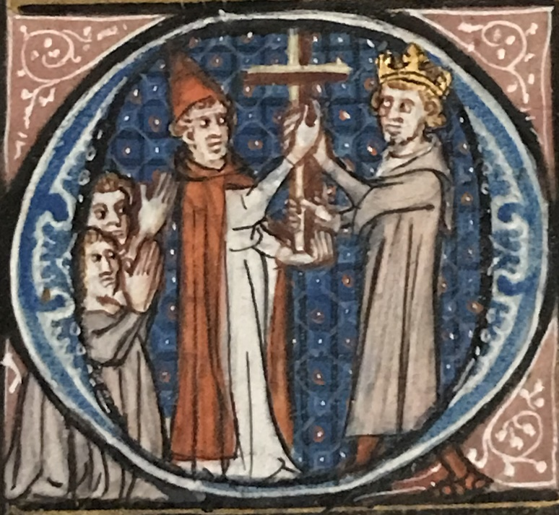
Building a curricular program at OSU:
Inert
Challenges:
Limited collections
Limited money
Limited contact hours in class
Limited opportunities for hands-on use
Transitioning from “treasure house” to “laboratory”
Operational
Participatory

Slide 10
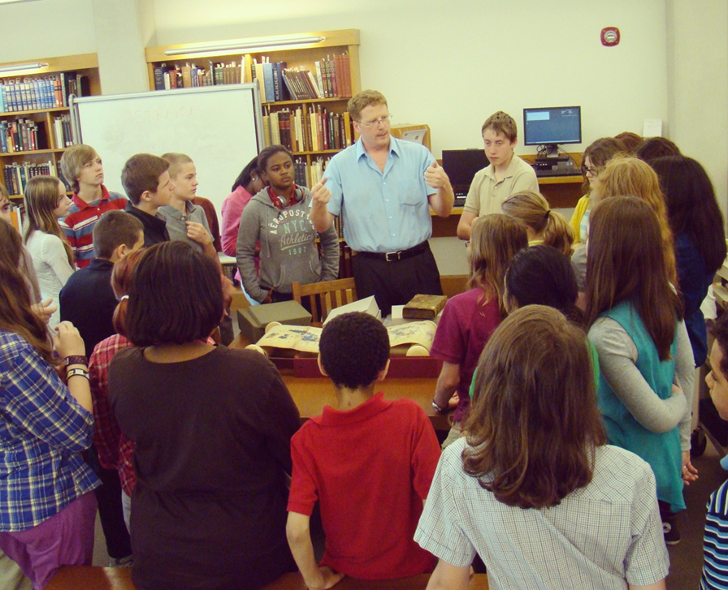
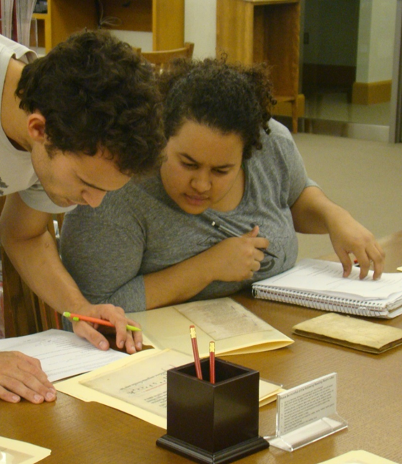
Building a curricular program at OSU:
Addressing the challenges:
Break barriers (both perceived and real) to wider access to collections: Take collections to their potential publics!
Identify and model the utility of deploying original MSS in direct student learning
Convey that (and how) even the most inexperienced learner can say intelligent things about MSS (and then build off of that)
Encourage shared ownership of collections by training teachers, empowering students, and engaging donors

Slide 11
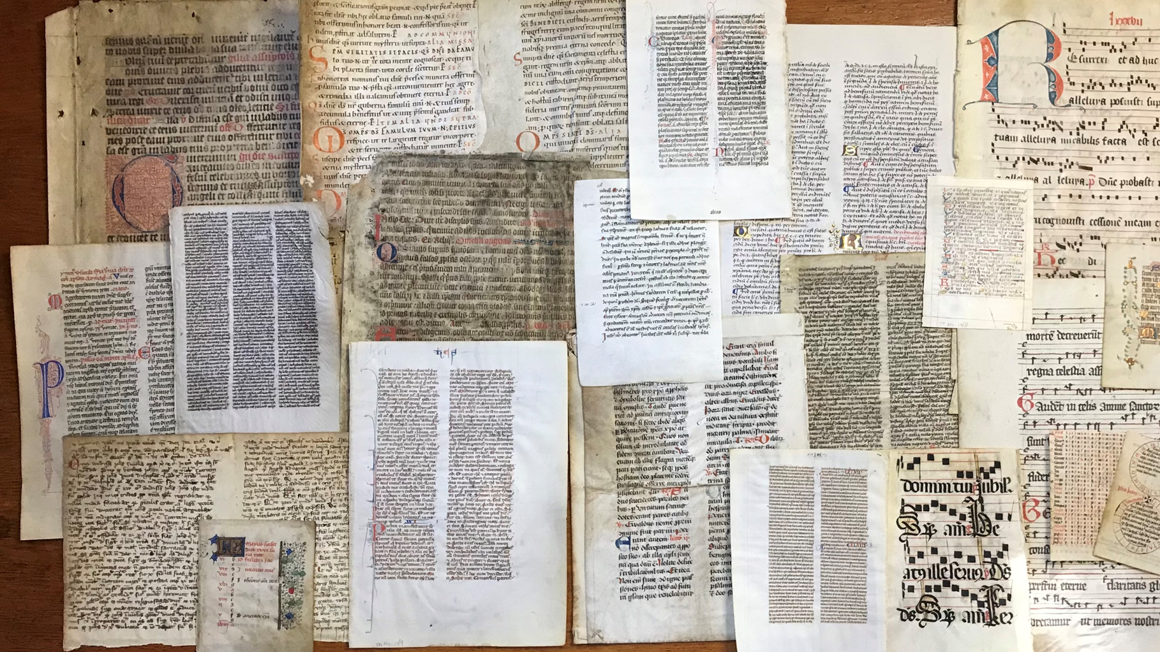
Embedded MSS instruction and student activity at OSU:
MedRen 5610 (“Medieval Manuscript Studies”)
Sessional teaching for 100+ courses across 25+ departments and programs
Term-long individual studies courses (15)
UG Honors theses (10)
Student conference papers (10)
UG Research Library Fellowships (4)
Teaching beyond OSU
16 HE institutions (OH, IN, PA, CT, SC)
K-12 partnerships
Public outreach programs:
Churches
Bibliophilic societies
Business associations
Arts groups

Slide 12
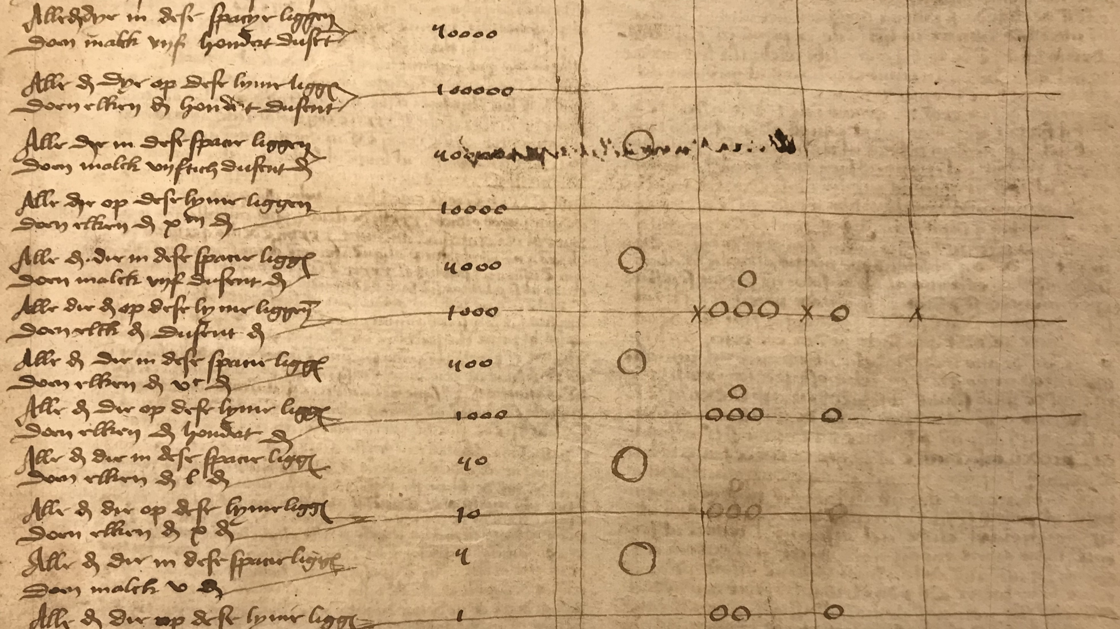
The end result: STATS! (and the stories they tell…)

Slide 13
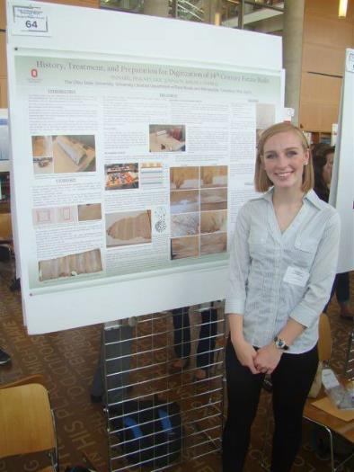
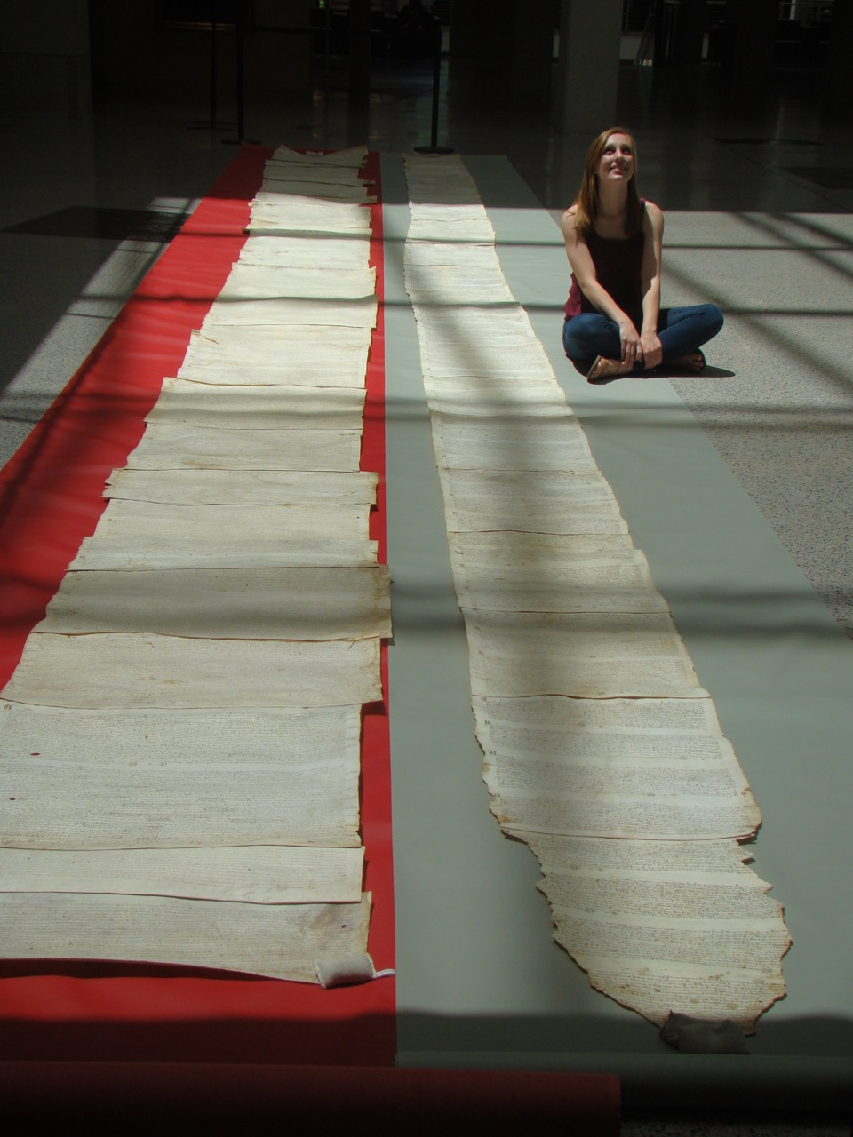
Student stories: Direct work on donor (deposit) collections

Slide 14
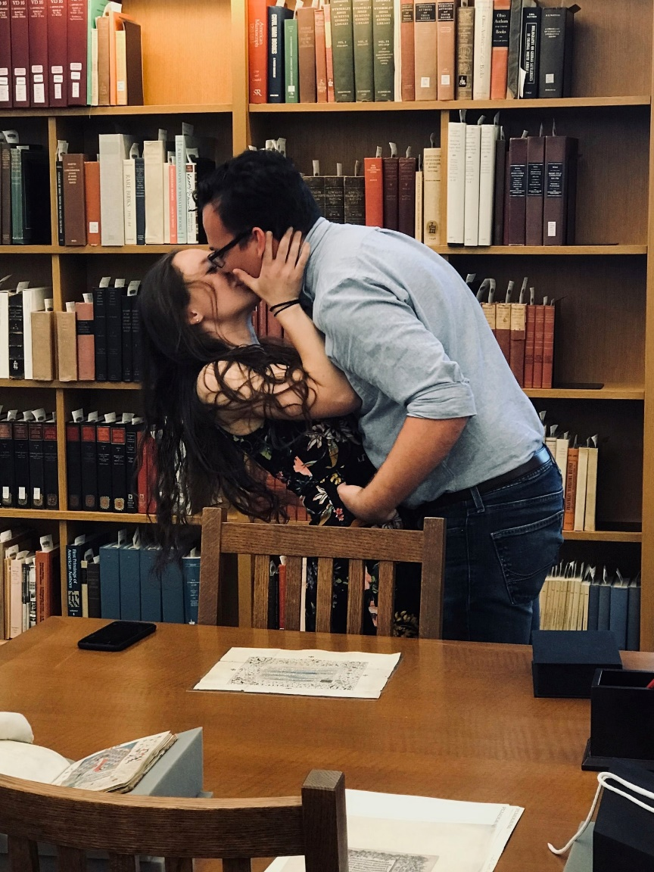
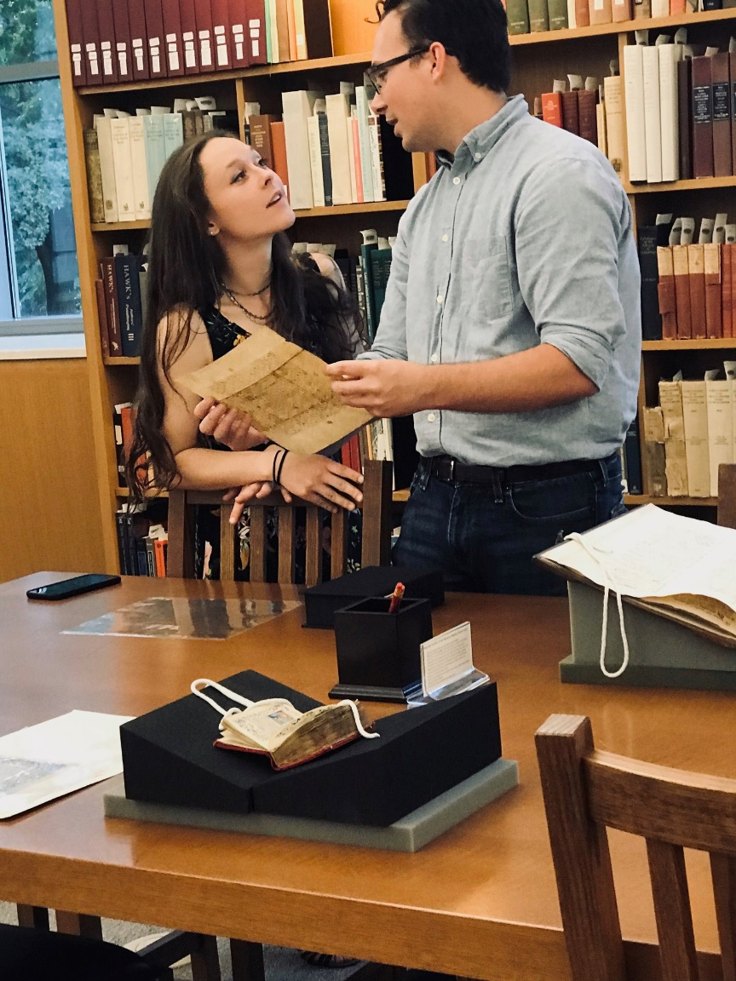
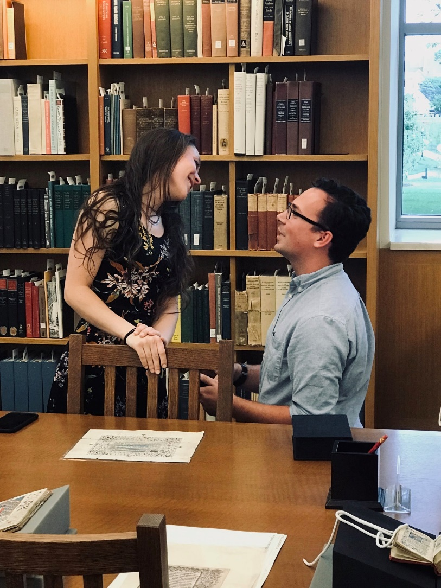
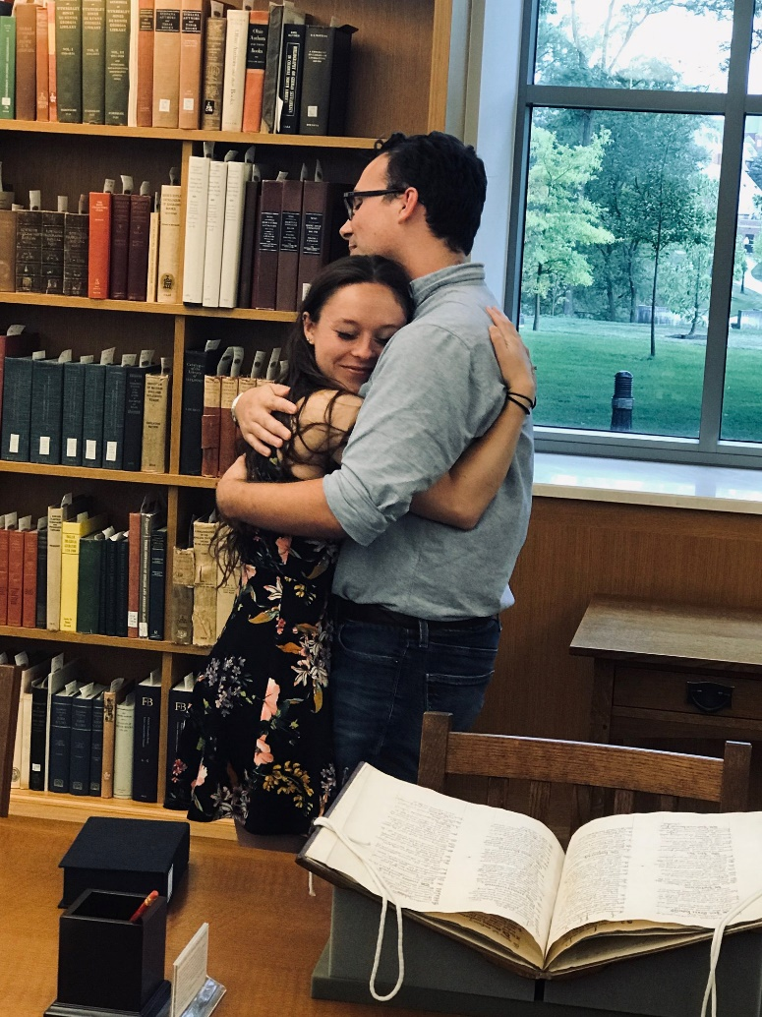
Student stories: The “romance” of MSS

Slide 15
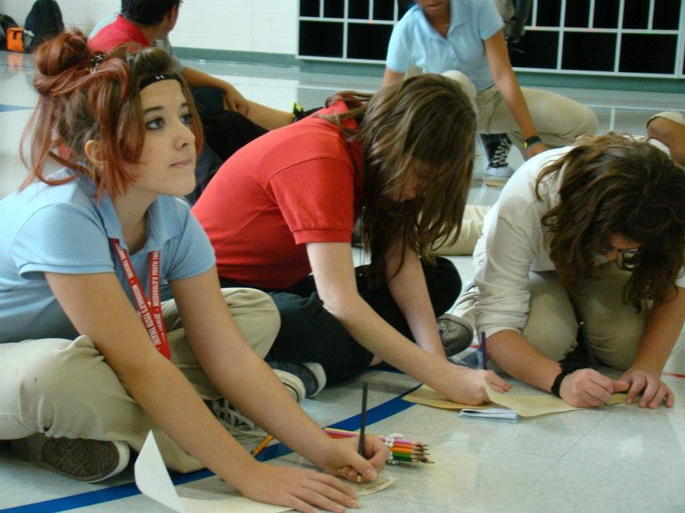
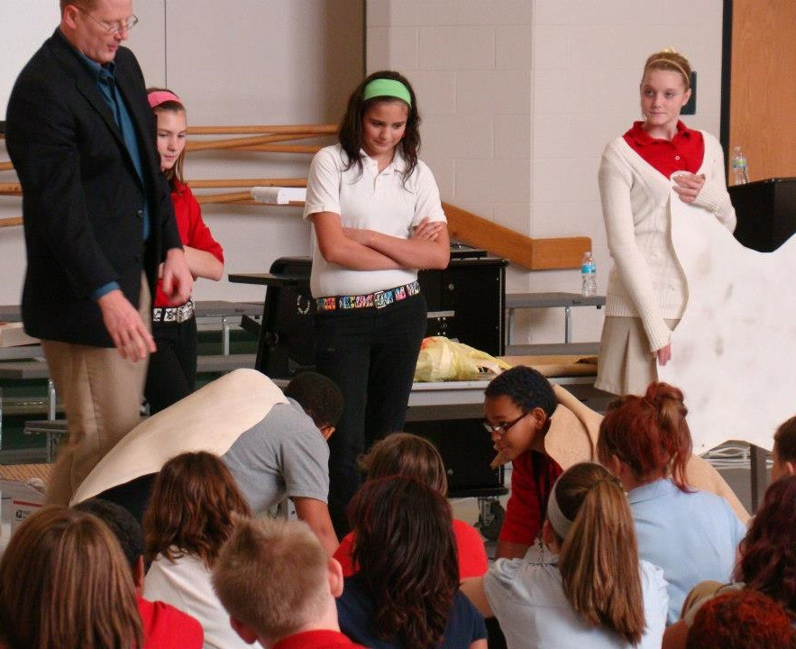
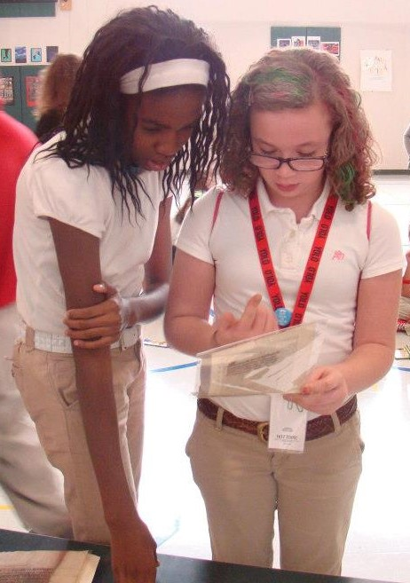
Student stories: MSS in Middle Schools

Slide 16
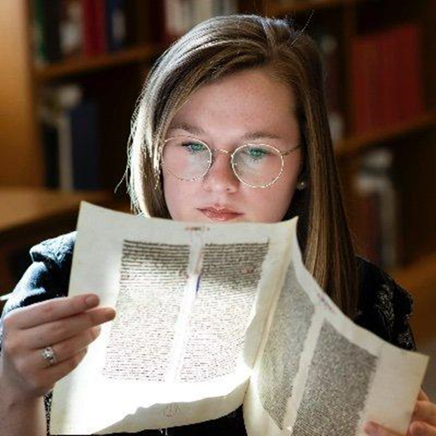
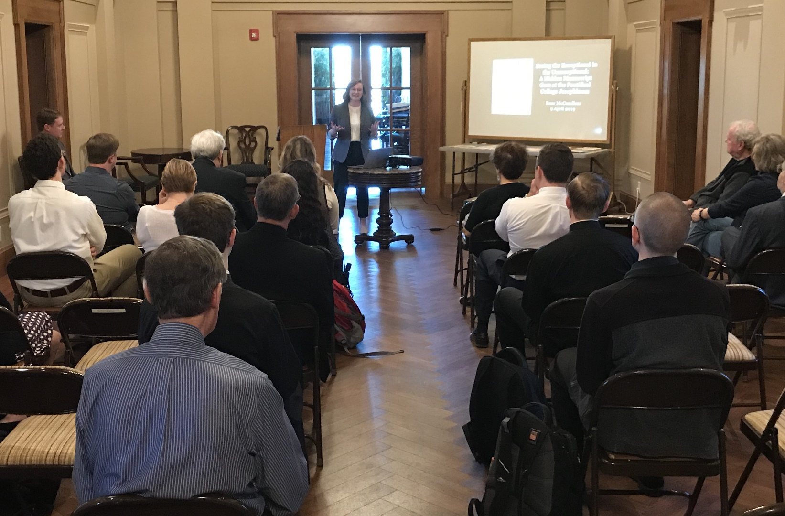
Student stories: Student as curator

Slide 17
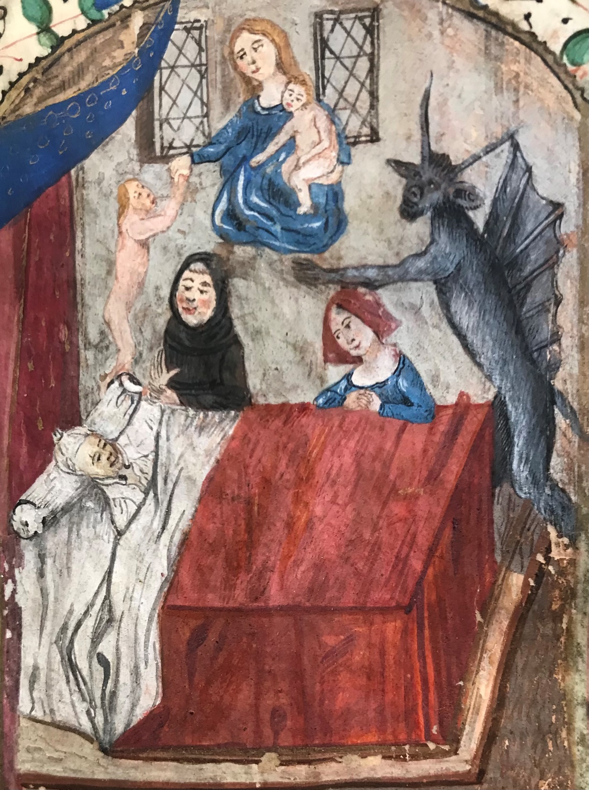
Growing the collection
Internal investment:
Administrative $$$
“Orphan” collections funds
General development funds
Colleague $$$
External investment:
Grant agencies / Foundations
Dealers
Donors
Hours of the Ursulines of Brown County, OH. Troyes, ca. 1470. Gift of Ann Dodson.

Slide 18
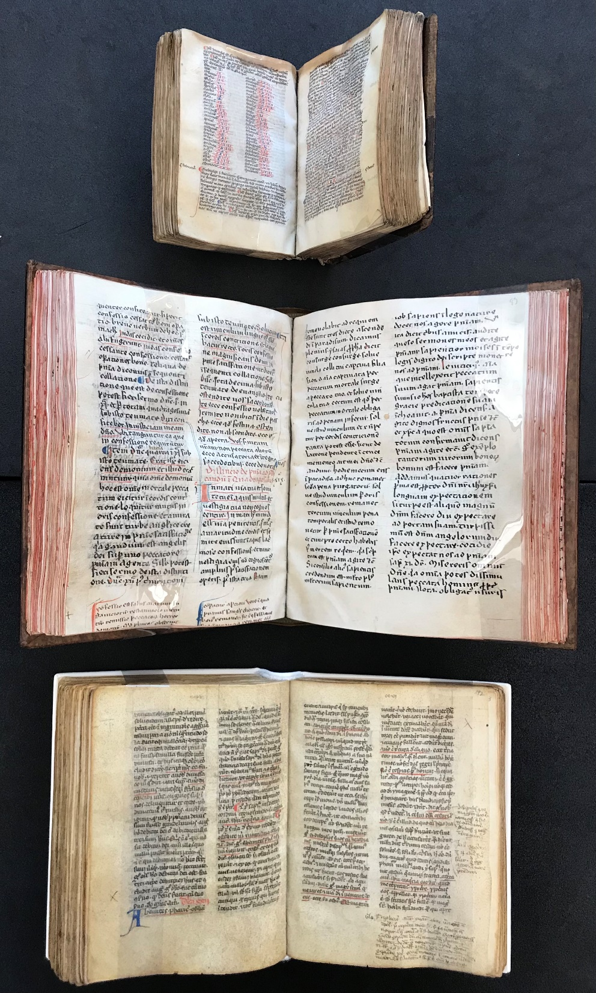
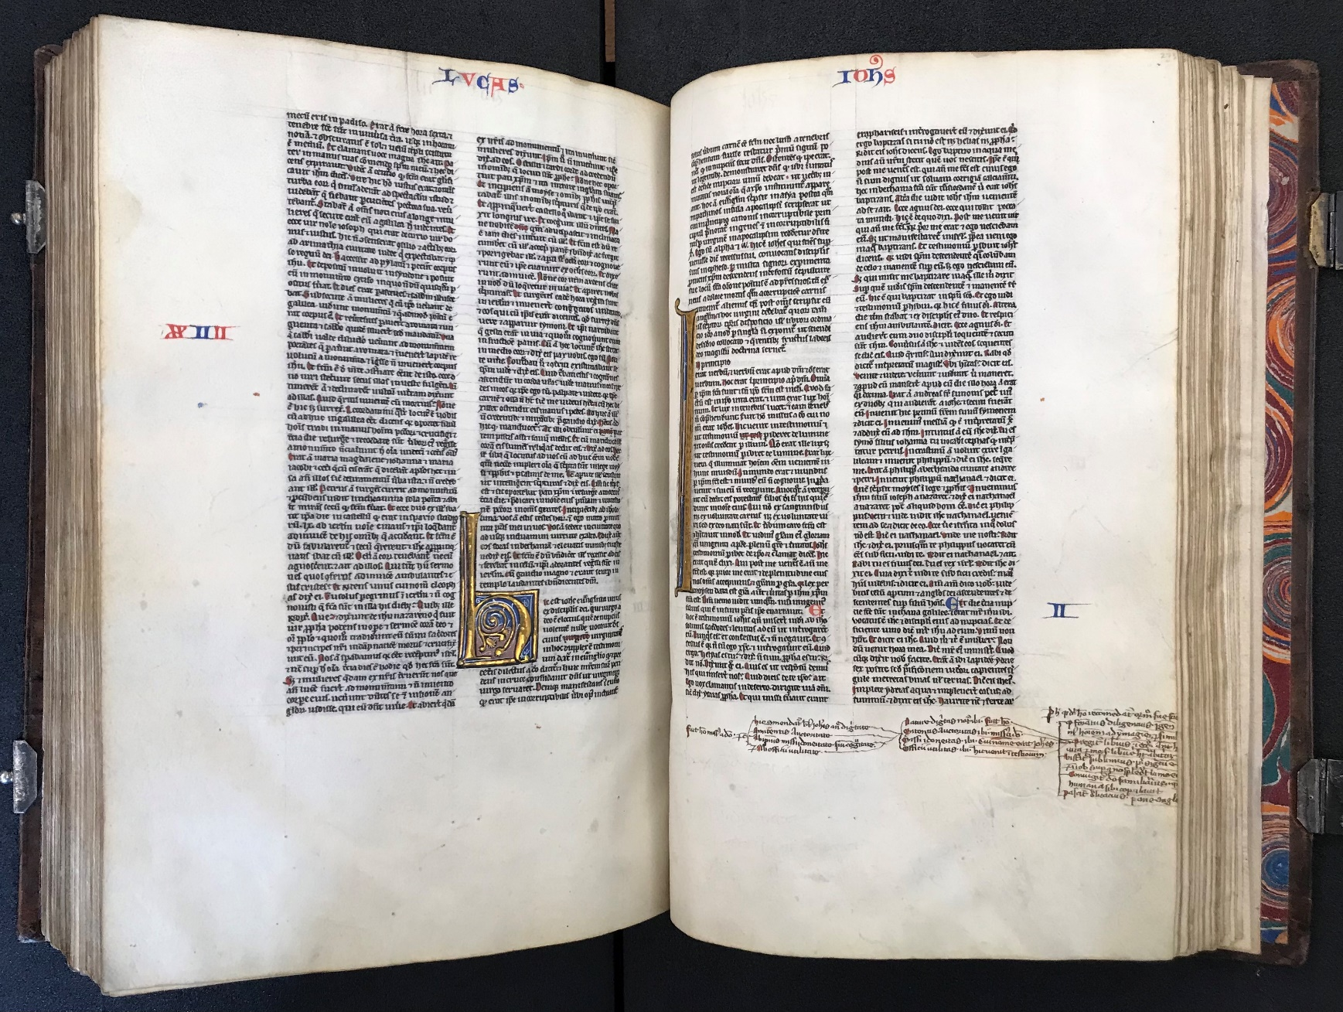
Dealer assistance and impact (2018-2021):
Bible of Pierre Turrell.
France, ca. 1230
Maurice of Provins. Distinctiones sacrae scripturae. Paris, ca. 1250
Collection of prototype sermons built on distinctiones. S. France, ca. 1275
Collection of 119 full distinctiones sermons. N. Italy, ca. 1275-1300

Slide 19
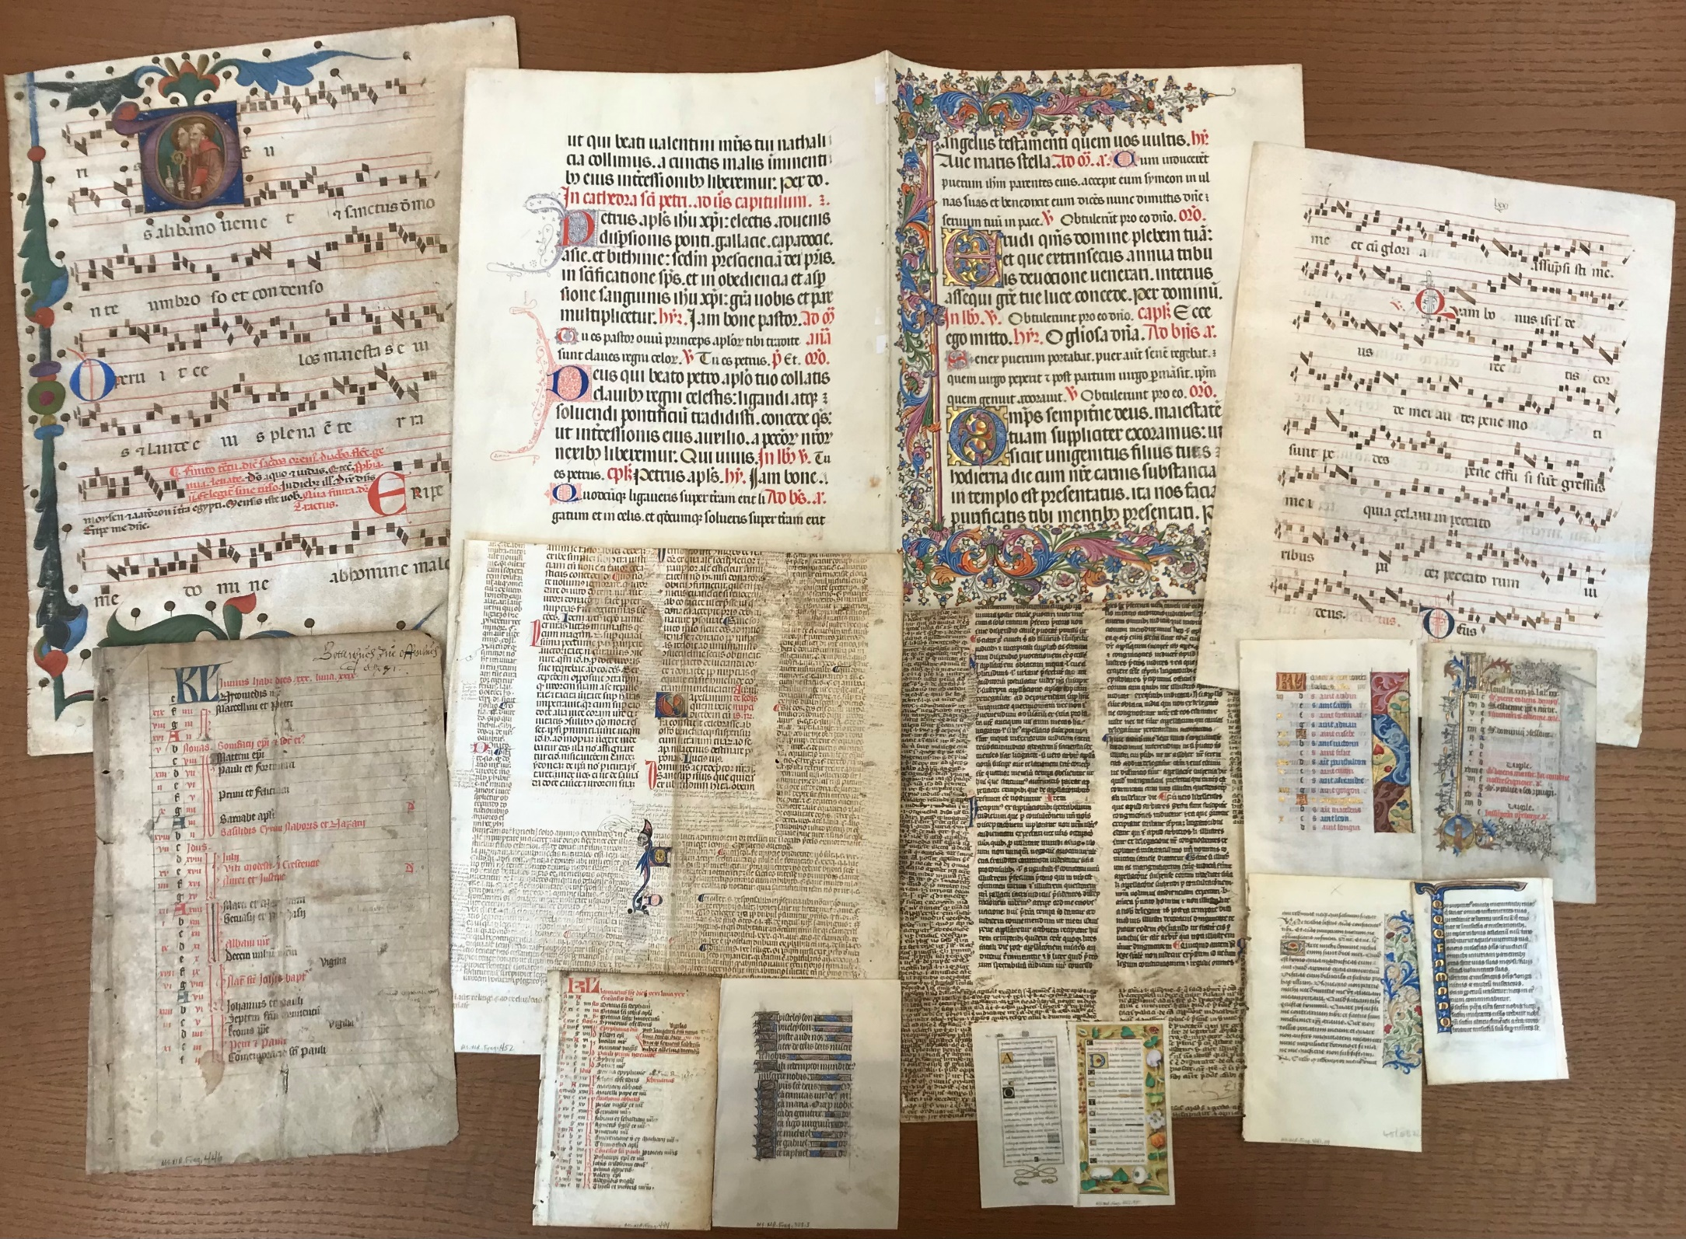
Donor assistance:
- Salon events (e.g. “Tasteful Evening”)
- Audience mixing (e.g. “Preview Night”
- Exploratory/Popular outreach
- Direct involvement of students in donor outreach and development
- Unsolicited help (via word of mouth
A portion of the Herb and Susie Coulter donation, 2022-23

Slide 20
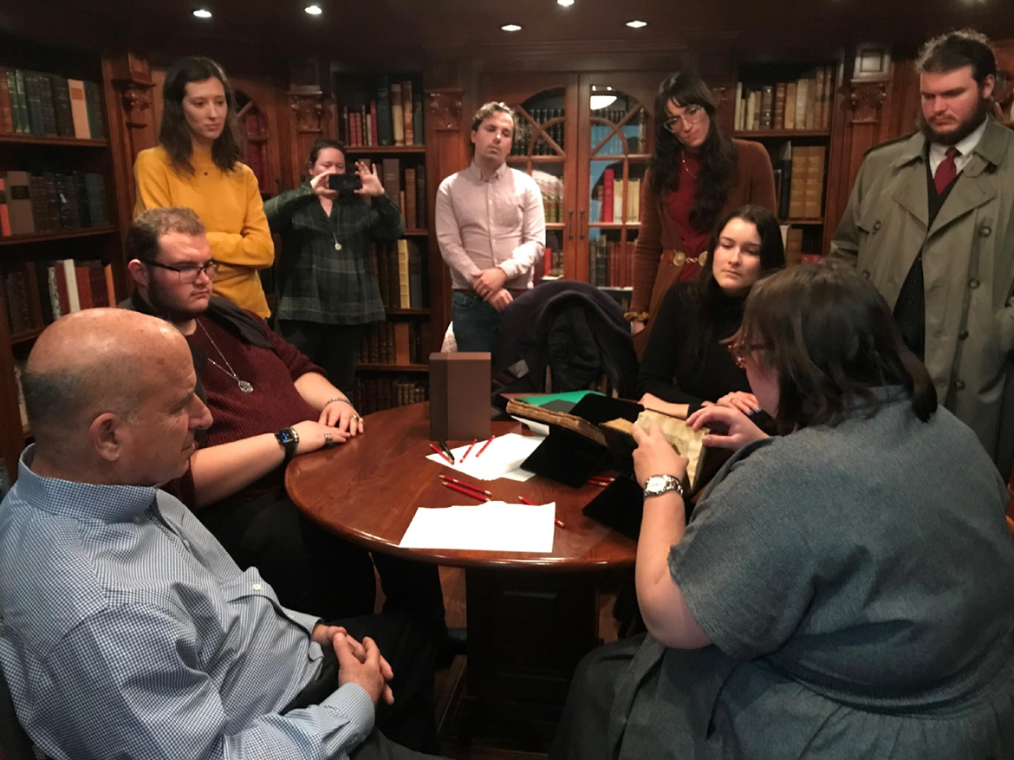
“The Price Is Right!”: Donor assistance and the marriage of collecting and teaching
Background and instructions: “RBML recently received an anonymous donation to be used for the immediate purchase of medieval manuscripts for student use and research. Together, the class will collaborate to analyze, evaluate, and select at least one medieval manuscript codex (but possibly two or three, pending class discussion, selection criteria, and item availability). Each of you will be responsible for evaluating a single codex. You will then work in small groups of 5 to compare, contrast, evaluate, and rank your manuscripts in order of their importance, desirability, and utility to RBML’s overall collection and its scholarly mission. The entire class will then collaborate in a larger discussion in which we will weigh our possible purchase options and come to a collective decision about what we will select.”
- Students not just users, but developers
- Donors not just funders, but immediate opportunity creators and teaching partners
- Collectively, students and donors create perpetual potential for teaching, research, outreach, and development
- Collaborative “ownership” of collections, collection development processes, and future opportunities
- Assignment triggers different donor motivations (e.g.: MSS; student experience; teaching/research; cultivating collectors)

Slide 21
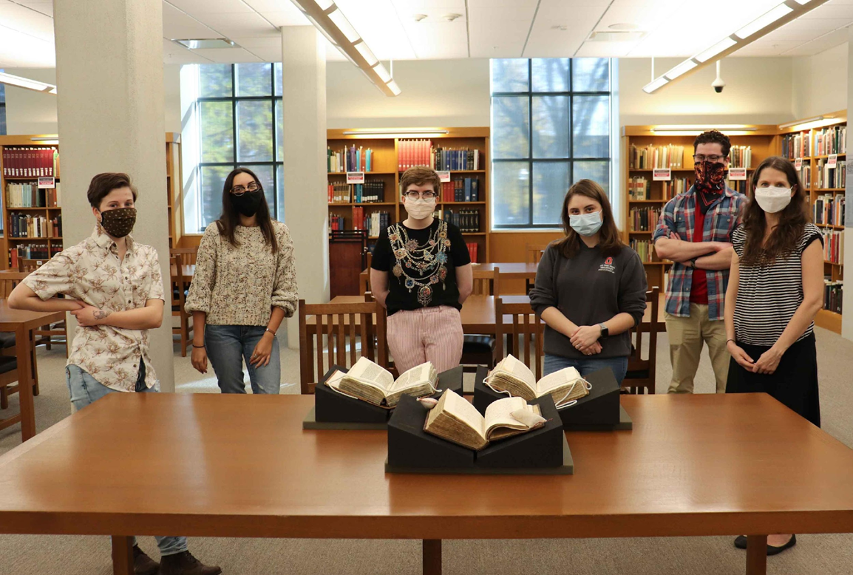
“Small gains do great things.” – James Lackington
Collections
Donor support
Use
Stories
2012-2019: $426,000
- Cash: $141,000
- GIK: $285,000
2020-2023: $820,000
- Cash: $685,000
- GIK: $135,000
Total since 2012: $1,246,000
(100+ donors; from $5 - $100,000+)
In progress:
- Cash: $50,000 per- year for PIR
- GIK: $5 – 7 million

Slide 22
Eric J. Johnson
Professor / Head of Thompson Special Collections
The Ohio State University
Tel: 614-688-8795
E-mail: johnson.4156@osu.edu
Twitter: @EJJohnson74

