Slide 1
Leveraging the Liaison Relationship: Strategies for a Successful Partnership with your Foundation Representative
By Carol E Smith and Sarah Ormeo
Notes:
Tues, June 20, 3:10pm-4:00pm: Estero Ballroom C
Intro: (:05)
Overview: CS (:05)
Importance: CS (:10)
Strategies: SO (:10)
Case study: SO (:05)
Sharing : SO & CS (:10)
Wrapup: SO & CS (:05)
CS/SO: Thank you for that introduction. And thank you for staying until the very end of ALADN 2023. This has been a great conference! We know your heads are swimming with new ideas after two days of learning and sharing and networking and meeting new colleagues, and we also know that you are looking forward to heading home to “Make Waves” at your own institution after a great conference and we appreciate your staying with us into this final session. For quite some time now, we’ve both been thinking about presenting on the subject of leveraging a successful relationship with your Foundation representative, because we’ve enjoyed such a positive and fruitful relationship with our own representative at the Colorado School of Mines.

Slide 2
Carol E Smith
Dean of KU Libraries
University of Kansas, Lawrence, KS
Notes:
…and of course, I’ve already been introduced. I’d just like to add that as part of my approaching transition to the University of Kansas, I’m also delighted to have several of my new colleagues from KU in the audience whom I’m just getting to know, from both KU Endowment - KU’s central advancement office – and from KU Libraries’ advancement team: Amy, Christy, Kevin, and Christine. Christy McWard has been instrumental in easing my transition to KU and I know she and I will be working very closely on library development, so I’m also so glad to have her attending today!
And a bit of a sidebar as the conference wraps up. This is really one of the things that I love and value about ALADN, that it’s time for advancement officers and library development leaders to spend time together, learning from each other. I encourage you to encourage colleagues at another university who perhaps hasn’t attended ALADN before, or recently, to come to the next one. Drag ‘em along!

Slide 3
Sarah Ormeo
Communications and Development Office; Library Program Administrator
Colorado School of Mines
Arthur Lakes Library
Notes:
SO: I would like to note with my amazing title that Development is supposed to be 25% of my job duties. Currently, I'm around 10-15% actually, working my way towards 25% and working on ways to lower the Program Administrator load, often with Student Workers. I think student workers are under utilized at most academic institutions and we don't let them help us as much as we should.

Slide 4
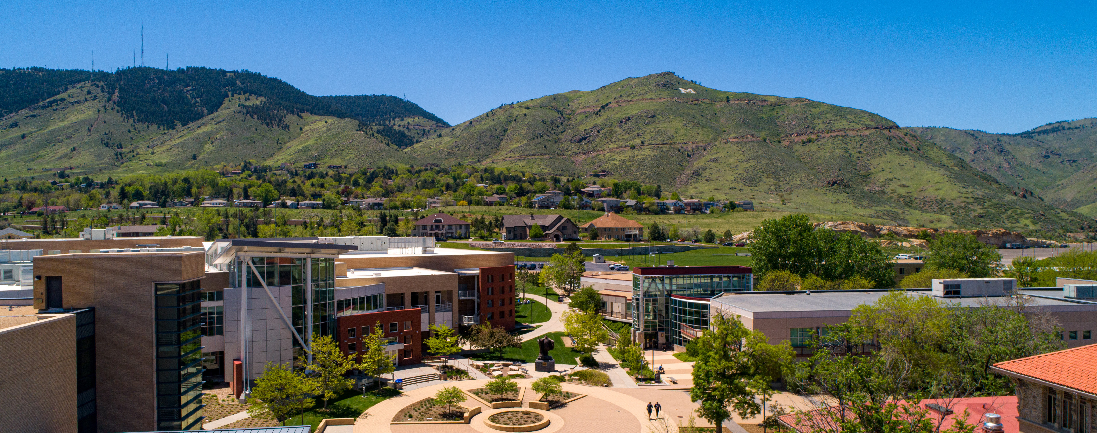
Colorado School of Mines
Colorado’s premier STEM Institution
Golden, CO
Public
7,172 students
150th anniversary in 2024
R1
$95M research awards in 2022
Innovative programs like:
Space Resources
Interdisciplinary
e.g., Quantum Engineering
Arthur Lakes Library
Notes:
Applied Mathematics and Statistics, Chemistry, Computer Science, Electrical Engineering, Materials Science, and Physics

Slide 5
Goals of the presentation
Provide an overview of the liaison model
Importance of a successful liaison partnership
Strategies for a successful liaison partnership
Case study of a successful liaison partnership
Sharing strategies
Wrap up
Notes:
CS:
(bullets 1-3): So, this is an overview of today’s presentation.
We’re first going to review what a liaison model looks like, as the structure can differ according to how the university and foundation’s structural model is set up. And that in turn can impact strategies for success.
We’ll then review why it’s so important in a liaison model environment to have an effective partnership with your assigned liaison.
And we’ll consider ways in which we can all strengthen that important partnership with your designated liaison.
SO: 4-6 We will share strategies in small groups around the room and as a larger group, finally wrapping it up. We will leave time for questions at the end but if you have a burning question in the middle, don't hesitate to ask!

Slide 6
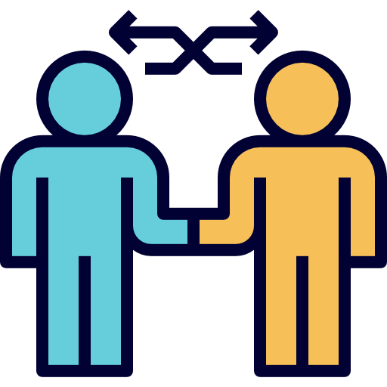
Overview of the Liaison Model
University/Foundation relationship structures
Our definition of ”Liaison”
Benefits
How it works
Notes:
II. Overview of the Liaison Model (:05) – Carol; slides 6 - 9
CS: So we’re going to start off with a 30,000 foot view and some very broad observations. As I’ve met and chatted with so many of you over the past three days, I’ve realized that while we are all engaged in the same work, the same important mission, the way that work is set up and the amount of human resources devoted to that work – can vary tremendously. Just observing the differences between the institution I’m about to leave and the one I’m about to join has been really eye opening. And this is in part because specific organizational structures between a university and their advancement office - the university foundation or endowment or whatever your particular philanthropic organization is called - can actually vary quite a bit. As all we attend ALADN presentations and hear about central development offices and officers and library development, we each may actually be envisioning very different arrangements. This is certainly proving true for me as I make the transition from Mines to KU. So we thought it might be helpful for us to first clarify what we – Sarah and I - mean when we say, “liaison model”. And acknowledge that the liaison relationship is likely to be different for each of you, maybe in subtle ways, maybe in significant ways. And I’ll find a few moments for us to share with each other what those differences may be.

Slide 7
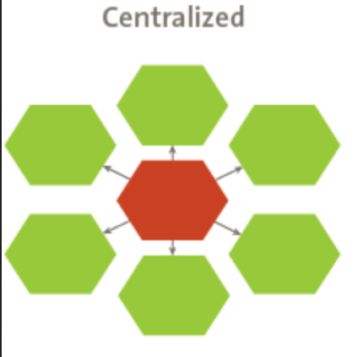
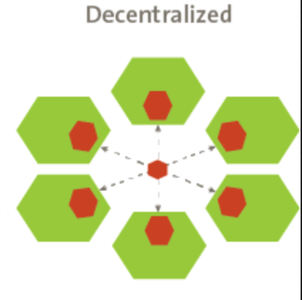
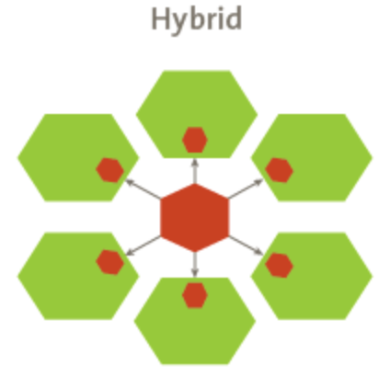
University/ Foundation Organizational Structures
Three general models
Consistency
Unified donor mgt
Efficient
Same goal: To facilitate effective collaboration between the foundation and the various departments and units, in order to maximize the university's fundraising potential and impact.
Independence
Distributed donor mgt
Tailored
Hub and spoke
Coordination
Balanced
Notes:
So let’s start with some really broad strokes. I don’t think we often step back and take a 30,000 foot view of the environment in which we interact on a daily basis, but it can be helpful to to do so. Understanding how an organization is structured – and why – will help you navigate that structure and develop strategies that will work effectively within that structure. There are probably three primary, general organizational structures for the relationship between a university and a university’s advancement office:
In a centralized model, the fundraising foundation serves as the central entity responsible for all fundraising activities on behalf of the university. The foundation in this model will maintain a centralized staff and all fundraising efforts are coordinated and managed by the foundation. The foundation will of course work closely with each university department and unit, providing guidance and support in fundraising activities. This model allows for consistency in fundraising strategies, centralized donor management, and efficient allocation of resources. It’s probably a more common model with larger universities.
In a decentralized model, each department or unit within the university has its own fundraising team or staff responsible for conducting fundraising activities. These decentralized units work independently, developing their own fundraising strategies and maintaining their own relationships with their respective donors. The fundraising foundation may provide some overarching support, such as training, coordination, and centralized systems, but the primary responsibility for philanthropic efforts lies with the individual department. This model allows for more tailored approaches to fundraising based on the specific needs and priorities of each department. I suspect this might be an approach used at small colleges with more limited resources.
And then there’s a hybrid approach that combines aspects of both centralized and decentralized models. With a hybrid model, the fundraising foundation serves as a central hub, providing coordination, strategic planning, and shared resources. While the foundation maintains a central staff and oversees overall fundraising efforts, each department or unit also has its own fundraising team or staff responsible for engaging with donors and executing department-specific fundraising initiatives. This model allows for a balance between centralized support and autonomy for departments. My guess is that this is a common model at many institutions, but perhaps particularly mid-size universities. There are probably dozens of different flavors for each of these general approaches, each with respective advantages and disadvantages, each uniquely tailored to fit the unique needs and context of a particular university. But the ultimate goal of these models is the same: To facilitate effective collaboration between the fundraising foundation and the various departments and units, in order to maximize the university's fundraising potential and impact. But the liaison relationship between department and foundation is probably going to vary quite a bit depending upon the model employed. Discussion:
Out of curiosity, let’s play show of hands. How many would say their institution employs a centralized model? Decentralized? Hybrid?
Does anyone think there are other primary approaches out there? My experiences are largely limited to the institutions I’ve served at. There may be more.
What does the overarching structure of responsibilities between foundation and department look like at your institution? Let’s see what kind of flavors are out there.
I would characterize the Colorado School of Mines as a hybrid model.
Okay, so let’s keep these three different models in mind as we hone in on liaison relationships.

Slide 8
Typical Liaison Relationships for Each Model
Primary, dedicated role for foundation staff: central advancement officer(s)
Part-time role for library representative(s)
Same goal: To establish effective communication channels, collaboration mechanisms, and shared accountability between the fundraising foundation and the departments or units across campus.
Primary, designated role for library representative(s): “library development officer”
Part-time role for foundation staff
Many flavors!
Notes:
I’m sure I’m overgeneralizing here, but broadly and typically speaking, the nature of a liaison relationship is going to differ depending upon the primary organizational structure between a university and its foundation. I encourage all of you to jump on in if you have thoughts and insights on the points I’m about to make, because our collective reality may look quite different from theoretical constructs.
In a centralized model, the foundation has a direct and central role with each department and unit on campus, including the library. A specific foundation advancement officer is the primary point of contact, and they will work closely with the library to understand fundraising needs, goals, and priorities, and they will lead collaborative efforts to develop fundraising strategies, coordinate campaigns, and they will lead the management of donor relationships. They’ll also provide guidance, resources, and support to departments with an eye to ensuring alignment with broader university development objectives. In a centralized model, I think it’s more likely that the department’s role is a part-time liaison vs. a dedicated responsibility. But I’m not fully sure of this – my experience is really limited to the models I’ve experienced at the institutions I’ve worked at over the years.
In a fully decentralized model, the roles are almost reversed. The library may have its own designated individual or team who takes the lead on engagement with their foundation. They will communicate department needs, goals, and fundraising strategies to the foundation, while also receiving guidance, training, and support from the foundation’s central staff. I also don’t have any experience with this model, but I suspect the role on the library end is more likely to be a formal title and dedicated responsibility, while the foundation staff member may be serving in a part-time liaison role, where it’s one assigned function of a foundation staff member who has other primary responsibilities.
And for a hybrid model, it’s more likely that both the foundation and the library both have assigned liaisons, so it’s a combination. The liaison based in the foundation's central office works directly with the library to provide strategic guidance, coordination, and support. They maintain ongoing relationships with their library representative to ensure consistency in fundraising practices and facilitate cross-departmental collaboration. And the library will also have its own internal liaison or fundraising staff responsible for day-to-day activities, donor cultivation, and executing unit-specific fundraising plans. The library liaison works closely with both the central foundation liaisons and their internal colleagues to ensure alignment and maximize fundraising outcomes. And no doubt there are multiple flavors of liaisons in this model for both the foundation and the library – some where the liaison role is their primary job function, some where it’s one of their responsibilities, but perhaps not their primary one.
So again - the general organizational structure between the foundation and the library and the specific nature of the liaison role within that structure can vary quite a bit, and that’s all going to depend upon on the university's size, culture, and resources. The primary goal remains the same, though: To establish effective communication channels, collaboration mechanisms, and shared accountability between the fundraising foundation and the departments or units across campus.
Discussion: Before I move on, any reflections on this, thinking about your own institution and how you’re organized? What is the combination of dedicated officer or representative vs. part-time liaison roles between the advancement office and your library? Is it one individual or a team on each side?

Slide 9
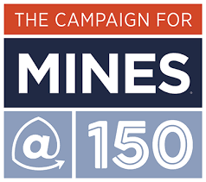
The liaison model at Mines
Mines Foundation:
“The foundation uses a liaison model with campus to navigate and coordinate the fundraising efforts of Mines. This model designates Foundation employees as the liaison to academic department or programs. Working closely with academic partners, who are experts in their fields and their departmental needs, the Foundation drives fundraising and engagement efforts that support their needs.”
Mines Foundation
Library
Part-time liaison
Part-time liaison
Notes:
So, the Mines Foundation employs a hybrid organizational structure in its relationship with the Colorado School of Mines, and the liaison model it employs is one in which – at least for the most part – the liaison role on both the foundation side and the department or unit side is not a primary job title or function – it’s an assigned additional role for an individual whose primary job title and function lies elsewhere. We each wear many hats, and our liaison role is an important one, but also one of many.
This is how Mines defines our liaison model (read). In our particular case, while it is an important responsibility, supporting the library is not the only or even primary role for our foundation liaison. Her primary responsibility lies more generally in cultivating large gifts for the university as a whole. And Sarah and I, as her counterparts on the library side, also have other primary responsibilities. My primary role is the library director, and Sarah wears several hats (too many!), including administrative, communications, and department-level fundraising responsibilities.
We’re all very busy and don’t often have time to take a step back and think in these broad terms. But I think it’s helpful to be able to be able to assess and categorize your foundation and university’s particular organizational model and liaison arrangements, because that’s going to impact how you work successfully within that environment, and how much time and resources you have and will need to bring to that relationship. And we’ll get to that when Sarah discusses strategies that we’ve found to be successful.
So, keep in mind that we’ll discussing successful strategies we have found work within our particular setup: a hybrid model where both the foundation and the library liaison have other primary job titles and functions. We’re all part-time library fundraisers! And we’d like you, along the way, to be thinking about what’s worked for you in terms of your working relationship between the foundation and the library, and how what’s worked for you may be tied to the organizational model at your particular institution.

Slide 10
Importance of a Successful Liaison Partnership
Alignment of Priorities
Strategic planning
Resource allocation
Donor cultivation
Collaboration and communication
Notes:
III. Importance of a Successful Liaison Partnership (:10) - Carol
But before we get to strategies for successful liaison relationships…why is the liaison relationship so important in the first place? I think we all understand why on a gut level, but we may not always take the time to consider it explicitly. But doing so is a first step to creating a successful partnership. And reviewing it periodically, together with each other, is a great way to improve it steadily over time. What’s working? Where can we improve? In a nutshell, an effective library-foundation liaison relationship is baseline essential for our ultimate goal – to effectively achieve our fundraising goals. And it’s baseline because everything that drives successful fundraising requires effective communication and collaboration between the foundation and the library. Everything is built upon the foundation of that relationship. The liaison relationship sits at the very nexus of that effective communication and collaboration, so it’s mission critical. If you have open, effective, and regular communication lines with your foundation partner, or your library partner, you’re far more likely to be crafting your fundraising structure together with each other. The liaison relationship between a university's fundraising foundation and the library is crucial for several reasons:
Alignment of Priorities: The liaison relationship helps ensure alignment between the fundraising foundation's goals and the specific needs and priorities of the library. It allows the foundation to understand the unique fundraising requirements of the library as a campus partner and as an academic discipline itself. This alignment ensures that fundraising efforts are targeted towards areas that are most important to the library, increasing the likelihood of success.
Strategic Planning: The liaison relationship enables collaborative strategic planning. By working closely with departmental representatives, the fundraising foundation can gather insights into the department's long-term vision, strategic goals, and fundraising aspirations. This information helps the foundation develop comprehensive fundraising strategies that are tailored to the specific needs and aspirations of the library, ensuring that resources and efforts are allocated strategically.
Resource Allocation: The liaison relationship facilitates efficient resource allocation. Libraries require financial support for many things – including strategic initiatives, research and curricular projects, community programming, and space enhancements to name just a few. Through the liaison relationship, the foundation can understand the resource needs of the library and allocate their focus accordingly. This collaboration ensures that resources are directed to areas with the greatest impact, maximizing the return on investment for both the foundation and the library.
Donor Cultivation: The liaison relationship plays a vital role in donor cultivation and stewardship. The foundation liaisons work closely with the library to identify potential donors who have an affinity for their specific areas of expertise or interest. They facilitate introductions, arrange meetings, and provide support in cultivating and stewarding relationships with donors. The foundation liaisons also serve as conduits for sharing donor information, ensuring that the library has the necessary knowledge and context to engage effectively with donors.
Collaboration and Communication: Effective liaison relationships foster collaboration and communication between the fundraising foundation and the library. It ensures good engagement and exchange of information with each other. Regular interactions and information sharing help build trust, enhance understanding, and strengthen the partnership between the foundation and the library. This collaboration can lead to joint fundraising initiatives, sharing of best practices, and even cross-departmental synergies, ultimately benefiting the university as a whole.
Overall, the liaison relationship between the fundraising foundation and the library promotes collaboration, strategic alignment, and efficient resource utilization. It enhances the foundation's ability to support the university's diverse fundraising needs and empowers the library to achieve their particular fundraising goals effectively. To sum it up, a successful liaison relationship is important because it underscores and drives everything that drives successful fundraising. The foundation better understands the work of the library, the library receives updates about foundation work that might not otherwise reach our attention, and we work with each other, together, to cultivate existing and new donors. We can then each go out into the broader campus and community and support each other’s work in building the success of the university.

Slide 11
Strategies for Successful Liaison Partnerships
Communication Strategies
Engagement Strategies
Monthly Check-ins (video or in-person)
Email in addition
Transparency/Honesty/Openness
Events and Activities
Site Visits
Opportunities for feedback
Notes:
SO: What strategies have we employed for our successful liaison partnership? We have communications strategies. These include monthly check-ins either in person or via video. Emails on top of our monthly check ins. All the while being open, honest, and transparent.
Every month, we meet with our liaison. She noted that monthly is perfect for the 30 mins we have together. While you can meet more often if you have an active campaign we have found that email communication often bridges the monthly gap. If you only meet every three months, it allows you to fall off the radar. From either the foundations end or your end forgetting about the foundation. Often balls are dropped and by the time you realize it, a deadline has passed. Keep your check-in's regular!
You want to be transparent, open, and honest. We need to be willing to tell others what we are actually doing so that no one assumes what we're doing. For example, recently we realized that our HR department was listing a former library program as a perk of working at Mines. That program had ceased. If we don't tell others what we are doing, they assume- for better or worse.
In addition, we have engagement strategies. When thinking about engagement strategies there are lots of events that our foundation does on a regular basis. We've tried to learn more about these events and participate. For example, we have an annual giving day call #idigmines. We participate in that and work with the foundation to be leaders among campus. Often our email messages are used as examples to others on campus. The foundation has an event called "Lunch Brunch" where a department or program is featured. The library was the highlight of one of those events reaching donors that we wouldn't have meet otherwise. Over 2 years later, the Foundation still tells us it was one of the best Lunch Brunch's they ever hosted!
I don't know of an academic institution that doesn't have Homecoming! How are you partnering with your Foundation for Homecoming? For several years we've hosted Mines Antique Roadshow. This is where Alumni can come and bring something from their time at Mines and our Special Collections Librarian can explain what that item is if they don't know. One year, we had a student read a letter he wrote to his mother that included the cost of education. The Foundation sends out Alumni emails, we try to get into the Alumni newsletter at least once a year.
Has your major gift officers visited your library? If they haven't, do they really know what you're up to? Our Liaison set up a time for all the foundation professionals to get a tour from us to the entire library. Learning about cool initiatives we've started, new rooms, and programs that were actually happening which they could bring donors to! This is also bi-directional as our liaison also visits major library donors and takes word from us to them in her visits. She has secured several end of life gifts on our behalf.
It also allows the opportunity for feedback.

Slide 12
Building Trust & Relationships
Notes:
SO: Another strategy we employ is building trust and relationships. We also need to build trust with our relationships. A little bit of humor this late in the day.
We've heard the phrase, it's not about what you know, it's about who you know. At least where I work, this is still true. You can cut thru red tape so fast when you know the right people, and when you don't, simple things can take months. Building Trust & Relationship with our Liaison has helped build a campus wide understanding of a library at a STEM institution. It also allows for honest conversations. It is hard to be open and honest without trust. That is why major gift officers go in person to the person who is donating a major gift! One thing our liaison mentioned to me recently is that because of our honesty and openness, we have helped the foundation generate better lists! We've been up front when things don't look right. I was expecting 500 names not 200. What's different? Working together, in partnership!
Finally, we are working toward learning who our "Library Alumni" are. There is a category for Library Alumni and at our institution while no one graduates from the library everyone uses it so we don't have traditional alumni. Speaking with our foundation liaison we were able to work together to start adding our student workers to the Library Alumni category.

Slide 13
Case Study of a Successful Partnership
Colorado School of Mines Foundation
& Arthur Lakes Library
Notes:
SO: Michele, if you are in the audience please stand! This is our Liaison! She is amazing. Not only is her smile contagious and her laughter infectious, she is knowledgeable and kind. Michele is a true partner with the library. For example, she connects us to the correct people. Remember it's about who you know!

Slide 14
Michele Bishop
Senior Associate Director, Major Gifts
Colorado School of Mines Foundation
Notes:
Michele is a Senior Associate Director at the Colorado School of Mines Foundation. She has responsibilities for Major Gifts at Mines and she also serves as a liaison to the Library & Museum department. This is Michele’s first opportunity to attend ALADN. And we kept this presentation as much of a surprise from her as possible until now!

Slide 15
Case Study of a Successful Partnership
Relationships
Library One-Pager to all major givers
Remote visits to library donors
Legacy gifts
Single voice for foundation
Monthly Reports
Challenges
Hybrid
On the road
Relationships
Challenges
Results
Notes:
SO: When we wanted to create a new 1-page document highlighting opportunities to give, she connected us to the marketing person within the foundation. I was then able to provide all the content and she edited. This is now in the foundation library where major gift officers put them in every packet that goes out the door. Michele visits library donors across the country on our behalf! Another example, for months, Michele worked on a Legacy Gift from a donor for the Library.
In addition, she accepts all of the Foundations questions for the library and answers them if she can and if not, brings them to us so we don't have a constant stream of questions when we are already planning monthly check ins. And if several people have the exact same question, Michele can field those for us.
Finally, "we" provide monthly reports to the foundation via Michele. Michele then passes along these monthly reports to the entire foundation team. It keeps the library top of mind for foundation fundraisers and it let's people know what the library has been up to. Often people assume that we don't do a lot, but because they are seeing what we're doing, they realize what a great investment they are making when they donate to the library.
Of course, there are challenges as well. In our current environment, many of us have remote or hybrid work schedules. This means finding times where everyone meets in person can be challenging! When Michele is on the road, it can be hard to meet. One day, Michele appears on zoom sitting in her car. Where are you? We asked. Oh, I am having lunch with a donor right now, they are in the restaurant and I stepped out to talk with you. That's dedication!

Slide 16
Results of Successful Partnerships
Notes:
SO: What are the results of this partnership? Our #idigmines campaign has steadily grown over the years. With 2022 being our largest fundraising year with the crowd sourcing campaign.
We’ve learned about 25+ student workers who worked at the library before I started. How? We asked for emails of anyone who is coded as “library alumni” and I sent out an email asking if anyone was a former library student worker. We discovered someone who worked at the library in the 1960’s before the building was renovated in the late 70’s. Why is this important? Because each year we feature a previous student worker in our annual newsletter. With the goal of driving pride in the library as well as desire to donate.
We’ve also learned three major reasons people donate to Arthur Lakes Library. 1) They have some connection to libraries. Someone close to them worked/works at a library. They donated time to a library post Mines. Or they had an experience pre-Mines with a library that gave them all the cozy feels. 2) They spent a lot of time during their studies at Mines in the library. The library was able to aid their research or they studied there or meet their significant other there. The library was their place as a student. 3) They worked at the library as a student worker during their time at Mines. Those are the three reasons that people give to us as a library. We wouldn’t have known that if I wasn’t able to get lists from the foundation to send out emails to our “Library Alumni” and find out. Now, we can develop that and create a pipeline for adding new library student workers to our Library Alumni foundation lists.

Slide 17
Sharing Strategies for Successful Partnerships
Let's learn from each other: break up into groups of 3-5 and discuss what has worked for your institution
We will have large group sharing after 10 mins
Notes:
SO/CS (:10)
Use Wordl tool to capture feedback.
https://www.polleverywhere.com/free_text_polls/argwjjXiGNc0qAvwHcO0W
Importance of continued partnership- sustained relationships

Slide 18
Thank you! Questions?
cesmith@ku.edu
ormeo@mines.edu
Notes:
CS/SO (:05): Thank you so much for coming to the last workshop of the conference! If you have any additional questions you can reach out via email to either one of us or ask now! Safe travels home and I hope you all got at least one idea to take home.

