Slide 1
Voices: Making the Case for Archival Collections
ALADN 2023 Conference
June 19, 2023
Cynthia Childrey
Dean and University Librarian
Cline Library

Slide 2
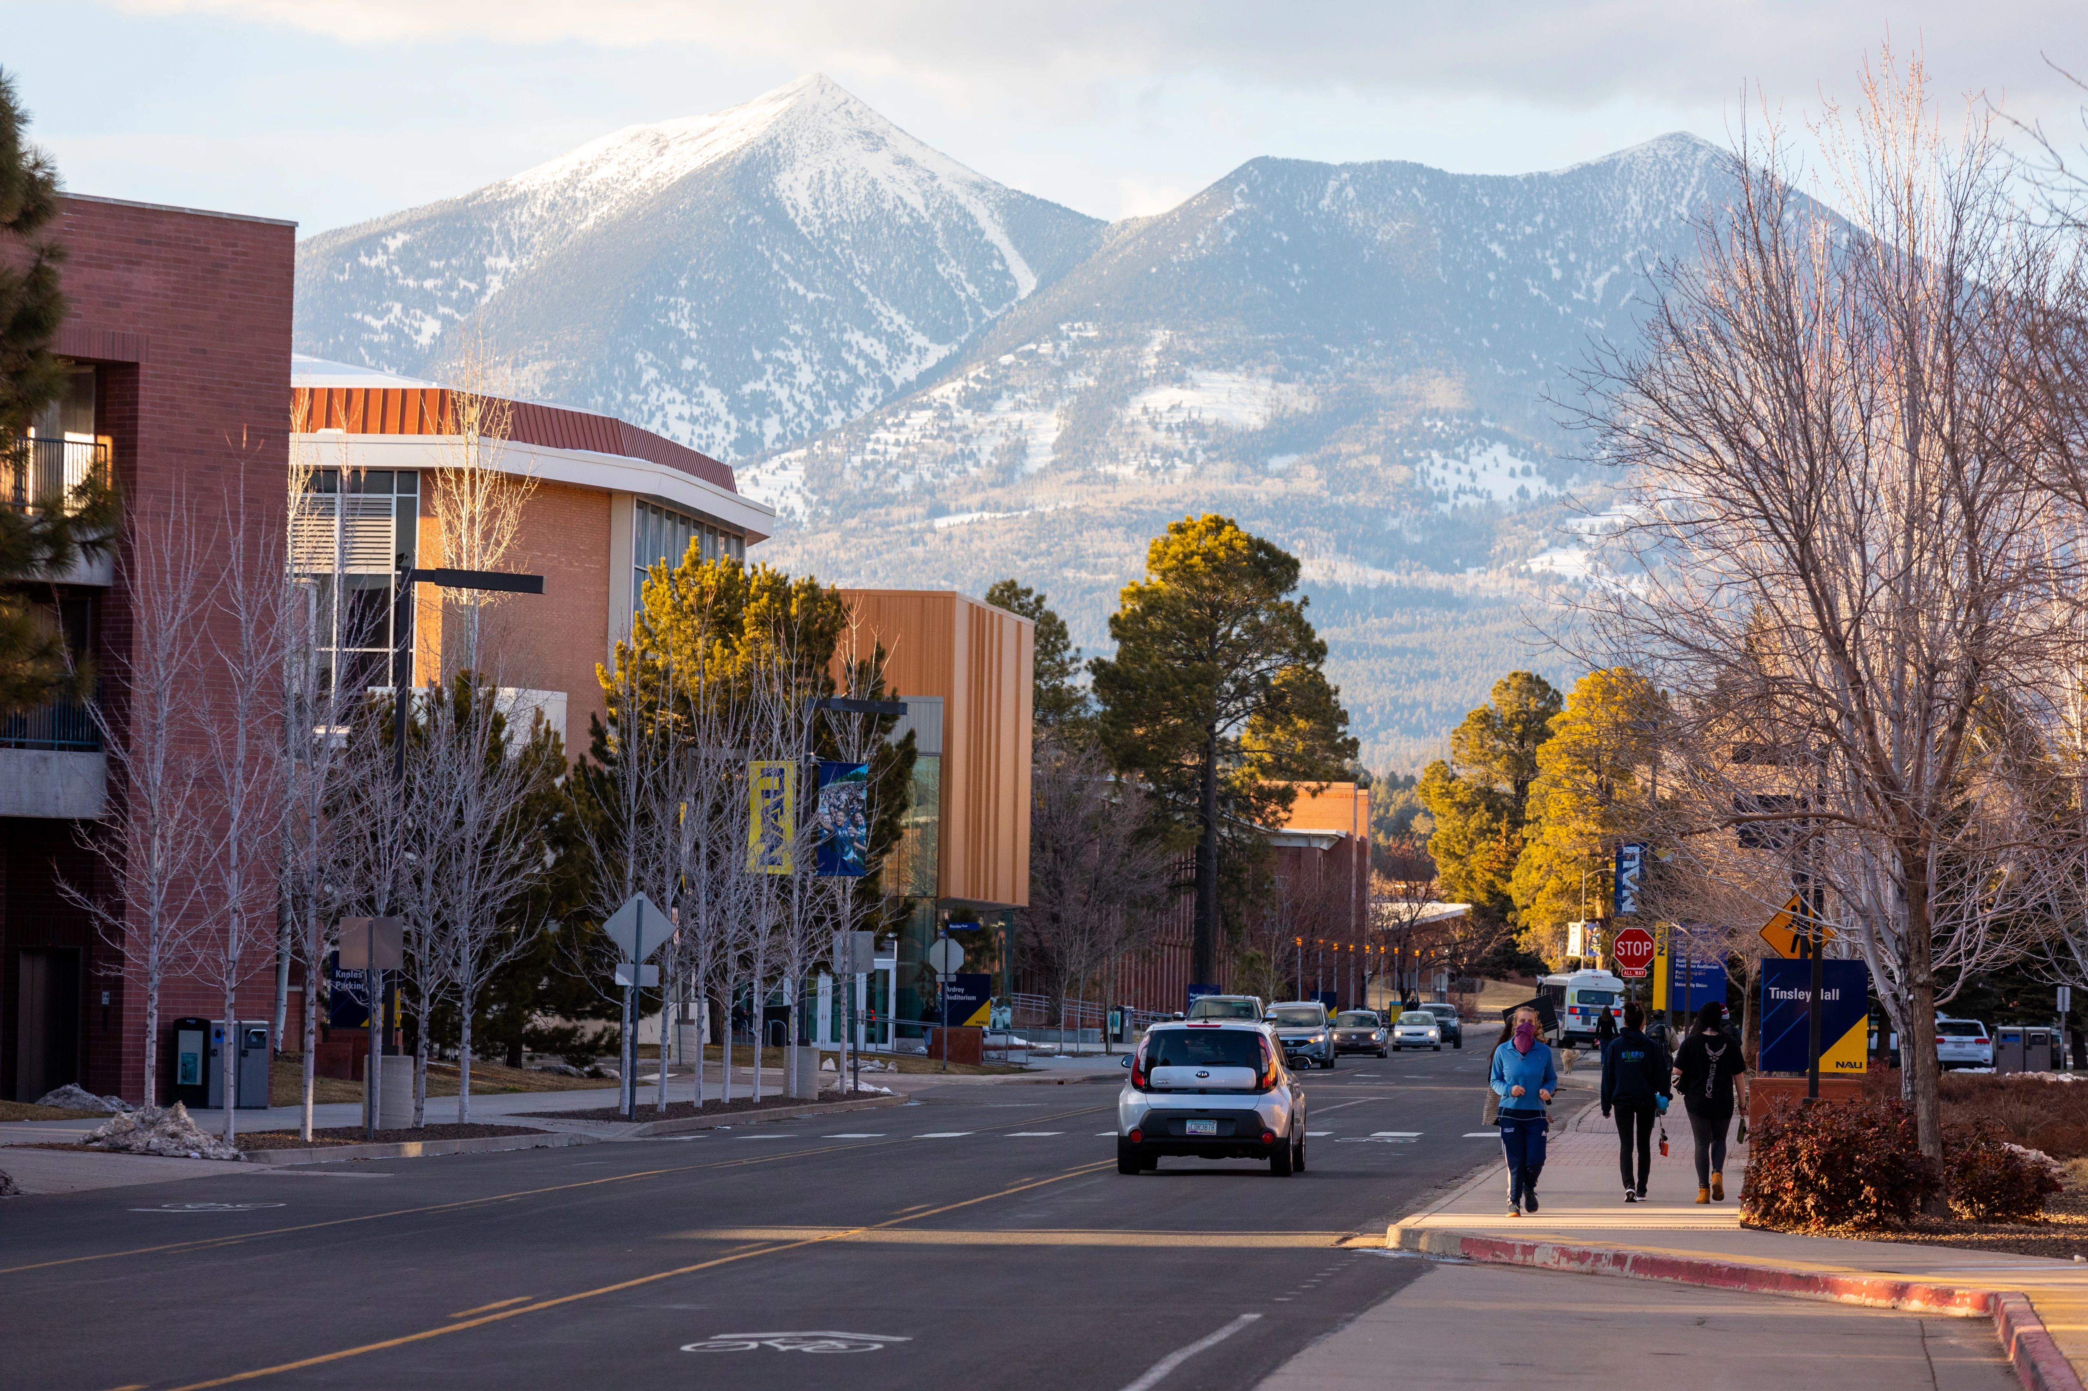
Northern Arizona University
Flagstaff, AZ
PHOTO

Slide 3
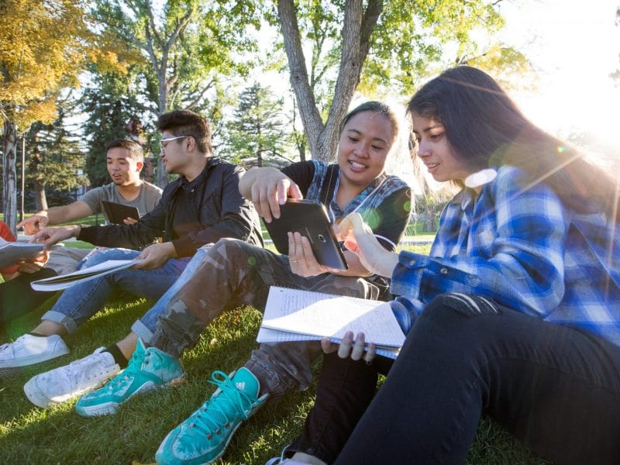
Northern Arizona University
Who are we?
Founded in 1899. Flagstaff, AZ
20+ locations around the state.
Public, doctoral university. High Research.
20,000+ Students
46%
First Generation College Students
Add a descriptive caption here.

Slide 4
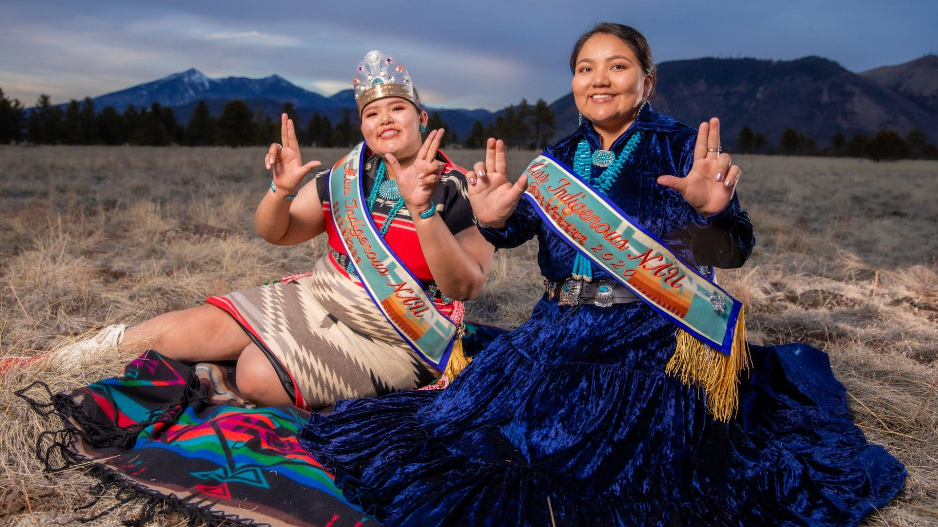
Northern Arizona University
Who are we?
Northern Arizona University sits at the base of the San Francisco Peaks, on homelands sacred to Native Americans throughout the region. We honor their past, present, and future generations, who have lived here for millennia and will forever call this place home. – NAU Land Acknowledgement
Add a descriptive caption here.

Slide 5
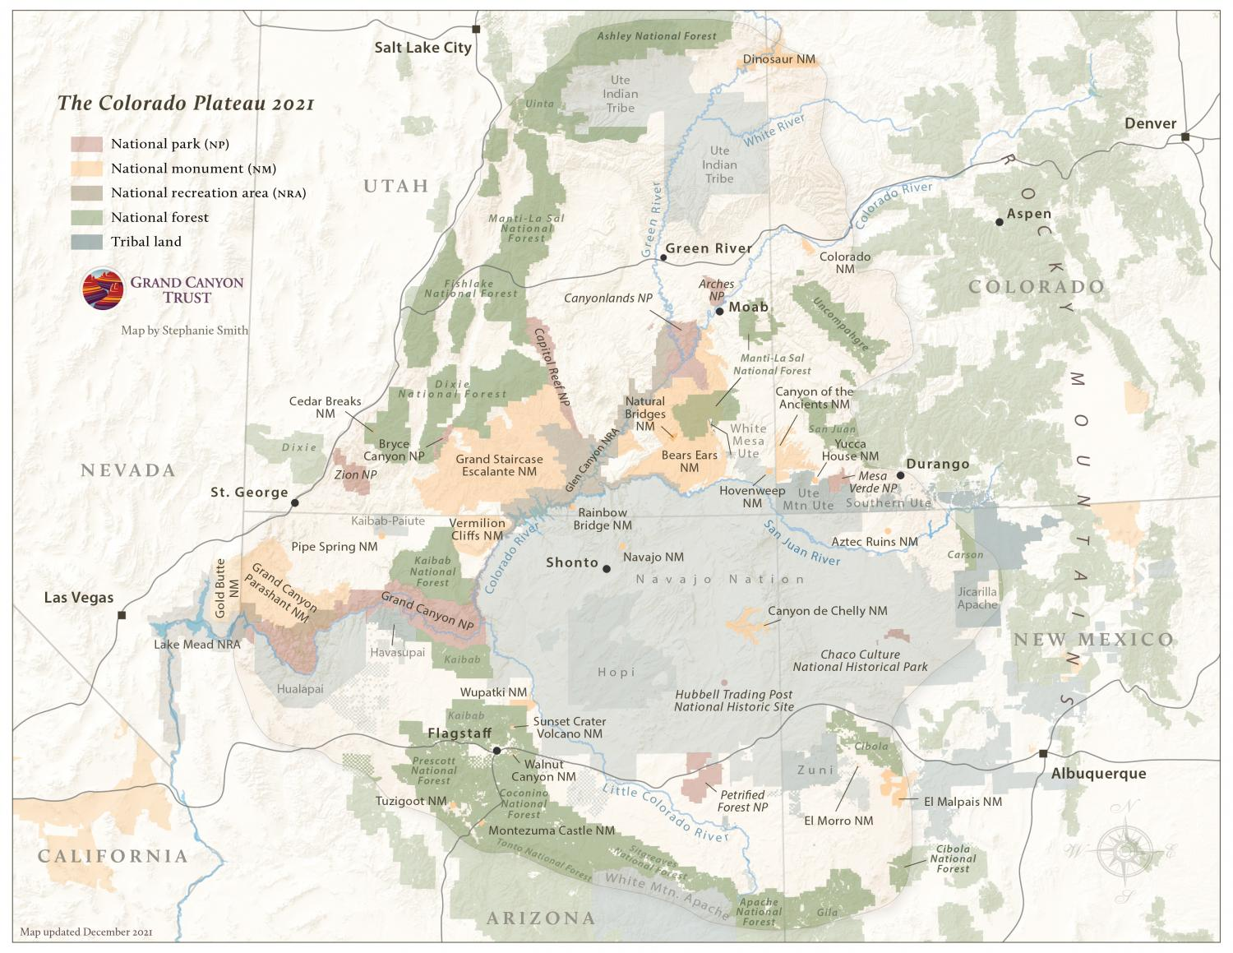
Colorado Plateau
Special Collections and Archives
600 collections
Most notable are photographic and oral histories
  Kolb Brothers, Grand Canyon
  Josef Muench
  Fred Harvey Co. Records
  Katie Lee
  Los Recuerdos del Barrio en Flagstaff Collection
  Route 66 Collections
  John Running
  Sue Bennett
  David Muench
PHOTO

Slide 6
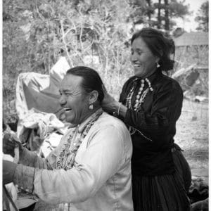
Colorado Plateau
Special Collections
and Archives
Current Initiatives
Indigenous Peoples Coursework Initiative – OER/indigenous learning materials repository and Archivist for Indigenous Initiatives and Cultures – Funded by Andrew Mellon and NAU Foundations in NAU’s Seven Generations Signature Initiative
Shades of Rt. 66: Celebrating Diversity Along Historic Rt. 66 in AZ – Funded by Historic Rt. 66 Assoc. of AZ
Digitizing Moving Images of the Colorado Plateau and the American Southwest – Funded by NEH with Hopi Tribe, Diné College, Hualapai Tribe
PHOTO

Slide 7
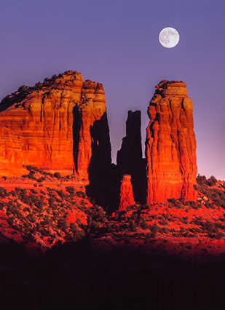
David Muench Photograph Collection
“We anticipate a community forming around it,” Runge said. “It has the potential to attract photographers, artists and others to Special Collections and Archives to explore the collection. There is a lot that people have not seen.” – P. Runge, Head, SCA

Slide 8
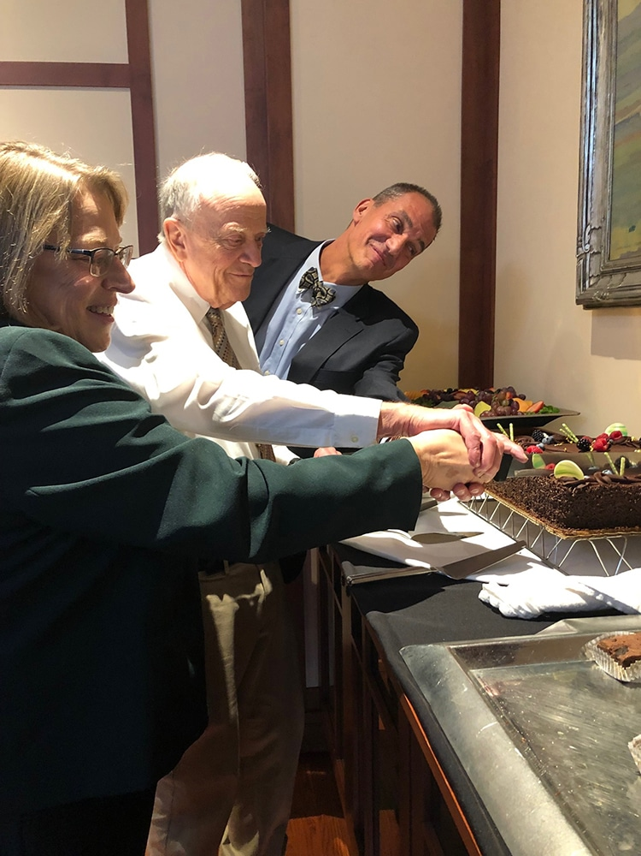
Cutting the cake
Hank Hassell, Librarian and Curator of Images of a Lost World: Glen Canyon on the Colorado with Peter Runge, Head, Special Collections and Archives and Cynthia Childrey, Dean and University Librarian celebrating the opening of the exhibit.
Hank Hassell was featured in Humans of Flagstaff
https://news.nau.edu/humans-of-flagstaff-hank-hassell/

Slide 9
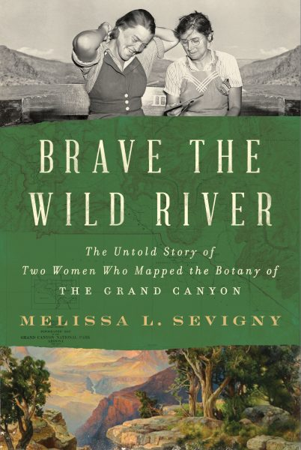
Melissa Sevigny in SCA July 13
Science journalist Melissa Sevigny will discuss her new book, Brave the Wild River: The Untold Story of Two Women Who Mapped the Botany of the Grand Canyon, at a July 13 program hosted by Cline Library Special Collections and Archives – home of the archival materials that inspired it.
A chance encounter with a pith helmet in the archives led Sevigny to write the book, which chronicles the 1938 journey down the Colorado River of pioneering botanists Elzada Clover and Lois Jotter. The women conducted the first formal survey of the plant life of the Grand Canyon on their 43-day trip. -- L. Taylor

Slide 10
Library Development for Special Collections – Team Relationships
Dream Team
Central Advancement
The Head, Special Collections and Archives brings expertise in collections and donor relations.
Solid relationships with your central advancement office makes all the difference.
Library Dean
Development Director
Head, Special Collections and Archives
Responsibility and expertise with communications, marketing, social media, events, and grants
VP of Advancement
Chief Financial Officer
Planned Giving
Prospect Research
Corporate and Foundation Relations
Giving Day and Annual Giving
Capital Campaign

Slide 11
The Development Team: Resources
The Library Dean
The Development Director
Head, Special Collections and Archives
--Carla M. Summers, “Archival Donor Relations and Development: Keeping a Balance,” Provenance, Journal of the Society of Georgia Archivists, 2002
--Victoria Steele, “The Role of Special Collections in Library Development,” in Burlingame, Dwight; Library Fundraising: Models for Success, 1995.
--Kimberly A. Thompson and Karlene Noel Jennings, “Your Special Collections,” in More Than a Thank You Note: Academic Library Fundraising for the Dean or Director, 2009.
--J.F. Paustenbaugh, “Fundraising for Special Collections,” The Bottom Line, 2002
-- Kathryn Dilworth and Laura Sloop Henzl, “Cases: Archives and Special Collections,” in Successful Fundraising for the Academic Library, 2017
PHOTO

Slide 12
Library Development for Special Collections – Donor/Partner Relationships
Donor-Investor
“An investor, or a donor-investor, is an individual or organization whose financial commitment to a nonprofit is guided by a belief in their shared values and in the ability of the investor and the organization to mutually benefit each other and the community.”
--Kay Sprinkel Grace, 2005
Partnerships
Partnerships with community and cultural organizations create opportunities and support
Mutual Aid Agreement for Emergencies
Museums and historical societies
Other college and university archives
Native American/Indigenous Nations, communities, and tribal councils
Community organizations
Faculty, student organizations, researchers

Slide 13
The Donor-Investor
“An investor, or a donor-investor, is an individual or organization whose financial commitment to a nonprofit is guided by a belief in their shared values and in the ability of the investor and the organization to mutually benefit each other and the community.”
“Investment should be approached as if it will be long term and renewable. Quick-fix fundraising does not stimulate investment. Investors in nonprofits look for two bottom lines (financial and values) but one principal return: the knowledge that their investment will have the intended results and make an impact on the organization and the community.”
“The investment concept is based on an understanding of the difference between development and fundraising. Development is a sustained and systematic multistep process; fundraising is a focused and immediate transaction. A successful development process facilitates effective fundraising.”
--Beyond Fundraising: New Strategies for Nonprofit Innovation and Investment by Kay Sprinkel Grace, 2005

Slide 14
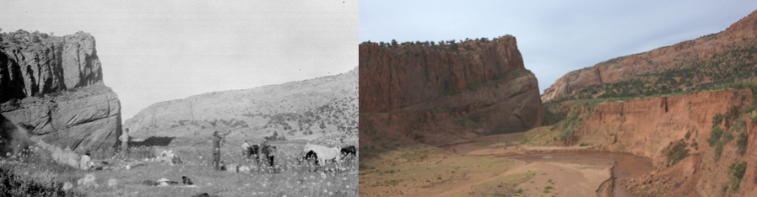
Donor Thomas C. Hanks – The James J. Hanks Photographs and the Dorothy T. and James J. Hanks Cline Library Endowment
PHOTO
“
“Hanks could not have known, however, that his photographs, when paired with repeat photographs taken at his 1927 and 1928 camera stations would often show significant cultural, ecologic, geologic, and/or hydrologic change, and such changes on the timescale of a human lifetime are critical concerns for how we view and use the land on which we live.” –Thomas Hanks

Slide 15
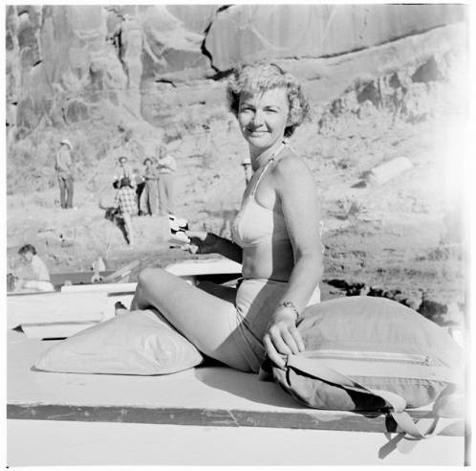
Donor Katie Lee – The Katie Lee Collection and the Katie Lee Endowment
In the early 1950s, Katie visited Glen Canyon for the first time. It was love at first sight.
The damning of Glen Canyon broke Katie’s heart but fueled her environmental activism.
Katie donated her extraordinary collection of photographs, writings, songs & music, letters, and journals to Cline Library Special Collections and Archives. She then established an endowment through a planned gift to support preservation and access for her collection and others.
--From: Katie Lee – Goddess of Glen Canyon, 1919-2017, Special Collections and Archives Blog
PHOTO

Slide 16
Cline Library
Development Program Timeline
An investment in development in partnership with the Head of Special Collections and Archives, talented archivists and staff continues to exponentially grow collections, build financial support, and attract opportunities and capacity.
2002-2005
2005-2020
2020 -- Present
Interim Dean to Dean
No Development Director
Discovered ALADN
SCA has an annual fund and 3 endowments
Library has 150 donors
Dean
Devel Dir: K. Schmand
Head, SCA: P. Runge
Central Advancement
SCA has an annual fund, 7 endowments, NEH and Private Found. Grants.
Library has 700+ donors
Dean
.5 Devel Dir: Serenbetz
Head, SCA: P. Runge
Central Advancement
SCA has an annual fund, 8 endowments, grants, 2 Planned Gifts, a major gift proposal

Slide 17
Library Development for Special Collections – Challenges & Opportunities
Challenges
Opportunities
Collections – Focus and saying no
Funding Preservation, Access, and Digitization at Scale
Planned gifts and endowments
Alignment of fundraising and needs
Staffing capacity
Special Collections as gateway to library development? Yes and no
Amazing Collections
Scholarships and internships – student experience and career pipeline
Building relationships/community
Planned gifts and endowments
Donor-Investors can lead to major gifts
University Archives

Slide 18
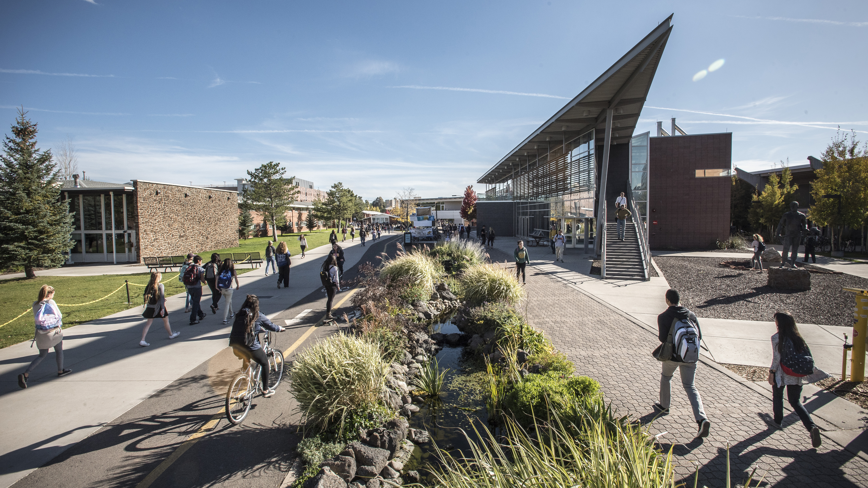
With many thanks to ALADN colleagues past, present, and future -- especially Samuel Huang, Karlene Jennings, and Joanie Barnes and my forever gratitude to Kathleen Schmand, who was up to the challenge of building a development program from the ground up!
Cynthia Childrey, Dean and University Librarian, Cline Library, Cynthia.Childrey@nau.edu

Slide 19
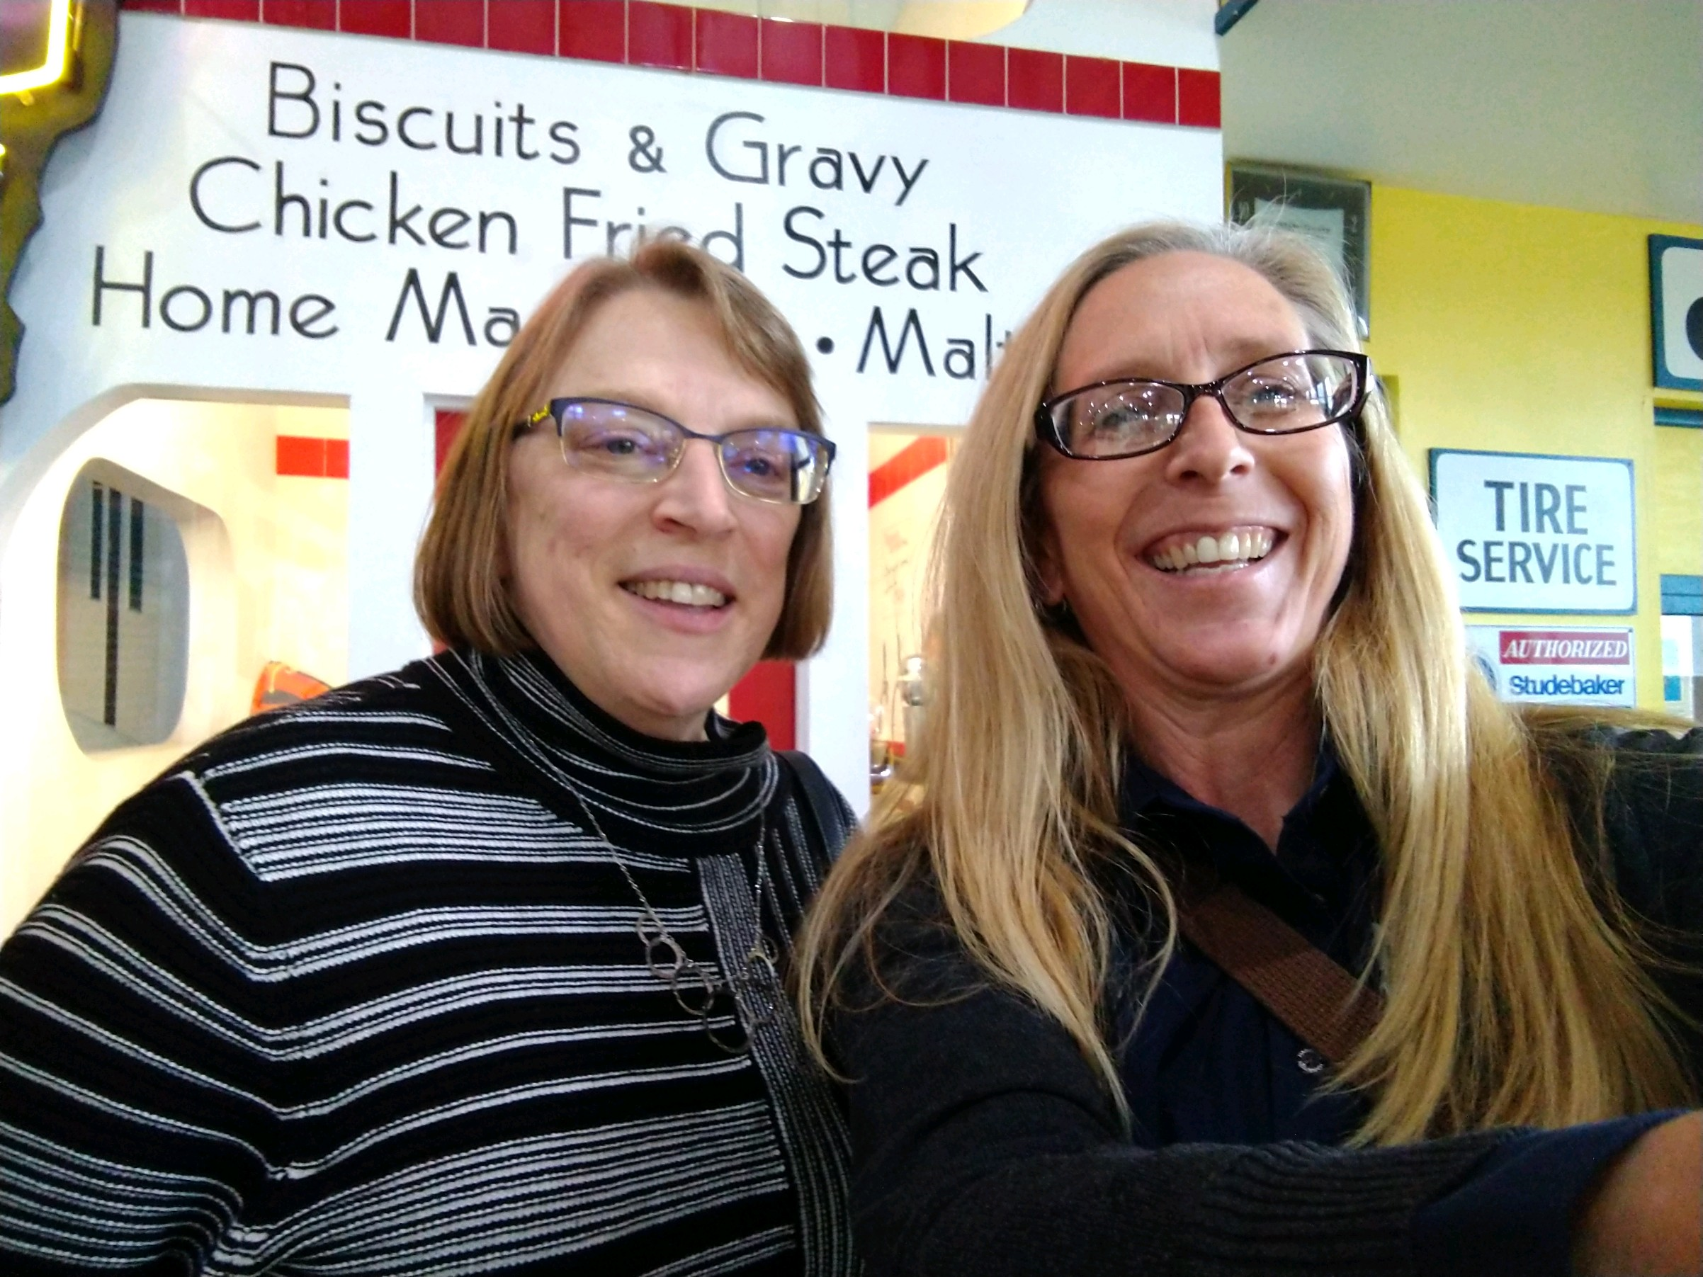
ALADN Outtake:
Who said there was no fun in fundraising?
Director of Communications and Development Kathleen Schmand and Dean and University Librarian Cynthia Childrey stop for a selfie while attending an Exhibit Opening at the Arizona Route 66 Museum in Kingman, AZ.
--Did we really take a picture in front of a sign that says Biscuits & Gravy????

